Slide 1
Proverbs 6:16-19
These six things the LORD hates, Yes, seven are an abomination to Him: ¹⁷ A proud look, A lying tongue, Hands that shed innocent blood, ¹⁸ A heart that devises wicked plans, Feet that are swift in running to evil, ¹⁹ A false witness who speaks lies, And one who sows discord among brethren.
Notes:
This is a model of speaking customary to the time.
Proverbs 30:18, 21, 29; Job 5:19; Ecclesiastes 11:2; Amos 1:3, 6, 9, 11, 13; 2:1, 4, 6
Hate and abomination are used interchangeably.
Hate – śânê' – to hate, be hateful.
Abomination – tô‛êbah tô‛êbah – something disgusting; an abhorrence.
These are things the Lord does not stand for. They are unacceptable to God.

Slide 2
The
Abominable
Notes:
This is a model of speaking customary to the time.
Proverbs 30:18, 21, 29; Job 5:19; Ecclesiastes 11:2; Amos 1:3, 6, 9, 11, 13; 2:1, 4, 6
Hate and abomination are used interchangeably.
Hate – śânê' – to hate, be hateful.
Abomination – tô‛êbah tô‛êbah – something disgusting; an abhorrence.
These are things the Lord does not stand for. They are unacceptable to God.
The Seven Abominations.
The seven things that are described as characteristics of “a worthless person, a wicked man” (v. 12-15)

Slide 3
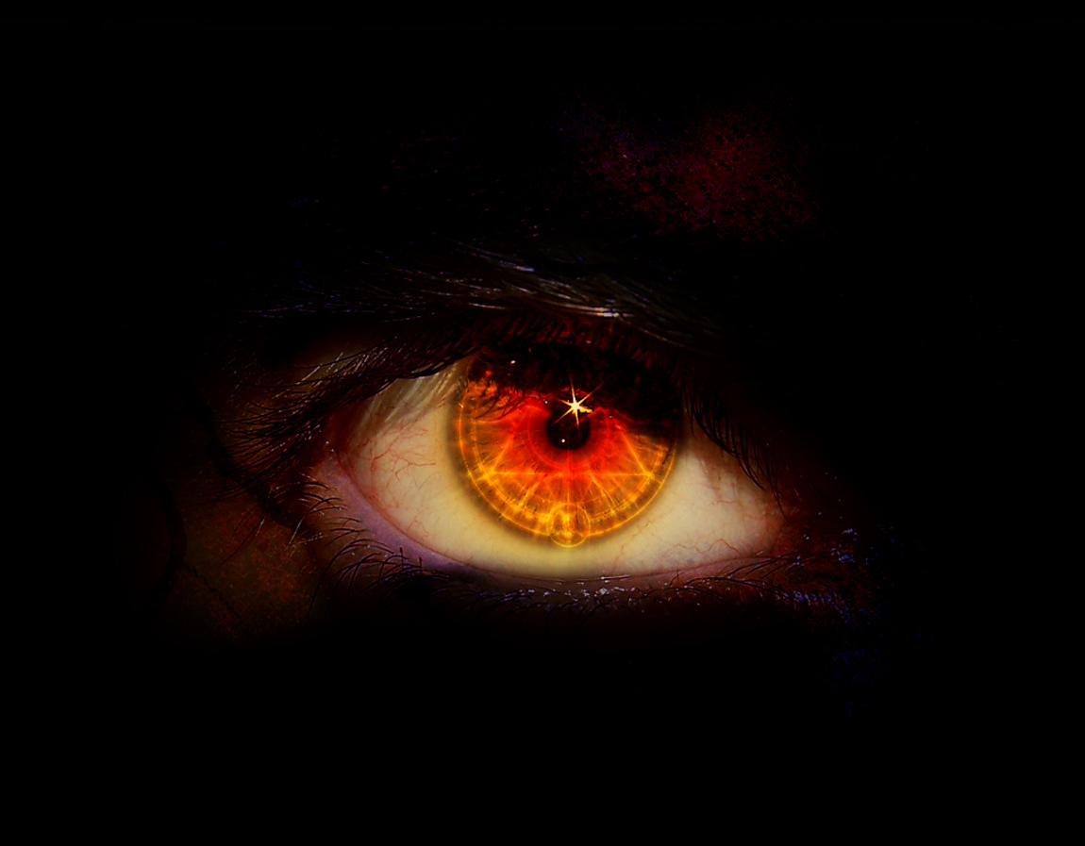
A Proud Look
Proverbs 16:18
Matthew 6:5
Luke 18:10-12
Notes:
A proud look.
Proverbs 16:18; Matthew 6:5; Luke 18:10-12

Slide 4
Proverbs 16:18
Pride goes before destruction, And a haughty spirit before a fall.
Notes:
A proud look.
Proverbs 16:18; Matthew 6:5; Luke 18:10-12

Slide 5
Matthew 6:5
And when you pray, you shall not be like the hypocrites. For they love to pray standing in the synagogues and on the corners of the streets, that they may be seen by men. Assuredly, I say to you, they have their reward.
Notes:
A proud look.
Proverbs 16:18; Matthew 6:5; Luke 18:10-12

Slide 6
Luke 18:10-12
Two men went up to the temple to pray, one a Pharisee and the other a tax collector. ¹¹ The Pharisee stood and prayed thus with himself, 'God, I thank You that I am not like other men--extortioners, unjust, adulterers, or even as this tax collector. ¹² I fast twice a week; I give tithes of all that I possess.'
Notes:
A proud look.
Proverbs 16:18; Matthew 6:5; Luke 18:10-12

Slide 7
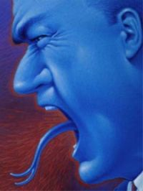
A Lying Tongue
Proverbs 12:22
John 8:44
Revelation 21:8
Notes:
A lying tongue.
Proverbs 12:22; John 8:44; Revelation 21:8

Slide 8
Proverbs 12:22
Lying lips are an abomination to the LORD, But those who deal truthfully are His delight.
Notes:
A lying tongue.
Proverbs 12:22; John 8:44; Revelation 21:8

Slide 9
John 8:44
You are of your father the devil, and the desires of your father you want to do. He was a murderer from the beginning, and does not stand in the truth, because there is no truth in him. When he speaks a lie, he speaks from his own resources, for he is a liar and the father of it.
Notes:
A lying tongue.
Proverbs 12:22; John 8:44; Revelation 21:8

Slide 10
Revelation 21:8
But the cowardly, unbelieving, abominable, murderers, sexually immoral, sorcerers, idolaters, and all liars shall have their part in the lake which burns with fire and brimstone, which is the second death.
Notes:
A lying tongue.
Proverbs 12:22; John 8:44; Revelation 21:8

Slide 11
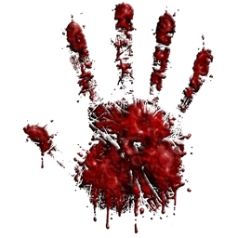
Hands That Shed Innocent Blood
Genesis 9:6
Galatians 5:19-21
Notes:
Hands that shed innocent blood.
Genesis 9:6; Galatians 5:19-21

Slide 12
Genesis 9:6
Whoever sheds man's blood, By man his blood shall be shed; For in the image of God He made man.
Notes:
Hands that shed innocent blood.
Genesis 9:6; Galatians 5:19-21

Slide 13
Galatians 5:19-21
Now the works of the flesh are evident, which are: adultery, fornication, uncleanness, lewdness, ²⁰ idolatry, sorcery, hatred, contentions, jealousies, outbursts of wrath, selfish ambitions, dissensions, heresies, ²¹ envy, murders, drunkenness, revelries, and the like; of which I tell you beforehand, just as I also told you in time past, that those who practice such things will not inherit the kingdom of God.
Notes:
Hands that shed innocent blood.
Genesis 9:6; Galatians 5:19-21

Slide 14
A Heart That Devises Wicked Plans
Matthew 15:19

Slide 15
Matthew 15:19
For out of the heart proceed evil thoughts, murders, adulteries, fornications, thefts, false witness, blasphemies.

Slide 16
Feet That Are Swift In Running To Evil
Jude 5-7

Slide 17
Jude 5-7
But I want to remind you, though you once knew this, that the Lord, having saved the people out of the land of Egypt, afterward destroyed those who did not believe. ⁶ And the angels who did not keep their proper domain, but left their own abode, He has reserved in everlasting chains under darkness for the judgment of the great day; ⁷ as Sodom and Gomorrah, and the cities around them in a similar manner to these, having given themselves over to sexual immorality and gone after strange flesh, are set forth as an example, suffering the vengeance of eternal fire.

Slide 18
A False Witness Who Speaks Lies
Proverbs 17:15; 21:28
Matthew 26:59
Notes:
A false witness who speaks lies.
Proverbs 17:15; 21:28; Matthew 26:59

Slide 19
Proverbs 17:15
He who justifies the wicked, and he who condemns the just, Both of them alike are an abomination to the LORD.
Notes:
A false witness who speaks lies.
Proverbs 17:15; 21:28; Matthew 26:59

Slide 20
Proverbs 21:28
A false witness shall perish, But the man who hears him will speak endlessly.
Notes:
A false witness who speaks lies.
Proverbs 17:15; 21:28; Matthew 26:59

Slide 21
Matthew 26:59
Now the chief priests, the elders, and all the council sought false testimony against Jesus to put Him to death.
Notes:
A false witness who speaks lies.
Proverbs 17:15; 21:28; Matthew 26:59

Slide 22
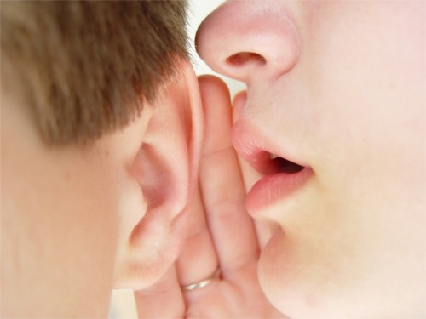
One Who Sows Discord Among Brethren
Titus 3:1-2
James 4:11
Notes:
One who sows discord among brethren.
Titus 3:1-2; James 4:11

Slide 23
Titus 3:1-2
Remind them to be subject to rulers and authorities, to obey, to be ready for every good work, ² to speak evil of no one, to be peaceable, gentle, showing all humility to all men.
Notes:
One who sows discord among brethren.
Titus 3:1-2; James 4:11

Slide 24
James 4:11
Do not speak evil of one another, brethren. He who speaks evil of a brother and judges his brother, speaks evil of the law and judges the law. But if you judge the law, you are not a doer of the law but a judge.
Notes:
One who sows discord among brethren.
Titus 3:1-2; James 4:11

Slide 25
The Seven Things the Lord Loves
A humble look.
Honesty.
Saving a life.
A heart that devises righteous plans.
Feet that are swift in running away from evil.
A credible witness.
One who sows peace among brethren.

