Slide 2
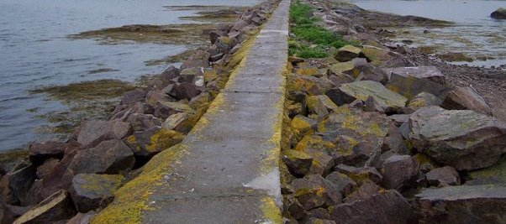
The Narrow Way
Father God, just for today,
Help me walk the narrow way;
Help me stand when I could fall.
Give me the strength to hear Your call.
May my steps be worship
May my thoughts be praise
May my words bring honor to Your name

Slide 3
The Narrow Way
John Oxenham wrote,
"To every man there openeth
A way and ways and a way;
And the high soul treads the high way,
And the low soul gropes the low;
And in between on the misty flats
The rest drift to and fro;
But to every man there openeth
A high way and a low;
And every man decideth
The way his soul shall go."

Slide 4
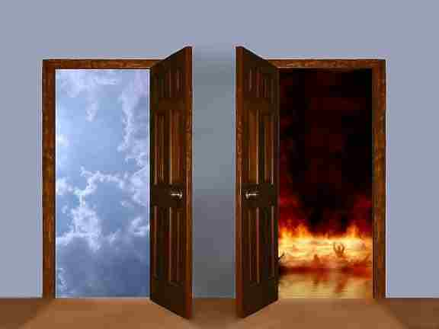
Two Gates
Gates Of Heaven
Gates of Hell
Col 3:5-10
5 Therefore consider the members of your earthly body as dead to immorality, impurity, passion, evil desire, and greed, which amounts to idolatry. 6 For it is because of these things that the wrath of God will come upon the sons of disobedience, 7 and in them you also once walked, when you were living in them. 8 But now you also, put them all aside: anger, wrath, malice, slander, and abusive speech from your mouth. 9 Do not lie to one another, since you laid aside the old self with its evil practices, 10 and have put on the new self who is being renewed to a true knowledge according to the image of the One who created him

Slide 5
Two Gates
Matthew 16:24
Then Jesus said to His disciples, “If anyone wishes to come after Me, he must deny himself, and take up his cross and follow Me
1 Corinthians 6:9-11
Or do you not know that the unrighteous will not inherit the kingdom of God? Do not be deceived; neither fornicators, nor idolaters, nor adulterers, nor effeminate, nor homosexuals, 10 nor thieves, nor the covetous, nor drunkards, nor revilers, nor swindlers, will inherit the kingdom of God. 11 Such were some of you; but you were washed, but you were sanctified, but you were justified in the name of the Lord Jesus Christ and in the Spirit of our God.

Slide 6
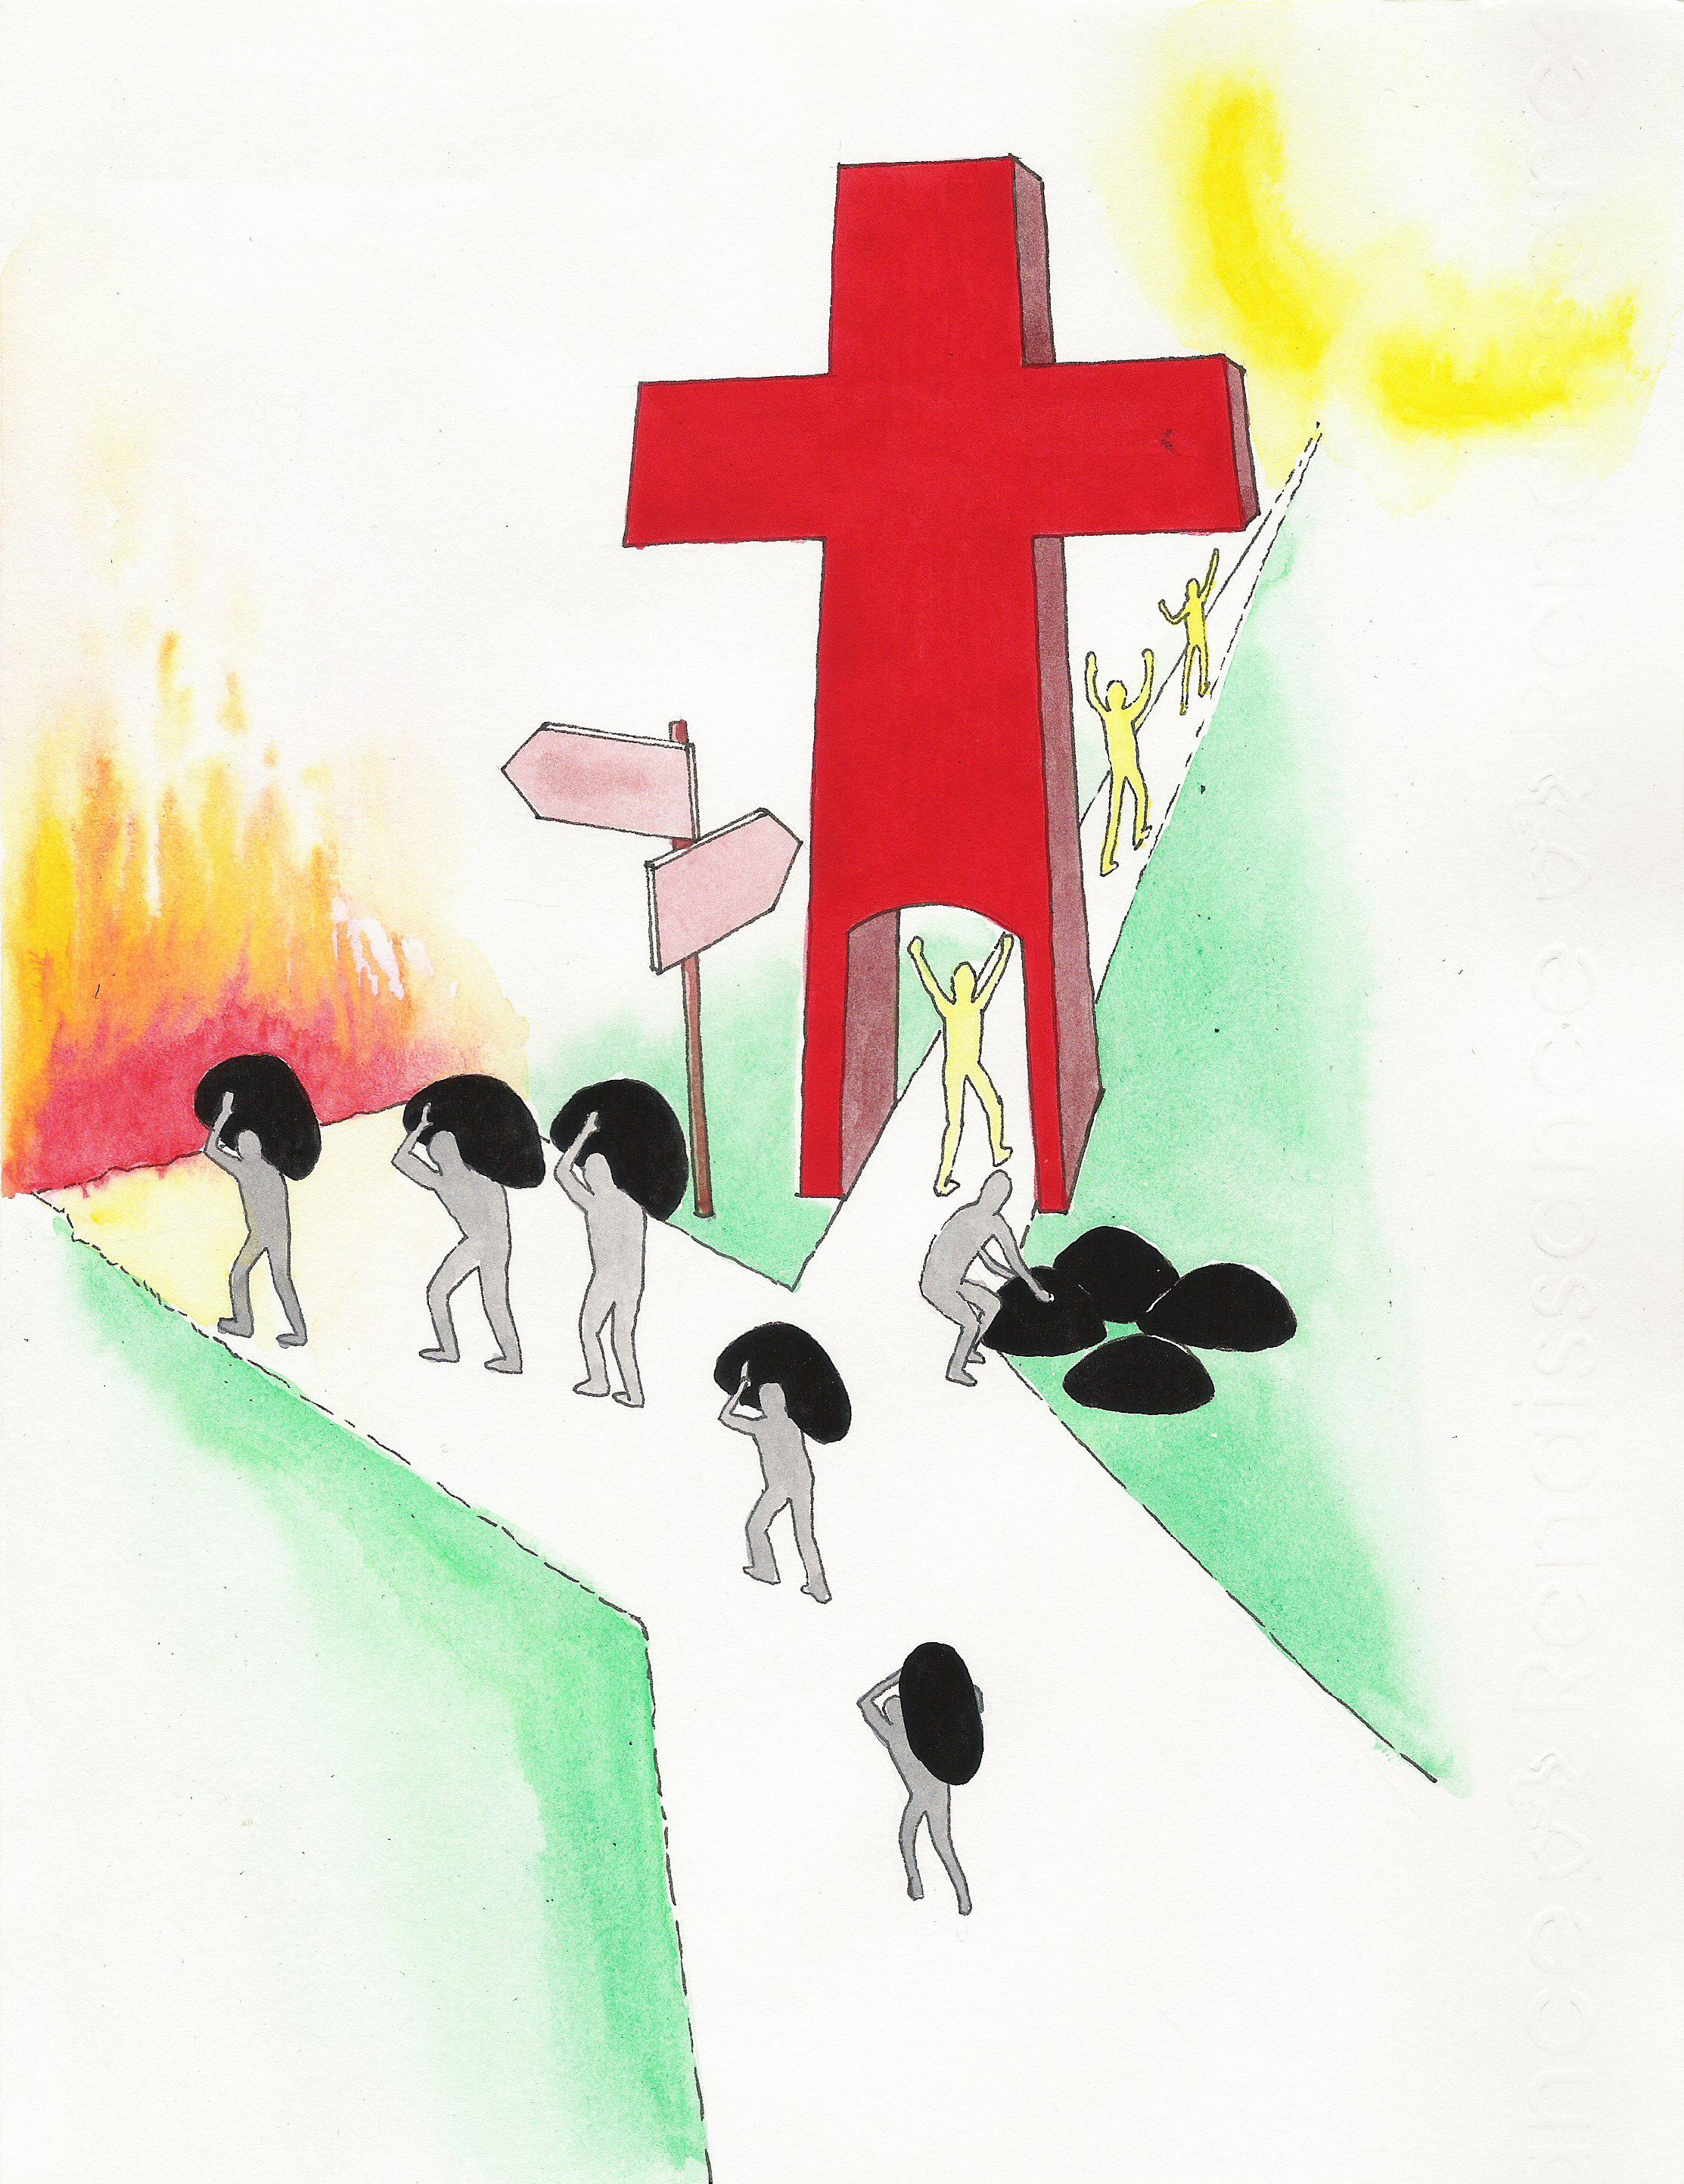
Two Ways
Narrow way
Broad way
Galatians 5:19-25
19 Now the deeds of the flesh are evident, which are: immorality, impurity, sensuality, 20 idolatry, sorcery, enmities, strife, jealousy, outbursts of anger, disputes, dissensions, factions, 21 envying, drunkenness, carousing, and things like these, of which I forewarn you, just as I have forewarned you, that those who practice such things will not inherit the kingdom of God. 22 But the fruit of the Spirit is love, joy, peace, patience, kindness, goodness, faithfulness, 23 gentleness, self-control; against such things there is no law. 24 Now those who belong to Christ Jesus have crucified the flesh with its passions and desires. 25 If we live by the Spirit, let us also walk by the Spirit

Slide 7
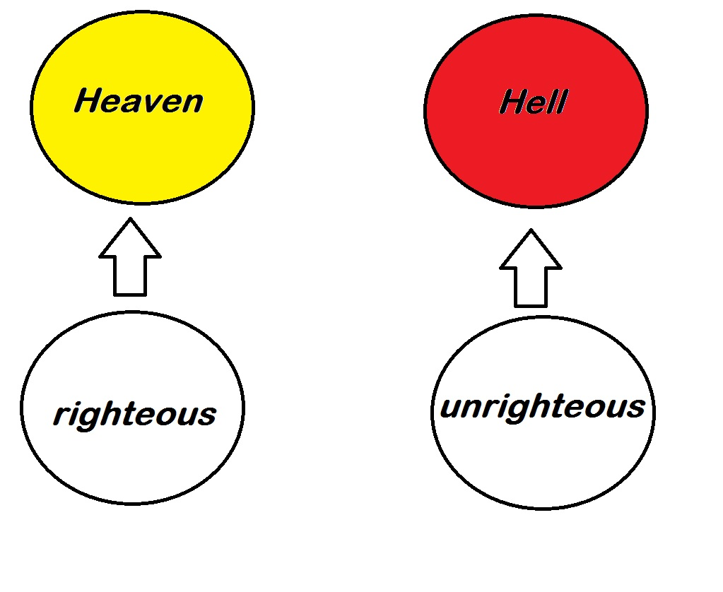
Two Groups
Saved
Not Saved
Luke 13:23-24
23 And someone said to Him, “Lord, are there just a few who are being saved?” And He said to them, 24 “Strive to enter through the narrow door; for many, I tell you, will seek to enter and will not be able.

Slide 8
Two Destinies
Heaven
Prepared for God and his followers, Those that do choose to walk the narrow way shall receive the reward of Heaven. Although some don’t believe Heaven is a real place IT IS!
Hell
Prepared for Satan and his angel, Those that DO NOT follow God and choose the broad way will end up here. Hell isn't just for the worst people of our society but for ALL who don’t obey God. Hell is just as real as Heaven is.

Slide 9
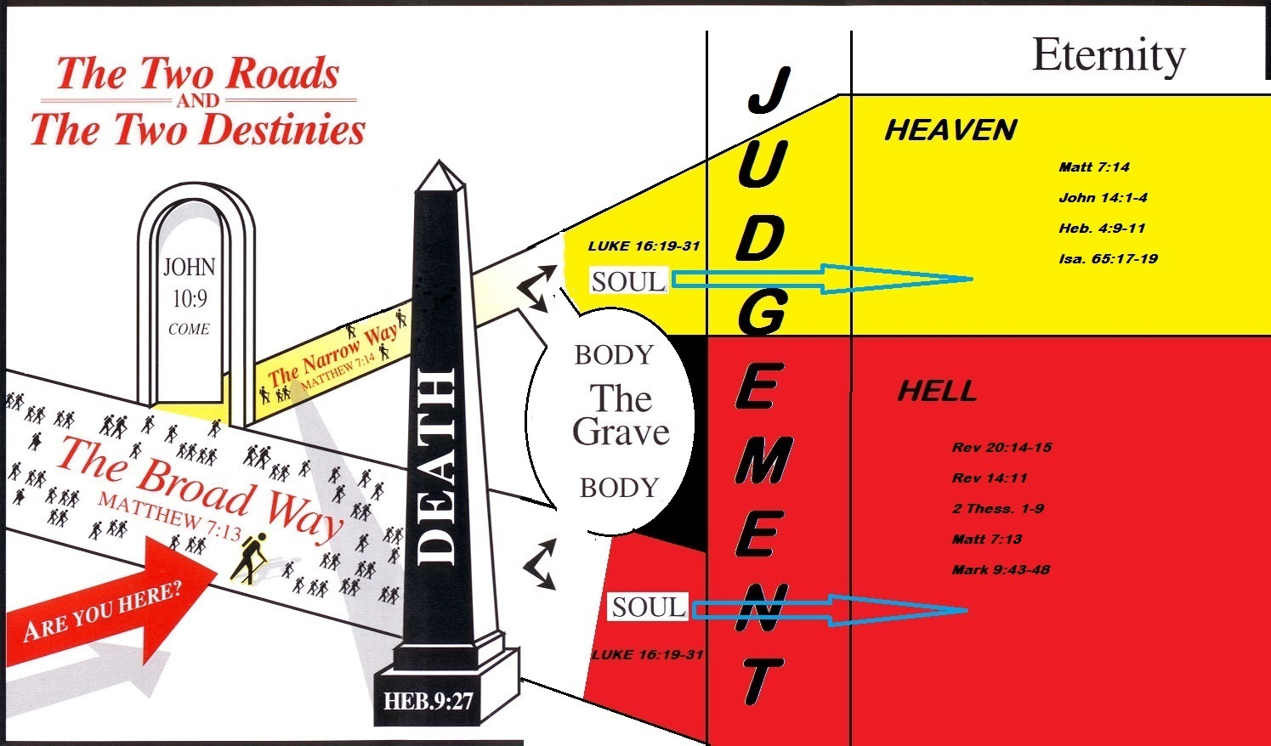

Slide 10
Invitation
The call to "enter" the narrow gate implies that whosoever desires to walk on the narrow way may enter. The blessings of the gospel are available to the one who wishes to participate in them (Rev. 22:17).
God's blessings are given without respect of persons. Christ's blood was shed for the whole world so that salvation could be offered to all men (Tit. 2:11; Matt 11:28-29).

Slide 11
Invitation
The call to "enter" also implies that man must do something to get to the life which God has prepared for him.
To participate in God's blessings, man must act. God has already done all that He will do to save us. Man must respond to His gospel to receive His grace.
Every man must enter, i.e. make some conscious choice to walk in God's way, in order to be saved in the end. If you don’t choose Gods way you choose to serve the Devil, its one or the other YOU CAN NOT serve to masters.

Slide 12
Conclusion
My friends, you have to make a choice of the road which you are going to travel in life. The choice which you make is going to determine whether you spend eternity in heaven or in hell. Which will you choose?

Slide 13
Choose you this day whom you will serve" (Josh. 24:15)

