Slide 1
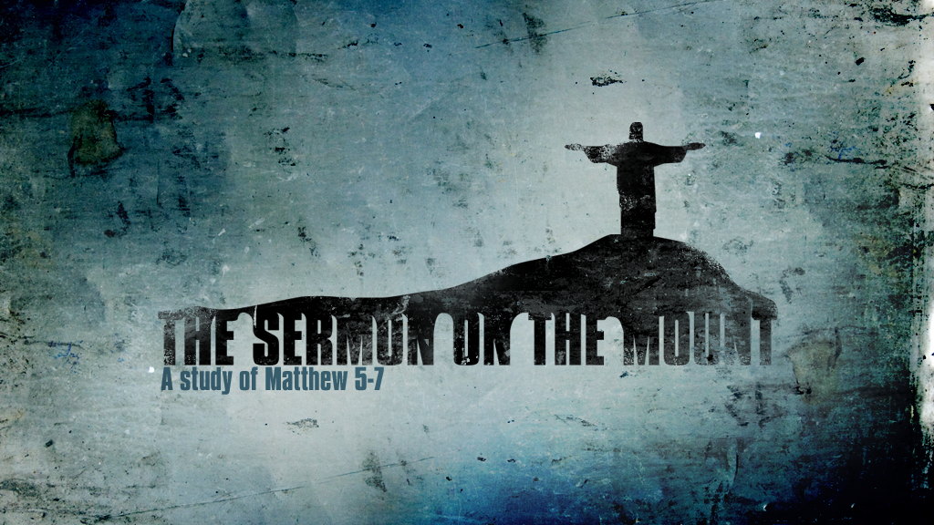
And seeing the multitudes, He went up on a mountain, and when He was seated His disciples came to Him. Then He opened His mouth and taught them, saying…

Slide 2

“You have heard that it was said…”
Matthew 5:20-48
Notes:
The scribes and Pharisees righteousness was false.
They bound some things that God didn’t even require.
There righteous is later described as “self-imposed religion” (Colossians 2:23).
The following points illustrate how Jesus’ law commands a righteousness that exceeds that of the scribes and Pharisees.
It requires a change of heart and mind; not just physical action.
Old Law didn’t allow these things (lust, hate, etc.) but this is how your righteousness will exceed that of the scribes and Pharisees.

Slide 3
“You have heard that it was said”
“It is written” – 4:5, 7, 10
Jesus’ teaching is not different from the Law.
Different from the “tradition of the elders” (Mark 7:5).
Jesus taught with authority. “But I say to you…”
Notes:
“You have heard that it was said”
Jesus usually said “It is written” (4:5, 7, 10 – answering devil while tempted).
His teaching not different from the Law.
Different from the “tradition of the elders” (Mark 7:5).
So-and-So taught this. “But (with authority) I (Jesus) say to you…”

Slide 4
“But I say to you…”
Murder is in the Heart (v. 21-26)
Notes:
“You shall not murder” (Exodus 20:13 – Ten Commandments). Mosaic Law.
Goes into the doctrine of the Kingdom.
Sin starts far before the physical murder.
Raca – brainless or worthless (worthy of answering to the Council).
“You fool.”
Both harsh expressions from one Jew to another. Also present among Christians. Should not be so.
We don’t make offerings like the Jews.
We do worship and it needs to be acceptable.
We must first be right with our Bro/Sis in Christ before we can be right with Him.
We must make peace with our brethren and acknowledge our wrong doings.

Slide 5
“But I say to you…”
Murder is in the Heart (v. 21-26)
Adultery is in the Heart (v. 27-30)
Notes:
Judges under Old Law could only judge actions.
Mosaic Law covered this.
God can judge the heart.
Lust is adultery.
A person wants the money in the bank but just lacks the opportunity. Same with lusting.
Preventative actions must be taken to ensure you don’t sin.

Slide 6
“But I say to you…”
Murder is in the Heart (v. 21-26)
Adultery is in the Heart (v. 27-30)
Marriage is Binding (v. 31-32)
Notes:
Certificate of divorce – Deuteronomy 24:1
Matthew 19:3-8 – hardness of their heat. (displeased with wife)
This was done for protection of the wife who was not pleasing to the husband lest he deal with her harshly.
Other than fornication causes commit adultery. (implies divorce being the cause of marrying another)
Marriage is sacred and binding. Not meant to end. Divorce is never without sin (at least with one party).

Slide 7
“But I say to you…”
Murder is in the Heart (v. 21-26)
Adultery is in the Heart (v. 27-30)
Marriage is Binding (v. 31-32)
Do Not Take Oaths (v. 33-37)
Notes:
Swearing is done to make the claim seem genuine.
People tell lies with while swearing to make them seem true.
If it is the truth it needs nothing added.
An honest man tells the truth even when it is against him.
Don’t swear. Be honest!

Slide 8
“But I say to you…”
Murder is in the Heart (v. 21-26)
Adultery is in the Heart (v. 27-30)
Marriage is Binding (v. 31-32)
Do Not Take Oaths (v. 33-37)
Go the Second Mile (v. 38-42)
Notes:
Resist – stand against; oppose.
Not up to us to punish them or retaliate. Leave that to God.
Fight them with the truth of the armor of God (Ephesians 6).
Do not seek revenge.
Man sues even though there are no grounds for it.
Wrong done to you but the same applies as before.
We aren’t to repay evil for evil.
Roman gov’t require services. Jews not like that. Give more to them.

Slide 9
“But I say to you…”
Murder is in the Heart (v. 21-26)
Adultery is in the Heart (v. 27-30)
Marriage is Binding (v. 31-32)
Do Not Take Oaths (v. 33-37)
Go the Second Mile (v. 38-42)
Love Your Enemies (v. 43-48)
Notes:
Affection is not expected toward our enemy.
However, we must love them.
Our enemies receive the same physical things as we do.
They are God’s creation and He loves them, so we should too.
Praying for them shows an immense amount of love for we want them to be saved.
Conclusion
The righteousness of the kingdom exceeds that of the scribes and Pharisees.
True righteousness is found in Christ.
God can judge our heart, and so we must live accordingly.

