Slide 1
God’s Mirror
James 1:21-25

Slide 2
The Word Reveals
A. It is always correct.
2 Timothy 3:16-17; Matthew 4:4; 1 John 1:8-10; Titus 1:2
Notes:
It is always correct. (It doesn’t lie.)
2 Timothy 3:16-17; Matthew 4:4; 1 John 1:8-10; Titus 1:2
Our reaction to the Word shows our true character.
Hebrews 4:11
Diligent (KJV – labor) – spoudazō - to use speed, that is, to make effort, be prompt or earnest.
4:12-13
It will cut right through the front you are putting on and show your true self.
We are not hidden from God.

Slide 3
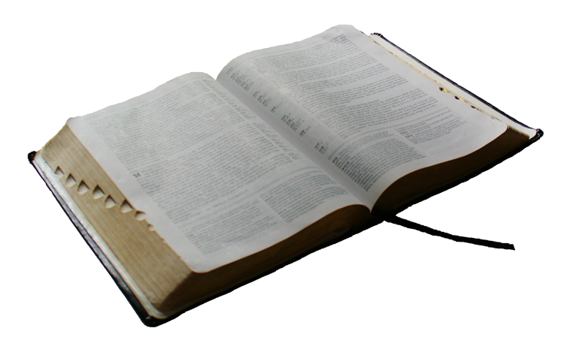
2 Timothy 3:16-17
All Scripture is given by inspiration of God, and is profitable for doctrine, for reproof, for correction, for instruction in righteousness,
¹⁷ that the man of God may be complete, thoroughly equipped for every good work.

Slide 4
Matthew 4:4
But He answered and said, "It is written, 'MAN SHALL NOT LIVE BY BREAD ALONE, BUT BY EVERY WORD THAT PROCEEDS FROM THE MOUTH OF GOD.' "

Slide 5
1 John 1:8-10
If we say that we have no sin, we deceive ourselves, and the truth is not in us. ⁹ If we confess our sins, He is faithful and just to forgive us our sins and to cleanse us from all unrighteousness. ¹⁰ If we say that we have not sinned, we make Him a liar, and His word is not in us.

Slide 6
Titus 1:2
Paul, a bondservant of God and an apostle of Jesus Christ, according to the faith of God's elect and the acknowledgment of the truth which accords with godliness, ² in hope of eternal life which God, who cannot lie, promised before time began.

Slide 7
The Word Reveals
A. It is always correct.
2 Timothy 3:16-17; Matthew 4:4; 1 John 1:8-10; Titus 1:2
B. Reaction shows our true character.
Hebrews 4:11
Diligent (KJV – labor) – spoudazō - to use speed, that is, to make effort, be prompt or earnest.
4:12-13
We are not hidden from God.
Notes:
It is always correct. (It doesn’t lie.)
2 Timothy 3:16-17; Matthew 4:4; 1 John 1:8-10; Titus 1:2
Our reaction to the Word shows our true character.
Hebrews 4:11
Diligent (KJV – labor) – spoudazō - to use speed, that is, to make effort, be prompt or earnest.
4:12-13
It will cut right through the front you are putting on and show your true self.
We are not hidden from God.

Slide 8
The Word Only Saves The Obedient
Luke 11:28
Notes:
The Word Only Saves Those Who Obey
Luke 11:28
Keep – phulassō - to watch, that is, be on guard.
Always watchful, and on guard, that you are in accord with the Word.
James 1:21-25; 2:10, 12; Philippians 2:12

Slide 9
Luke 11:28
"More than that, blessed are those who hear the word of God and keep it!"

Slide 10
The Word Only Saves The Obedient
Luke 11:28
Keep – phulassō - to watch, that is, be on guard.
James 1:21-25; 2:10, 12; Philippians 2:12
Notes:
The Word Only Saves Those Who Obey
Luke 11:28
Keep – phulassō - to watch, that is, be on guard.
Always watchful, and on guard, that you are in accord with the Word.
James 1:21-25; 2:10, 12; Philippians 2:12

Slide 11
Philippians 2:12
Therefore, my beloved, as you have always obeyed, not as in my presence only, but now much more in my absence, work out your own salvation with fear and trembling.

Slide 12
The Word Reveals What Is Modest
1 Timothy 2:8-10
Modest – orderly.
Propriety (KJV – shamefacedness) – bashfulness, that is, (towards men), modesty.
Moderation (KJV – sobriety) – soundness of mind, that is, self-control.
1 Thessalonians 4:3-5
Inward show of character and intent of the heart.
Godliness – piety (reverence) toward God; a Godward attitude; attitude pleasing to God.
1 Peter 3:3-6
Notes:
1 Timothy 2:8-10
Modest – orderly.
Propriety (KJV – shamefacedness) – bashfulness, that is, (towards men), modesty.
Matthew 5:27-28
The man sinned…but was the woman dressed with propriety?
Moderation (KJV – sobriety) – soundness of mind, that is, self-control.
1 Thessalonians 4:3-5
Not merely outward appearance, but an inward show of character and intent of the heart.
Godliness – piety (reverence) toward God; a Godward attitude; attitude pleasing to God.
1 Peter 3:3-6
Dressing flashy, or dressing not to cover up, but to reveal for attraction, is immodest dress. So where do we draw the line? What is acceptable to God?

Slide 13
The Word Reveals What Is Modest
Genesis 3:7
Coverings not sufficient, and they knew it (v. 8-10).
God covered their nakedness (v. 21).
Tunic – (KJV – coat) Ketonet – to cover; a shirt – coat, garment, robe.
Zondervan’s Bible Dictionary – “This garment usually had long sleeves, and extended down to the ankles when worn as a dress coat, and was held in place by a girdle. Hard-working men wore them more abbreviated – sometimes even to their knees, and without sleeves.”
Notes:
The mirror, that is, God’s word, reveals unto us in further detail what modest apparel is.
Genesis 3:7 (knew they were naked)
Coverings not sufficient, and they knew it (v. 8-10).
God covered their nakedness (v. 21).
Tunic – (KJV – coat) Ketonet – to cover; a shirt – coat, garment, robe.
Zondervan’s Bible Dictionary – “This garment usually had long sleeves, and extended down to the ankles when worn as a dress coat, and was held in place by a girdle. Hard-working men wore them more abbreviated – sometimes even to their knees, and without sleeves.”

Slide 14
The Word Reveals What Is Modest
Exodus 28:40, 42
Tunic – same as Genesis 3:7.
Linen trousers – “to cover their nakedness”
“reach from the waist to the thighs”
Isaiah 47:2-3 (uncovering of thigh = nakedness)
Thigh – the part of the lower limb in humans between the hip and the knee. (dictionary.com)
Notes:
Exodus 28:40, 42
Tunic – same as Genesis 3:7.
Linen trousers – “to cover their nakedness”
“reach from the waist to the thighs”
Isaiah 47:2-3 (uncovering of thigh = nakedness)
Thigh – the part of the lower limb in humans between the hip and the knee. (dictionary.com)
The occasion is irrelevant.
Tight clothing is also unacceptable. (tunics were loose fitting)
Are you considering others? (stumbling block)

Slide 15
Conclusion
God’s word is a mirror that exposes your blemishes.
Are you going to deceive yourself?
Is your apparel within God’s standard?
If not, change it!
Notes:
The occasion is irrelevant.
Tight clothing is also unacceptable. (tunics were loose fitting)
Are you considering others? (stumbling block)
Conclusion
God’s word is a mirror that exposes your blemishes.
Are you going to deceive yourself by walking away, and forgetting what you saw?
If so, it won’t change what man you actually are.
Look to the mirror of God’s word, and a physical mirror, and see if your apparel is within God’s standard of dress.
If not, change it!

