Slide 2
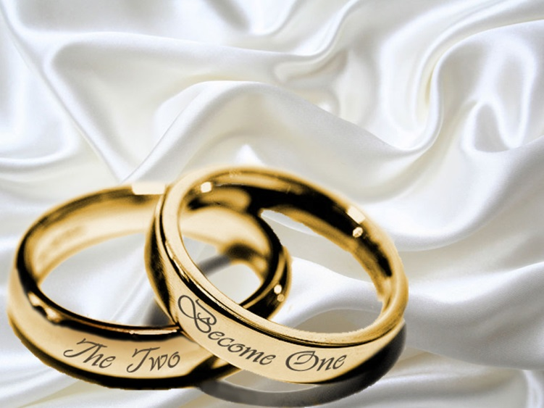
Choosing a Good Mate 1 peter 3:1-7 Gen 2:24

Slide 3
Introduction
Many, if not most people, spend a fair chunk of their life trying to reach a decision regarding who they will marry
Sadly, most leave this important choice to impulsive feelings. Little thought is given
Others agonize over the decision because they aren’t certain what they should be looking for. They want the perfect mate, and are afraid they might make a mistake

Slide 4
The reality is ...
1. Feelings can be manipulated, they are rarely stable, and they do change. Feelings are a miserable guide for decisions - Proverbs 28:26
2. No one is perfect. We all have flaws.
Romans 3:23
But it doesn’t mean there is no criteria to consider

Slide 5
I want to present some things you ought to think about before selecting someone for your spouse.
Then think also what kind of partner you are setting yourself out to be.

Slide 6
Spiritual Qualities

Slide 7
Spiritual Qualities
Honest – 1 Cor. 13:6-7, Ps. 5:9, Proverbs 13:11, 31:11
Trustworthy – Matt. 7:16-20, Malachi 2:14 Proverbs 2:16-19
Forgiving – Matt. 6:15, 1 Cor 13:5
Humble(accepts correction)
- Proverbs 12:1, 13:18, 11:2, 13:10

Slide 8
Spiritual Qualities
Confident – Eph. 5:28-30, Proverbs 31:25
Discretion(good judgment)
- Proverbs 21:5, 29:20, 31:16, 19:11
Patient – Rom. 2:7, 1 Cor. 13:4

Slide 9
Actions

Slide 10
Actions
Industrious (hard working not lazy)
Proverbs 31:13-19, 27, 24:30-34, 2 Thes. 3:10
Kind- Eph. 4:32, 1 Cor. 13:4, Proverbs 27:3-4
Moral – 2 Cor. 6:14-19, 1 Cor. 15:33

Slide 11
Behavior

Slide 12
Behavior
Polite – Col. 4:6, Ecc. 10:12, Proverbs 15:4, 16:21
Listens – James 1:19, 1 Cor. 2:11,
Peaceful – Proverbs 19:13, 21:9,19, Proverbs 22:10, 16:7
Optimistic – Proverbs 18:14, Phil. 4:4-7, 1 Cor. 13:7, Col. 3:15-17

Slide 13
behavior
Sober – Deut. 29:18-20, Titus 2:2, Proverbs 20:1, 21:17
Responsible – 1 Cor. 16:13, Titus 3:14, 1 Tim. 5:8
Loves Others – Proverbs 31:10, Phil. 1:9,
1 Thes. 3:12
Loves You – 1 Cor. 13:4-8, Eph. 5.25-29, 33, Sol. 8:6-7

Slide 14
What a woman should look for
A Leader
– 1 Tim 3:3-5, Proverbs 31:28-31
A Provider
– 2 Thes. 3:10
Security
– Eph. 5:25

Slide 15
What a Man should look for
Nurturing
– Ps. 127:3-5, Titus 2:4
A quiet spirit
- 1 Peter 3:3-4
Not Looks or Charm
- Proverbs 31:30

Slide 16
. A Christian usually makes the best mate
So many problems can be avoided when two people share the same faith - I Peter 3:1-7
When you consider someone for marriage, look at who they are, not who you hope they will become.
So many people marry their hopes instead of the person in front of them and then are dismayed to find out they got the person in front of them.
Yes, people do change. So look for the changed person, not the dream person.

Slide 17
Marriage is a life long decision. Matt 19:4-6 , 1 Cor.7:39
Put God first, Serve him Joshua 24:15, Matt 22:37

