Slide 2
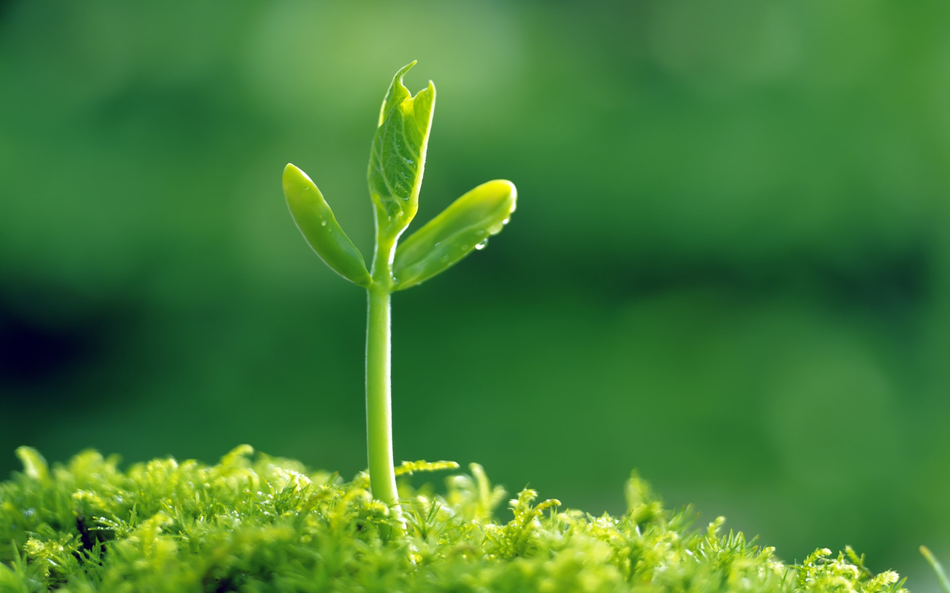
The Success of the Seed
Luke 8:4-15
Notes:
What is needed for the seed to be successful? (Luke 8:4-8, 11-15)

Slide 3

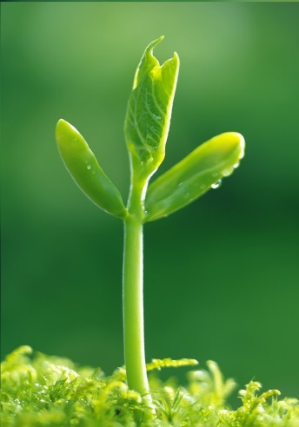
THE Seed
“The seed is the word of God.”
  Romans 1:16; 1 Cor. 1:18-25; 2:11-12
Notes:
“The seed is the word of God.” (v. 11)
Romans 1:16
God has the power. This is the plan of salvation God has created for the world.
1 Corinthians 1:18-25
God has made salvation for man simple. The message is not complex. It is a message that anyone can understand.
“the world through wisdom did not know God” (v. 21)We can’t know what God wants unless He reveals it to us (cf. 2:11-12).
It is ironic that the “creature” perceives the “Creator’s” message to be foolish!
Men, through their own wisdom, “request a sign” or “seek after [worldly] wisdom” instead of accepting the will of God by divine revelation from God Himself.

Slide 4
THE Seed
“The seed is the word of God.”
  Romans 1:16; 1 Cor. 1:18-25; 2:11-12
NO Additions!
  1 Cor. 2:1-5; Galatians 6:7-8; 1:6-10
  THE Seed produces Christians – 1 Peter 1:22-23; John 8:31-32; Acts 11:26
Notes:
Additions can only corrupt the seed.
Farmers use fertilizer, steroids, and other additions to improve the growth of the crop. These things might be necessary for literal farming. However, the word of God needs no addition! Instead of improving the seed, additions to God’s word distort, and corrupt the seed.
1 Corinthians 2:1-5
If Paul added human wisdom as an enhancer to the gospel, the people’s faith wouldn’t be in the gospel at all!
Galatians 6:7-8 (not talking about the Word; talking about our own lives; however, same principle applies.)
The seed principle is simple. If you sow an apple seed you get apples. If you sow the word of God, it yields salvation. If you sow the perverted gospel, it yields damnation (cf. Galatians 1:6-10).
“for it [gospel of Christ] is the power of God to salvation” (Romans 1:16)
God chose the gospel as the way to salvation. Nothing else can produce salvation.
1 Peter 1:22-23
Those who have “purified [their] souls” are those who were “born again…through the word of God.”
John 8:31-32 – Abide in the word you are disciples. Acts 11:26 – Disciples of Christ are called Christians.
People put FILTERS on the word and it changes the fruit that it yields, because the filter corrupts the word.
Bible + Baptism manual = Baptist; Bible + Methodist discipline = Methodist; Bible + Book of Mormon = Mormon

Slide 5
A Sower
Sowers are needed!
  Romans 10:14-15
  “Christ has no hands but our hands to do His work today, He has no feet but our feet to lead men in His way; He has no tongue but our tongues to tell men how He died, He has no help but our help to bring them to His side.”
  – ‘The Worlds Bible’
  1 Cor. 3:5-8; Acts 8:3-4, 27-31, 34-35
  1 Timothy 4:12-16; 2 Timothy 2:15; 4:1-5
Notes:
“A sower went out to sow his seed.” (Luke 8:5)
Sowers are necessary.
Romans 10:14-15
“how shall they hear without a preacher?”
“Christ has no hands but our hands to do His work today, He has no feet but our feet to lead men in His way; He has no tongue but our tongues to tell men how He died, He has no help but our help to bring them to His side.” – ‘The Worlds Bible’
This isn’t taking away from the power of God’s word.
1 Corinthians 3:5-8
But a sower is needed. (Acts 8:3-4 – after Stephen’s death)
Acts 8:27-31, 34-35
The eunuch was reading scripture. The power was in the word, but Phillip “preached Jesus to him.”
Sowers must know what they are sowing.
1 Timothy 4:12-16
The preacher must take heed to doctrine. He must give himself ENTIRELY to them!
2 Timothy 2:15
He must be able to understand the truth. He must be able to communicate it to others. He must preach it in the way it was meant to be preached.
2 Timothy 4:1-5
He must stand fast. He must only preach the truth! He must always be ready!

Slide 6
Good Soil
“The ones that fell on the good ground are those who, having heard the word with a noble and good heart, keep it and bear fruit with patience.”
– Luke 8:15
Acts 17:10-12
John 12:48; Hebrews 4:12-13
Notes:
The seed will not grow in corrupt soil. This is up to the recipient.
“The ones that fell on the good ground are those who, having heard the word with a noble and good heart, keep it and bear fruit with patience.” – Luke 8:15
Acts 17:10-12
They “received the word with all readiness.”
They had decided beforehand that if what they were being told was true to the scriptures that they would obey it!
They were prepared to hear the truth and act upon it.
Those who did not believe had that which would judge them (cf. John 12:48).
Hebrews 4:12-13
The word will reveal your true character.
You cannot hide from God.

