Slide 2
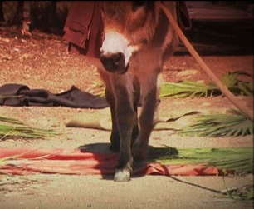
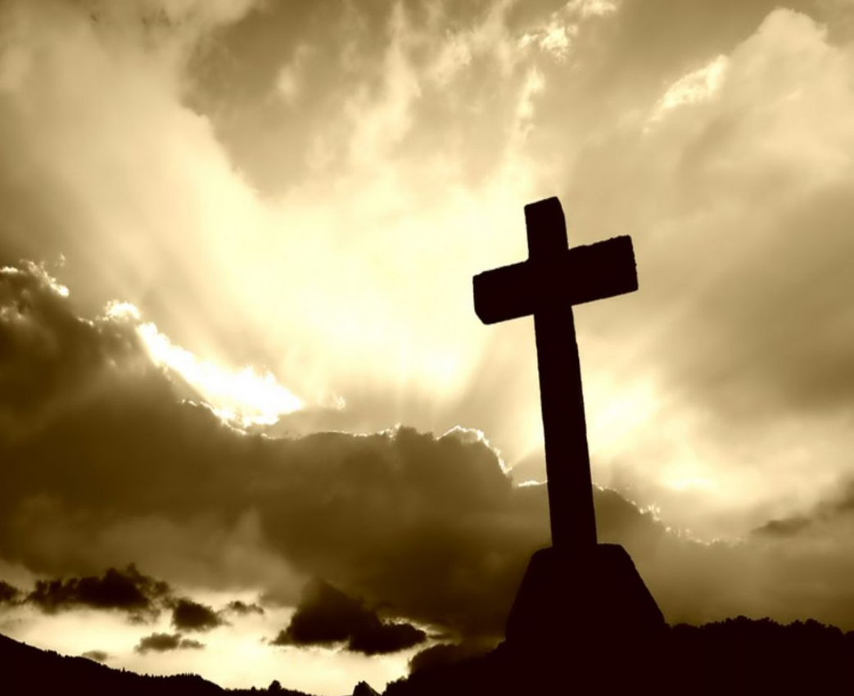
From The
Triumphal Entry
Cross
To The
Notes:
Introduction
John 12 records Jesus’ entry into Jerusalem that is known as “The Triumphal Entry.”
This is the beginning of the events directly leading up to His death, burial, and resurrection.
His triumphal entry is on a Sunday, and His death would occur on the very next Friday.
Just 4 days after the great multitude welcomed Him into Jerusalem, they slayed Him on the cross.
Why such a dramatic change in events?

Slide 3
From The Triumphal Entry To The Cross
Lazarus Raised – John 11
Jesus’ Triumphal Entry – John 12
Jesus’ Death – John 19
Notes:
Lazarus Raised.
John 11:1-4
Lazarus’ sickness served a Divine purpose – to glorify the Son of God.
Jesus often used situations such as this to bring glory to God.
Jesus words display an emphasis on God’s will. It wasn’t about Lazarus in the grand scheme.
His illness, and any emotional inclination to act on it, took a back seat in Jesus mind to God’s will.
(11:5-7) – Jesus was close to Lazarus, and as a man would naturally have strong emotion toward the news of his illness.
He did not go immediately to heal him, for it seemed to be God’s will for him to die in order to bring glory to God later on. →
11:11-15 – “that you may believe.”
It is apparent by Jesus remarks that had He been with Lazarus that He would have healed him.
Yet, Jesus even had the power to heal him remotely, but didn’t. Why? →
Christ once again shows His appeal to a higher purpose. He allowed Lazarus to die so He could perform in such a way that would bring glory to God and belief to the people.
John 11:38-44
(v. 39) – The circumstance of this miracle would be undeniable. Lazarus had been declared dead, and buried in the tomb for four days. (v. 19 – many understood he had been dead for that time. The proof was all there.)
(v. 42) – Certainly Jesus had compassion for Lazarus and his family (v. 35). But this was so people would know who Jesus was.
This prayer of thanks to God as His Father pointed to His messiahship. Jesus was the chosen one, the Son of God, and this would be further proof.
John 11:45-48
“Then many” (v. 45) – This miracle performed by Christ caused others to believe in Him.
Later in his gospel, John describes the purpose of Christ’s miracles (cf. John 20:30-31).
At the start of the church there were miracles to confirm the gospel message (cf. Hebrews 2:2-4).
“but some” (v. 46) – Then the chief priests and rulers plotted to kill Him (cf. 11:53; 12:9-11).
They, knowing how others would react, did not want their position taken away from them.
This shows how some, despite the evidence before their eyes, refuse to render themselves subservient to the overwhelming truth.
Raising Lazarus from the dead caused many to believe which lead to the triumphal entry. (Fulfillment of prophecy, yet caused by the performed miracle.)
Triumphal Entry.
John 12:12-19
The people praised Jesus and welcomed Him!
“Hosanna” – save now.
Praise to Jesus as conqueror.
Palm branches and clothes laid in His path – a sign of honor! They recognized Him as an important individual and showed Him respect.
They called Him “King!”
Matthew records them saying, “Hosanna to the Son of David!”
The people ascribed to Him kingship, and recognized His authority from God to rule!
Recognized Him as coming “in the name of the Lord.”
At that time the people accepted Jesus as the Christ (the anointed one, the messiah).
Amongst them were those who witnessed Lazarus being raised from the dead (12:17). They contributed to the multitudes welcoming Jesus into Jerusalem (12:18).
The Phar. saw the influence Jesus had on the multitude of people (12:19).
Jesus Rejected and Crucified.
A drastic change in attitude and perception of Jesus transpired later. This ultimately led to His death on the cross.
“they cried out, saying, ‘Crucify Him, crucify Him!’” (John 19:6).
He was beaten, spat upon, mocked, by many of the same who praised Him coming into Jerusalem.
They put Him – the One chosen by God, deserving of praise and honor – to an open shame in the death on the cross.

Slide 4
From The Triumphal Entry To The Cross
Why the drastic change?
Obstinate Hearts – John 12:37-41
– Romans 12:1-2; Ephesians 5:17 –
Outer Persuasion – Matt. 27:15-22
– Galatians 1:8-9; Psalm 119:11 –
Notes:
Why the change?
Obstinate Hearts.
John 12:37-41 – Some of those of the multitude who had praised Him, who had witnessed His power in resurrecting Lazarus, who had been told of His power, did not believe in Him.
Their hearts were hardened. They had conjured a messiah that was not in agreement with God’s plan. →
John 12:20-34
Jesus spoke of the necessity of His death (v. 24, 27).
Further proof was given that He was legitimate (v. 28-30).
People understood He was saying He must die but did not understand (v. 32-34).
They thought Jesus to be a physical King who would bring them salvation from the Roman rule. They were wrong.
His kingdom is spiritual (cf. John 18:36 – “My kingdom is not of this world. If My kingdom were of this world, My servants would fight, so that I should not be delivered to the Jews; but now My kingdom is not from here”).
Although Christ Himself, already being proved, supplied evidence of a plan contrary to theirs, they stuck with their own and rejected Him.
Same is with people today. They get excited about Jesus, and the scheme of redemption, but when they see what it really is, they reject it and conform to their own standards.
We are told not to do this – Romans 12:1-2
Ephesians 5:17 – “Therefore do not be unwise, but understand what the will of the Lord is.”
When our thoughts prove not to be His thoughts do we dispose of them and cling to His?
Outer Persuasion.
Of those who crucified Christ were some who participated with the great multitude upon His triumphal entry.
Before they looked to Jesus, but then they let others persuade them to believe the contrary.
Matthew 27:15-22 – Chief priests and elders persuaded the multitudes!
Many in the world, after having already received the truth, allow themselves to be influenced by other teaching.
We are warned! – Galatians 1:8-9
Psalm 119:11 – “Your word I have hidden in my heart, that I might not sin against You.”
We know the truth. Therefore, we should be confident in it, and not forsake it due to tempters.
Conclusion
We know Christ. We know who He is.
We should not allow ourselves to be wrapped up in our own preconceived notions. Instead, we should be willing to conform to who He says He is.
We should know the truth does not change, and that we should only be persuaded by it, and not others.

