Slide 2
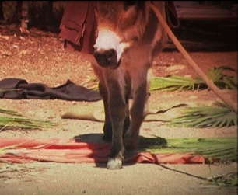
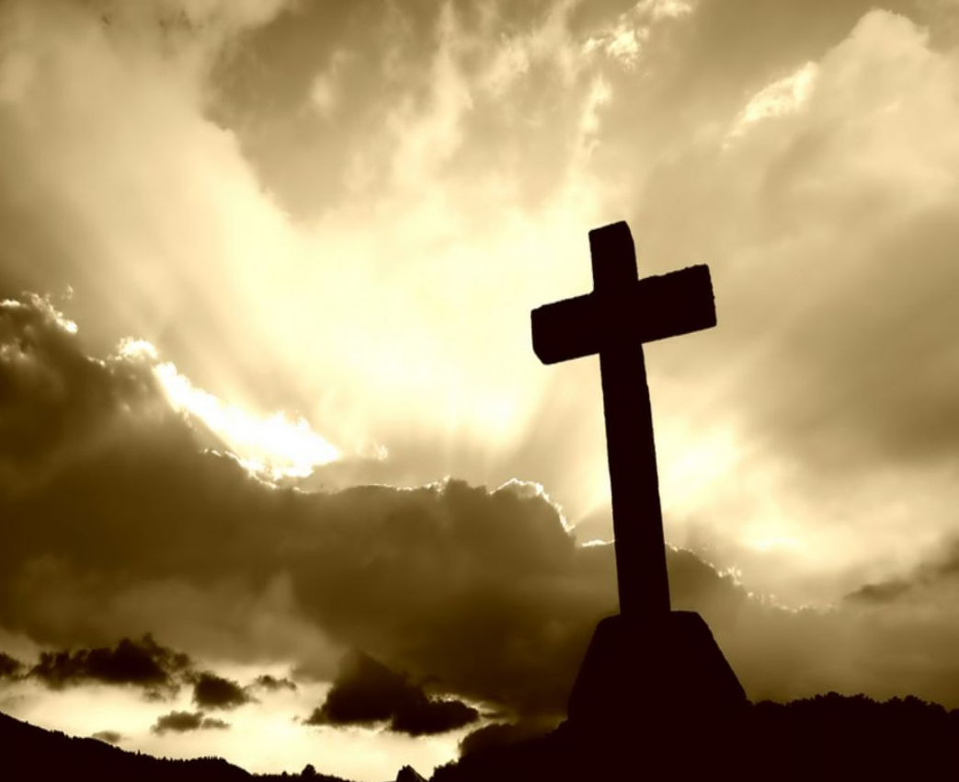
From The
Triumphal Entry
Cross
To The
Notes:
Introduction
John 12 records Jesus’ entry into Jerusalem that is known as “The Triumphal Entry.”
This is the beginning of the events directly leading up to His death, burial, and resurrection.
His triumphal entry is on a Sunday, and His death would occur on the very next Friday.
Just 4 days after the great multitude welcomed Him into Jerusalem, they slayed Him on the cross.
Why such a dramatic change in events?

Slide 3
From The Triumphal Entry To The Cross
Lazarus Raised – John 11
Jesus’ Triumphal Entry – John 12
Jesus’ Death – John 19
Notes:
Lazarus Raised.
John 11:1-4
Lazarus’ sickness served a Divine purpose – to glorify the Son of God.
11:11-15 – “that you may believe.”
11:21 – Martha; 11:32 – Mary, “Lord, if You had been here, my brother would not have died.”
John 11:38-44
Lazarus was raised from the dead even after being dead four days.
John 11:45-48
This miracle performed by Christ caused others to believe in Him.
Later in his gospel, John describes the purpose of Christ’s miracles (cf. John 20:30-31).
Then the chief priests and rulers plotted to kill Him (cf. 11:53; 12:9-11).
Triumphal Entry.
John 12:12-19
The people praised Jesus and welcomed Him!
“Hosanna” – save now.
Praise to Jesus as conqueror.
Palm branches and clothes laid in His path – a sign of honor! They recognized Him as an important individual and showed Him respect.
They called Him “King!”
Matthew records them saying, “Hosanna to the Son of David!”
The people ascribed to Him kingship, and recognized His authority from God to rule!
Recognized Him as coming “in the name of the Lord.”
At that time the people accepted Jesus as the Christ (the anointed one, the messiah).
Amongst them were those who witnessed Lazarus being raised from the dead (12:17). They contributed to the multitudes welcoming Jesus into Jerusalem (12:18).
The Pharisees saw the influence Jesus had on the multitude of people (12:19).
Jesus Rejected and Crucified.
A drastic change in attitude and perception of Jesus transpired later. This ultimately led to His death on the cross.
“they cried out, saying, ‘Crucify Him, crucify Him!’” (John 19:6).

Slide 4
From The Triumphal Entry To The Cross
Why the drastic change?
Obstinate Hearts – John 12:37-41
– Romans 12:1-2; Ephesians 5:17 –
Outer Persuasion – Matt. 27:15-22
– Galatians 1:8-9; Psalm 119:11 –
Notes:
Why the change?
Obstinate Hearts.
John 12:37-41 – Some of those of the multitude who had praised Him, who had witnessed His power in resurrecting Lazarus, who had been told of His power, did not believe in Him.
Their hearts were hardened. They had conjured a messiah that was not in agreement with God’s plan. →
John 12:20-34
Jesus spoke of the necessity of His death (v. 24, 27).
Further proof was given that He was legitimate (v. 28-30).
People understood He was saying He must die but did not understand (v. 32-34).
They thought Jesus to be a physical King who would bring them salvation from the Roman rule. They were wrong.
His kingdom is spiritual (cf. John 18:36).
Although Christ Himself, already being proved, supplied evidence of a plan contrary to theirs, they stuck with their own and rejected Him.
Same is with people today. They get excited about Jesus, and the scheme of redemption, but when they see what it really is, they reject it and conform to their own standards.
We are told not to do this – Romans 12:1-2; Ephesians 5:17
When our thoughts prove not to be His thoughts do we dispose of them and cling to His?
Outer Persuasion.
Of those who crucified Christ were some who participated with the great multitude upon His triumphal entry.
Before they looked to Jesus, but then they let others persuade them to believe the contrary.
Matthew 27:15-22 – Chief priests and elders persuaded the multitudes!
Many in the world, after having already received the truth, allow themselves to be influenced by other teaching.
We are warned! – Galatians 1:8-9; Psalm 119:11
We know the truth. Therefore, we should be confident in it, and not forsake it due to tempters.
Conclusion
We know Christ. We know who He is.
We should not allow ourselves to be wrapped up in our own preconceived notions. Instead, we should be willing to conform to who He says He is.
We should know the truth does not change, and that we should only be persuaded by it, and not others.
Take heed lest we are guilty of doing the same as those who welcomed and praised Jesus, and a few days later, crucified Him!

