Slide 2
How Our Time is Spent:
6 months at stoplights
8 months opening junk mail
1 year looking for misplaced objects
2 years unsuccessfully returning phone calls
5 years waiting in line
6 years eating
21 years watching TV
We waste a lot of time!

Slide 3
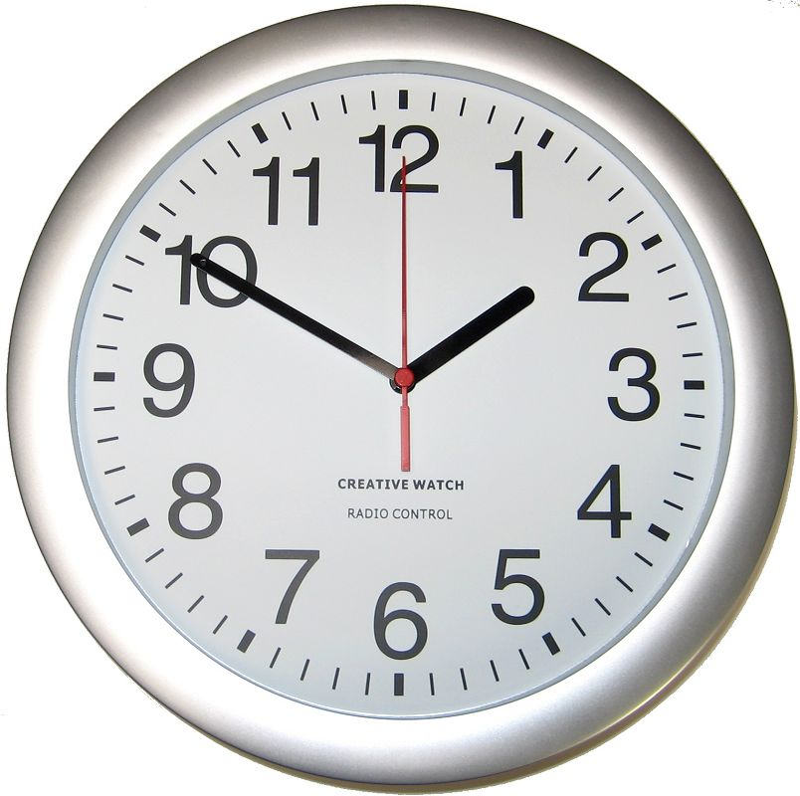
Redeeming the Time
Ephesians 5:15-17; Colossians 4:5

Slide 4
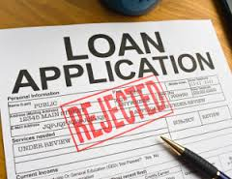
The Proper Use of Our Possessions
We are stewards of property
All we have comes from God
James 1:17
Christians look at everything in life from the viewpoint of God’s ownership and man’s responsibility

Slide 5
The Proper Use of Our Possessions
We are stewards of property
Opportunities for “redeeming the time” with our property is temporary
Luke 12:16-21
All that we really have is that which we have given away
Matthew 6:19-21
2 Peter 3:10-12

Slide 6
The Proper Use of Life
Life is a trust – It can’t be purchased
Life is not ours to do as we please
All possessions, powers and responsibilities are ours in trust
Life is ours for management
1 Corinthians 6:20
We must give account of our life
Romans 14:12
James 4:13-17

Slide 7
The Proper Use of Opportunity
We are responsible for opportunities
Opportunity knocks
Opportunity must be anticipated
Take advantage of small and great opportunities
Often times big opportunities are reached by way of small opportunities:
Prov. 27:1; Matt. 6:34

Slide 8
The Proper Use of Our Knowledge
2 Corinthians 4:7
1 Thessalonians 2:4
Desire and pray for opportunities and wisdom to make the knowledge of God known
Colossians 4:3-6
Responsibility is upon all of us
Matthew 28:19-20

Slide 9
Conclusion
Recognize our responsibility
Which would you rather be at the judgment?
Acts 4:32
Revelation 3:15-17
Redeem the Time!

Slide 10
Conclusion
Recognize our responsibility
Which would you rather be at the judgment?
Acts 4:32
Revelation 3:15-17
“Dost thou love life? Then do not squander time, for that’s the stuff life is made of.”
Benjamin Franklin
“Dost thou love eternal life? Then do not squander time, for that makes your eternity.”
The Christian
Redeem the Time!

Slide 11
Conclusion
Recognize our responsibility
Which would you rather be at the judgment?
Acts 4:32
Revelation 3:15-17
“Dost thou love life? Then do not squander time, for that’s the stuff life is made of.”
Benjamin Franklin
“Dost thou love eternal life? Then do not squander time, for that makes your eternity.”
The Christian
Redeem the Time!

Slide 12
Conclusion
Recognize our responsibility
Which would you rather be at the judgment?
Acts 4:32
Revelation 3:15-17
Galatians 3:13
Romans 13:11
Redeem the Time!

