Slide 2
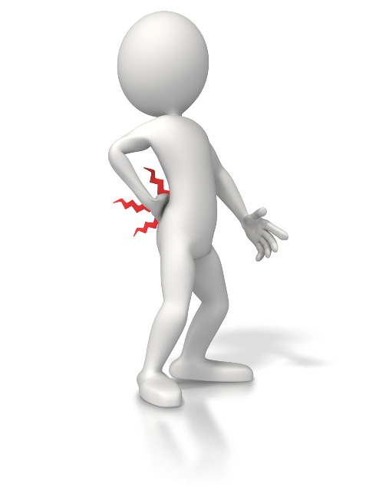
The Pain of Change or Regret
Which do you prefer?
Notes:
Introduction
Pleasing God requires a change of life.
This change is not always easy, and often brings some pain.
However, having not changed, when Christ comes again the pain of regret will be far worse, and last an eternity.
“I hated every minute of training, but I said, ‘Don’t quit. Suffer now and live the rest of your life as a champion.’” – Muhammad Ali
“There are two types of pain you will go through in life, the pain of discipline and the pain of regret. Discipline weighs ounces while regret weighs a ton.” – Jim Rohn (author/public speaker)

Slide 3
The Pain of Change
Leaving your past behind.
Matthew 16:24-27; 2 Corinthians 5:14-15; Matthew 19:16-22
Suffering persecution from past company.
1 Peter 4:4
Growing pains.
James 1:2-4; Hebrews 12:7-11; 1 Timothy 4:12-13; Hebrews 5:12-14
Change is necessary.
John 3:3,5; Romans 12:2
Notes:
The Pain of Change.
Leaving your past behind.
Matthew 16:24-27 – In order to follow Jesus we must change. That change is from pride to humility (cf. Matthew 5:3).
We live this life on earth for Christ, not ourselves. Whereas before, we lived for ourselves (cf. 2 Corinthians 5:14-15).
Matthew 19:16-22 – Self-denial is not always easy.
Our relationship with Christ is like a marriage (cf. Ephesians 5:22-33 – MENTION).
Suffering persecution from past company.
1 Peter 4:4 – Our past life in contrast with our new life will make people speak against us.
Notice: this can be painful, but it is cause for rejoicing! (cf. 4:12-13).
We must not concern ourselves with their unrighteous judgment (cf. 4:6).
Growing pains.
Leaving your past, and suffering persecution for doing so, are both part of growing.
James 1:2-4 – Growing is not always easy, or pleasant.
Chastening from God leads to strength (cf. Hebrews 12:7-11).
1 Timothy 4:12-13 – Growth in the word is necessary.
It isn’t always easy (cf. 2 Peter 3:15b-16).
God makes the truth able to understand (cf. 2 Timothy 2:15).
Hebrews 5:12-14 – If we do not endure growing pains, and desire growth, we will experience spiritual atrophy.
Change is necessary to get to heaven. (Even if it means experiencing pain or discomfort.)
John 3:3,5 – Being born again is a complete change. A new creation.
Romans 12:2 – We must transform (a type of change) ourselves by the word of God.

Slide 4
The Pain of Regret
Separation from God and Christ.
Revelation 1:4-7; 2 Thessalonians 1:9-10
Eternal punishment in hell.
Revelation 20:11-15
Realization of finalization and eternity.
Luke 16:19-31
Notes:
The Pain of Regret.
Seeing the glory of God and being separated from Him.
Revelation 1:4-7
When Christ comes, those who rejected Him will realize what they’ve done to Him, and themselves.
2 Thessalonians 1:9-10
That day will be wonderful for some, and terrible for others.
Imagine seeing Jesus in all His glory, and then being sent away from Him for eternity.
God is the one who showers down blessings even on those who aren’t obedient (cf. James 1:17). And the disobedient will be sent away.
Eternal punishment in hell.
Revelation 20:11-15
After being judged, and cast into the lake of fire, there will be eternal regret, knowing that the book by which you were judged was available while on earth (cf. John 12:48). (Recognizing you had the knowledge of what you should have done.)
Realization of finalization and eternity (Rich man and lazarus).
Luke 16:19-31
The rich man experienced the pain of regret. Yet, it was too late to change.

Slide 5
The Pain of Change or Regret
Regardless of the path we choose, pain will be experienced.
Do you want to experience the temporary pain of change, or the eternal pain of regret?
Notes:
Conclusion
Which pain would you rather experience?
If you endure the pain of change, and the hardships on the narrow way to heaven, it will be well worth it.
However, skipping out on the difficulty of change, and dedication to God will be regretted for eternity.

