Slide 2
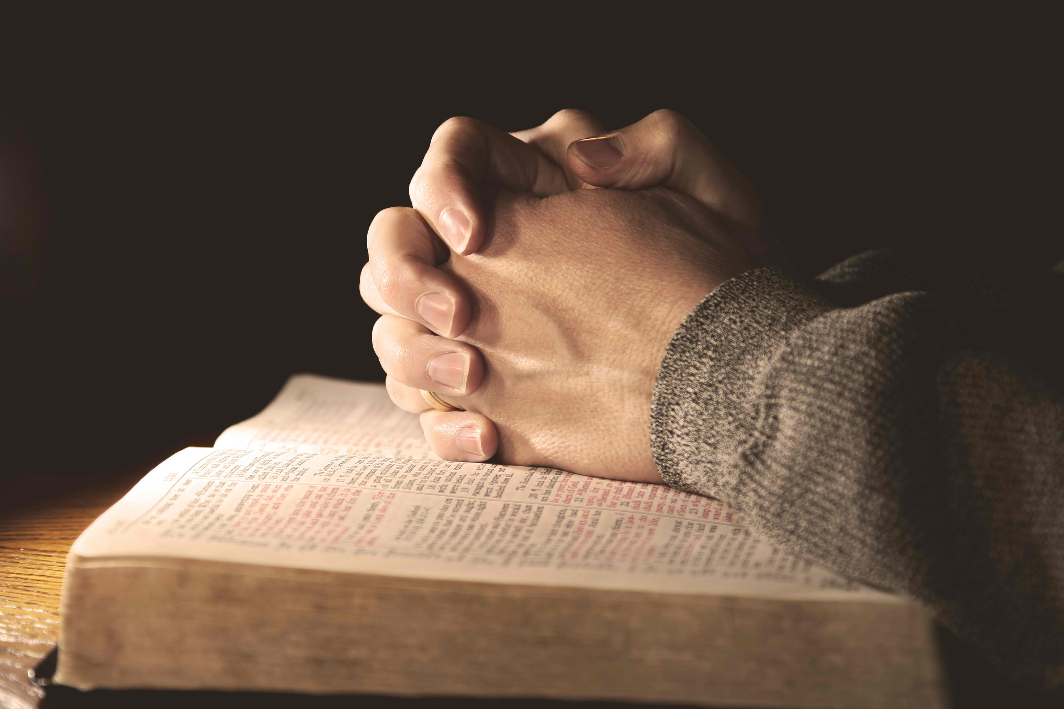
“In this manner, therefore, pray”
Matthew 6:9-15
Notes:
Matthew 6:9-15
Introduction
Many give this text the title, “The Lord’s Prayer.” This is inaccurate. Jesus is teaching how we ought to pray. (He was not asking for God to forgive Him – He is perfect.)
When this is recited we disobey another command given by Jesus in the same context (cf. 6:7).
Our prayers should not be mindless repetitions, but well thought out sentiments of the heart.
God is not pleased with “vain repetitions.” Prayer should have sincere meaning.
He is not condemning any persistence in prayer. Persistent prayer is encouraged and commanded (cf. Luke 18:1 – Parable of the persistent widow who’s petition was answered by the judge because of her continual requests.)
This prayer was a model prayer. “In this manner” implies the prayer was an example.
What does the Master Teacher reveal about prayer, and how it is to be practiced?

Slide 3
To Be Heard by God
Pray
“Pray to your Father who is in the secret place; and your Father who sees in secret will reward you openly.”
Daniel 6:10-11
Daniel “gave thanks before his God.”
Notes:
Pray to be heard by God (not man). (v. 5-6)
Again, Jesus is not saying this is the only way we can pray. The point is concerning the nature of prayer. It is between the one praying, and God, and only for that purpose.
Daniel 6:10-11 – Daniel was praying where it was possible for men to see him. However, this was not his purpose.
He continued his custom – In no way did he change to show off his religious practice. He “gave thanks before his GOD.”

Slide 4
With Humility and Reverence
Pray
“Our Father in heaven, Hallowed be Your name.”
Father – 1 John 3:1; Ephesians 6:1-2
Isaiah 40:21-23
Hallowed – Exodus 20:7; 3:4-6
Notes:
Pray with humility and reverence. (v. 9)
“Father” – denotes a special relationship with Him as His children (cf. 1 John 3:1).
Ephesians 6:1-2 – A father is one with authority to which honor is due. Even more so with our heavenly Father. →
Isaiah 40:21-23 – Recognizing His place in heaven allows us to remember ours on earth beneath Him. (cf. James 4:6).
“Hallowed” – holy, set apart, pure, consecrated. His name is one to be reverenced (cf. Exodus 20:7 – 3rd of the 10 commandments.)
God is holy! We must come before Him as such (cf. Exodus 3:4-6 – Moses at the burning bush.)

Slide 5
His Will be Done
Pray
“Your kingdom come. Your will be done on earth as it is in heaven.”
Matthew 26:39
The kingdom had not yet come. However, it is here now – Acts 2:47
Notes:
Pray His will be done. (v. 10)
Matthew 26:39 – Jesus’ prayer in the garden.
“I prayed about it so it must be okay.” – Prayer does not annul God’s commandments. Notice, Jesus continued on the path that was the Lord’s will, He did not run away because He prayed let this cup pass.
“You kingdom come” – this was God’s will. It had not yet occurred.
The church (Kingdom) was instituted – Acts 2:47.
To pray “your kingdom come” today would be inaccurate, for it is already here.
It can also be destructive for there are some who teach the kingdom is yet to come to this very day. (Premillennialism)
People still recite that because the “prayer” has no meaning to them.

Slide 6
For Necessities
Pray
“Give us this day our daily bread.”
James 1:17
He knows! (v. 8)
Then why pray?
1 Thessalonians 5:17; Matthew 6:30; James 1:6; 5:15
Notes:
Pray for necessities. (v. 11)
Bread was something needed daily. It was a necessity.
James 1:17 – All blessings are from God. It is only He that is capable of supplying such needs.
(v. 8) – He already knows (Omniscience)! Why pray?
1 Thessalonians 5:17 – It is commanded!
Matthew 6:30 – don’t worry – It shows our dependence upon Him!
James 1:6 – It shows faith. – James 5:15
Matthew 7:7-8 – If we ask we will receive.
This understanding requires thanksgiving – Colossians 3:17

Slide 7
For Forgiveness
Pray
“And forgive us our debts, as we forgive our debtors.”
Acts 8:18-23
1 John 1:9
Conditional! (cf. v. 14-15)
Notes:
Pray for forgiveness. (v. 12)
Acts 2:38 – Baptism is for the remission of sins.
Acts 8:18-23 – However, this does not mean we can’t sin again. The solution is repentance and prayer to God for forgiveness. (cf. 1 John 1:9).
The forgiveness we receive is conditional upon us forgiving others (cf. v. 14-15).

Slide 8
For Spiritual Deliverance
Pray
“And do not lead us into temptation, but deliver us from the evil one.”
James 1:13
1 Corinthians 10:13
Matthew 26:41
Notes:
Pray for spiritual deliverance. (v. 13)
Jesus is not implying that God can tempt us (cf. James 1:13).
The idea is that we pray to God for an escape that is sufficient for us not to go further into that temptation (cf. 1 Corinthians 10:13).
God is not going to take temptations away. They are allowed by Him to test our faithfulness, and strengthen us further (cf. James 1:2).
However, He will do His part so as to ensure an escape that we do not tarry when temptation presents itself to us (cf. Matthew 26:41 – His command was for them to pray so that when temptation inevitably arrived they would be able to turn to the other direction instead of going into it themselves!)

Slide 9
With Praise!
Pray
“For Yours is the kingdom and the power and the glory forever. Amen.”
1 Chronicles 29:10-13
Notes:
Pray with praise. (v. 13)
Doxology – glorification – Often appears at the end of prayers and epistles.
Why? God is worthy of praise and glorification!
1 Chronicles 29:10-13 – David to God.
We praise Him because of who He is, and He deserves/expects it!

Slide 10
“In this manner, therefore, pray”
Matthew 6:9-15
Notes:
Conclusion
God commands that we pray.
It is for our benefit. When we fail to pray we fail God, but we also neglect ourselves!
We must not pray how we think we should pray, but how God instructed us to pray.
Our prayers should be well thought out and delivered in such a way that displays the attitude that our Lord Himself possessed!

