Slide 2
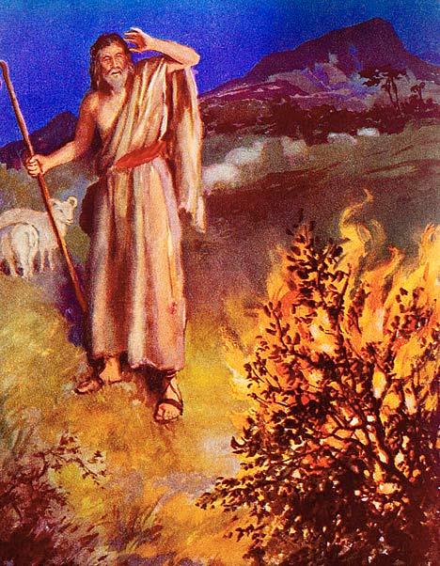
The Excuses of Moses
Exodus
3:1 – 4:17
Notes:
When Moses was grown, he killed an Egyptian who was beating an Israelite. When it was made known, he fled to Midian.
Later, God acknowledged the burden of the Israelites, and called Moses to return to Egypt, to lead the people out of bondage.
God appeared to Moses in a burning bush. The conversation is related in our text
(READ GODS CALLING, 3:1-10)

Slide 3
The Excuses of Moses
Who Am I? (3:11)
Notes:
Read (3:11-12)
Moses questioned whether he was the man for the job. God assured him that with His help he could do it! (cf. vs. 12)
Christians today can feel the same way, but GOD is with us too!
(Romans 8:31), “What then shall we say to these things? If God is for us, who can be against us?”
(Philippians 4:13), “I can do all things through Christ who strengthens me.”

Slide 4
The Excuses of Moses
Who Am I? (3:11)
What Shall I Say? (3:13)
Notes:
Read (3:13-17)
God directed Moses in exactly the words he should use in talking to Israel.
Christians today have God’s word to direct them as well!
(Mark 16:15-16), “And He said to them, “Go into all the world and preach the gospel to every creature. 16 He who believes and is baptized will be saved; but he who does not believe will be condemned.”
(1 Corinthians 2:2), “For I determined not to know anything among you except Jesus Christ and Him crucified.”

Slide 5
The Excuses of Moses
Who Am I? (3:11)
What Shall I Say? (3:13)
Suppose They Will Not Believe Me? (4:1)
Notes:
Read (4:1-9)
It seems that Moses was afraid he would not be taken seriously
God promised to supply signs to bring about faith
God has given us sufficient evidence to prove to the honest that our faith is legitimate!
(John 20:30-31), “And truly Jesus did many other signs in the presence of His disciples, which are not written in this book; ³¹ but these are written that you may believe that Jesus is the Christ, the Son of God, and that believing you may have life in His name.”
The gospel is able to produce faith! (Romans 10:17), “So then faith comes by hearing, and hearing by the word of God.”

Slide 6
The Excuses of Moses
Who Am I? (3:11)
What Shall I Say? (3:13)
Suppose They Will Not Believe Me? (4:1)
I am Slow of Speech and Slow of Tongue. (4:10)
Notes:
Read (4:10-11)
Moses considered himself lacking in ability.
God was capable of making up for any shortcomings of Moses (and supplied Aaron as a help, cf. 4:14-16)
Christians today make the same excuse!
Did not slow down Paul! (1 Corinthians 2:3-4), “I was with you in weakness, in fear, and in much trembling. 4 And my speech and my preaching were not with persuasive words of human wisdom, but in demonstration of the Spirit and of power.”
Paul emphasized to the Corinthians that the success of the gospel was not dependent on human ability.
“For I am not ashamed of the gospel of Christ, for it is the power of God to salvation for everyone who believes, for the Jew first and also for the Greek” (Romans 1:16).
At least do as Cornelius, and arrange for men to be present in your home as a teacher leads the study. (cf. Acts 10:24,33)
An angel appeared to Cornelius and told him to send for Peter. Peter would teach him the gospel.
When Cornelius was expecting Peter he “had called together his relatives and close friends” (10:24).
Then they heard from Peter the “things commanded…by God” (10:33).

Slide 7
The Excuses of Moses
Who Am I? (3:11)
What Shall I Say? (3:13)
Suppose They Will Not Believe Me? (4:1)
I am Slow of Speech and Slow of Tongue. (4:10)
Please send someone else! (4:13)
Notes:
Read (4:13-17)
All before merely smokescreens, this was the real trouble
Moses didn’t want to do God’s will. This irritated God (cf. 4:14a)
Too often with Christians today, the problem is exactly the same!
We would rather God use someone else
We don’t want to do what God has called us to do!
We must repent of making excuses, and determine to do God’s will!
Jesus’ prayer in the Garden (Matthew 26: 39), “He went a little farther and fell on His face, and prayed, saying, “O My Father, if it is possible, let this cup pass from Me; nevertheless, not as I will, but as You will.”

Slide 8
Conclusion
Moses answered the call and went to Egypt
He led the people to glory!
What about us? What will be the rest of our story?
Will we do God’s will? Or will we make excuses, hoping He will choose another to take our place?

