Slide 2
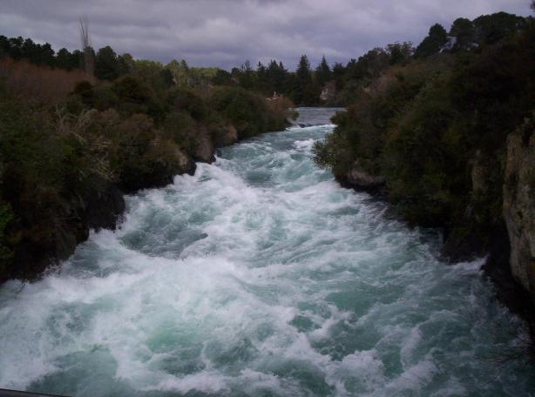
Approaching Jordan’s Bank
Notes:
Approaching Jordan’s Bank
Introduction
Our God has called us to salvation. Answering this call sets us apart from this world.
When we are set apart, we are expected to trust in Him, and live for Him every day.
This task is impossible without Him, but with Him it is a surety (cf. Matthew 19:23-30).
The path to heaven is described as difficult (cf. Matthew 7:13-14).
It is a life of work, and the rest is our reward, but we cannot stop working until we reach our destination – “Let us therefore be diligent to enter that rest, lest anyone fall according to the same example of disobedience” (Hebrews 4:11).
The example referred to is that of disobedient Israel →

Slide 3
Approaching Jordan’s Bank
Disobedient Israel
Hebrews 3:7-19
Notes:
Approaching Jordan’s Bank
Disobedient Israel
The warning given of failing to enter the rest is not given to discourage us, it is given to exhort us to continue to trust God, and live a faithful life accordingly.
Hebrews 3:7-19 – Israel were hardened by sin. They did not trust God fully – this showed by their disobedience.
This was not a one-time chance given by God. He was longsuffering with them, but the majority didn’t come around.
Part of Israel’s problem, and also a Christian who falls away, is losing confidence in God (v. 14-15). – This is manifested in disobedience.
10:19-22 – We must have boldness in Christ. We must have “full assurance of faith.”
Israel did not – look what happened! →

Slide 4
Approaching Jordan’s Bank
Disobedient Israel
Hebrews 3:7-19
Unconfident Israel
Exodus 14:10-16; Numbers 13:26-29, 31-33
Notes:
Unconfident Israel
Their lack of confidence in God showed several times:
In the Exodus – Exodus 14:10-16
They doubted God’s faithfulness to deliver them to from the Egyptians.
Moses reminded them of God’s ability, and faithfulness.
Instead of scrambling in life, we need to stand still and remember God’s promises, and appreciate them. This renews trust and confidence in times of adversity!
God said move forward!
There are times we must force ourselves to move forward, trusting in God’s faithfulness and ability to help us.
At Jordan’s banks #1 – Numbers 13:26-29, 31-33
The irony in the passage is overwhelming.
Before they had complained God had taken them out of an okay situation into a difficult one.
Now they see an incredible land God is offering them, and they refuse it!
Why? → They don’t trust Him that He can deliver!
We must recognize this life is temporary.
Many do, and seek something better in Christ.
But some grow weary on the way, and while approaching Jordan’s banks they fall short for lack of confidence in God!
We must have confidence in God to deliver us. If He promised, and we follow Him, He must deliver, and will!

Slide 5
Crossing the Jordan
Confident Israelites
Numbers 13:30; 14:6-9; Joshua 1:1-9
Notes:
We must have confidence in God to deliver us. If He promised, and we follow Him, He must deliver, and will!
Crossing the Jordan
Confident Israelites
Caleb and Joshua (confident spies) – Numbers 13:30; 14:6-9
Caleb and Joshua displayed a confidence in God’s faithfulness to deliver on His promises.
They did not see the difficulty in taking the land like the others did. Rather, they saw the immense blessings God WOULD give them if they followed Him.
Numbers 14:22-24 – Joshua and Caleb were the only ones allowed to cross the Jordan because of their faithfulness.
Joshua appointed leader – Joshua 1:1-9
If anyone had a situation so daunting it was cause for a lack of confidence it was Joshua.
Moses had died, and now he was the one to lead the Israelites into the land which the ancestors were afraid to enter. But Joshua had reason to be confident in God.
(v. 1-4) – God reminded Him of the fact that this was a promise, and He would deliver.
(v. 5-9) – On the condition of Joshua keeping the law, God reminded him that He is with him always.
Joshua was exhorted to be strong and courageous! God is with him, what is there to fear?
It is prudent for us to take God’s advice to Joshua and apply it to our lives. If these are considered we will have confidence in Him! →

Slide 6
Crossing the Jordan
Confident Israelites
Numbers 13:30; 14:6-9; Joshua 1:1-9
Confident Christians
Hebrews 6:13-18 (Promise); Romans 8:31-39 (Protection); 2 Timothy 3:16-17 (Provision)
Notes:
Confident Christians
He has promised – “Every place that the sole of your foot will tread upon I have given you, as I said to Moses” (Joshua 1:3). – Hebrews 6:13-18
God cannot lie. He promised salvation to those who love Him, and He will deliver!!
No man can stand against us – “No man shall be able to stand before you all the days of your life; as I was with Moses, so I will be with you. I will not leave you nor forsake you.” (Joshua 1:5). – Romans 8:31-39
The only one who can take us away from Christ is ourselves.
We will not fall short of the promise because God did not deliver!
Keeping God’s word will bless us (It is sufficient) – “This Book of the Law shall not depart from your mouth, but you shall meditate in it day and night, that you may observe to do according to all that is written in it. For then you will make your way prosperous, and then you will have good success.” (Joshua 1:8). – 2 Timothy 3:16-17
God’s word is sufficient for our walk through life.
It is not accurate to say we need something more in order to get to heaven. His word is sufficient!
Luke 16:27-31 – The rich man thought his brothers needed something more to lead them away from ungodliness to God. God said His word is enough.

Slide 7
Approaching Jordan’s Bank
Notes:
Conclusion
We are ever approaching Jordan’s banks. The promise is not far.
However, we must not grow discouraged, and lose confidence in our God!
1 Thessalonians 5:23-24 – He said He’d do it, and He will. We have to be confident in that – by obeying Him!

