Slide 2
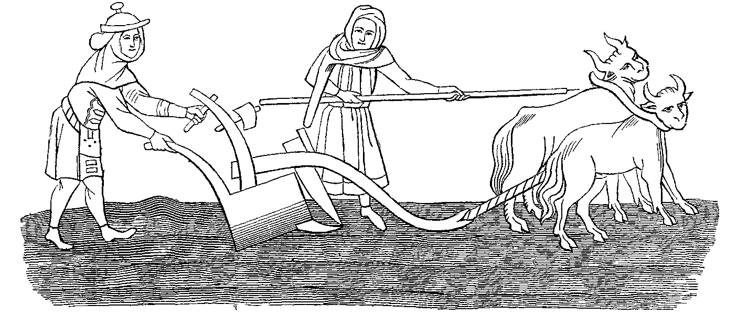
“It is hard for you to kick against the goads”
Acts 9:5
Notes:
Acts 9:5
Introduction
When Jesus appeared to Saul on the road to Damascus He described Paul as one who was kicking against the goads (cf. Acts 9:5).
This description speaks volumes about Saul’s life prior to obeying the Gospel.
We need to consider the phrase, “It is hard for you to kick against the goads” and make sure it is not what we are doing in our lives.

Slide 3
Kicking Against the Goads
Goad – A long wooden stick tipped with a sharp point sometimes of metal used to clean the plow tip and also to prod the plow animals if they slowed down.
It denotes “rebellion against lawful authority, and thus getting into greater difficulty by attempting to oppose the commands to duty.” This is the condition of every sinner. If people wish to be happy, they should cheerfully submit to the authority of God. They should not rebel against his dealings. They should not complain against their Creator. (Barnes Commentary)
Notes:
Kicking Against the Goads
Goad – A long wooden stick tipped with a sharp point sometimes of metal used to clean the plow tip and also to prod the plow animals if they slowed down.
Sharp enough to be used as a weapon – (Judges 3:31 – Shamgar killed 600 men with an ox goad)
Thus, sharp enough to cause pain and discomfort.
The expression “kick against the goads” paints the picture of an ox’s stubborn rebellion against his master’s direction.
The ox kicks against the prod and hurts no one but himself, and in the process accomplishing nothing but hardship for himself.
It is a metaphor used to express an obstinate rebellion against authority that proves vain in the end.
It denotes “rebellion against lawful authority, and thus getting into greater difficulty by attempting to oppose the commands to duty.” This is the condition of every sinner. If people wish to be happy, they should cheerfully submit to the authority of God. They should not rebel against his dealings. They should not complain against their Creator. (Barnes Commentary)
It is certain we see this in the nature of Christ’s authority. Submission to it proves beneficial, while rebellion is always futile and harmful. →

Slide 4
Christ’s Authority
“All authority has been given to Me in heaven and on earth”
– Matthew 28:18 –
All Authority
Matthew 28:18
Authority Not Abused
John 14:6; Matthew 11:25-30
Notes:
Christ’s Authority
All Authority
Matthew 28:18 – This authority eclipses all others.
His power extends not only to the borders of His kingdom, but everything in existence.
He reigns on the greatest throne of all – Hebrews 1:8
There is an argument with MDR that suggests the marriage law only applies to Christians. Thus, when unbelievers are in an adulterous marriage under such bounds of marriage, they actually aren’t. However, Jesus authority extends over them as well.
If this were not so there would be no sin (cf. 1 John 3:4; Romans 3:23).
It is foolish to rebel against Christ’s authority in an effort to live a more fulfilling life. Kicking against the goads makes life more difficult. True fulfillment is found in submitting to our designed purpose.
Authority not abused (He doesn’t reign as a tyrant.)
John 14:6 – He offers the way to the Father.
Being with the Father is supreme blessedness (cf. Revelation 7:13-17)!
Matthew 11:25-30 – His authority is a yoke of ease.
It is not meant to make our life more difficult, but to make our life easier.
Mankind was not created to be independent, but dependent upon a Guider in life.
Psalm 23 – A shepherd guides the sheep. He has authority and HE gives THEM direction. Following is not oppressive, but helpful.
To submit to Christ’s authority is to allow Him to supply us with rest, refreshment, healing, guidance, protection, purpose, and hope.

Slide 5
Saul’s Actions
Devout Jew
– Philippians 3:3-6; Acts 7:57-8:1 –
Headed to Persecute Christians
– Acts 9 –
Notes:
Saul’s Actions
Saul was a devote Jew – Philippians 3:3-6
He was zealous toward God and did what he thought was God’s will.
He wasn’t ignorant of the Gospel of Christ – Acts 7:57-8:1
Saul was there when Stephen preached the truth. He too wanted Stephen dead.
In his own words, he was blind to the truth for He had “a zeal for God, but not according to knowledge. For [he] being ignorant of God’s righteousness, and seeking to establish [his] own righteousness [did] not submit to the righteousness of God.” (Romans 10:2-3).
He was headed for Damascus to persecute Christians – Acts 9:1-2.
9:3-6 – When Saul saw Jesus’ bright countenance, before knowing specifically who He was, Saul recognized Him as one with authority – “who are you Lord” – supreme in authority.
When Jesus told Saul “It is hard for you to kick against the goads” he recognized what damage he had cause himself.
He was seeking to do what was right, and thus looking out for his own good, when in reality he was hurting himself the entire time.
He was denying, and persecuting the One who could fix all his problems!
9:7-9 – His actions speak of great remorse for the wrongs he had committed. Thus he recognized the dangerous position he was in, and what great need he had of forgiveness!
Saul no longer kicked against the goads… (cf. 9:17-20 – He was baptized for the remission of his sins and put on the light yoke of Christ. His life was never the same.)

Slide 6
Your Actions?
Life Isn’t Right
– 1 John 1:5-6; 2:15-17a –
God Offers Correction
– 1 John 1:7; 2:17b –
“It is hard for you to kick against the goads”
Notes:
What will you do?
God says your life is not right, and it is hurting you – 1 John 1:5-6; 2:15-17a
But with authority He gives you an exceptionally positive alternative – 1 John 1:7; 2:17b
The life of a Christian is contrary to the world’s standard of happiness and prosperity.
However, God defines happiness and prosperity. Thus, when you deny His plan for you as His creation you hurt yourself severely.
You will never reach fulfillment in your life without coming to Him, and letting Him guide your life.
Will you obey? – “It is HARD for you to kick against the goads” (Acts 9:5). “And now why are you waiting? Arise and be baptized, and wash away your sins, calling on the name of the Lord” (Acts 22:16).

