Slide 2
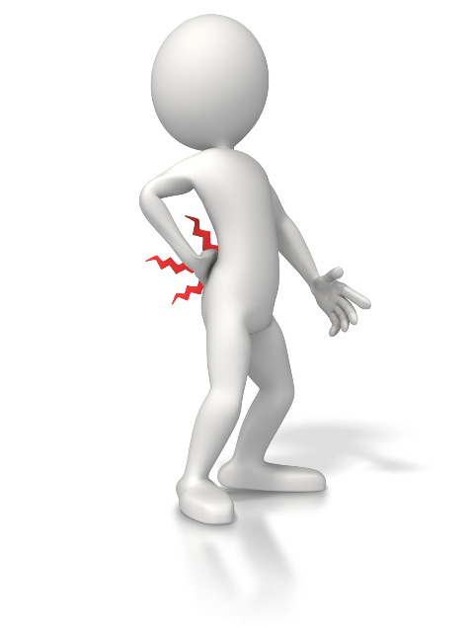
The Pain of Change or Regret
Which do you prefer?
Notes:
Introduction
Pleasing God requires a change of life.
This change is not always easy, and often brings some pain.
However, having not changed, when Christ comes again the pain of regret will be far worse, and last an eternity.
The change that must take place is sacrificial, and therefore will include some discomfort. But the pain of regretting to change is much worse.

Slide 3
The Pain of Change
Leaving Your Past Behind
Matthew 16:24-27; Philippians 2:5-8
Suffering Persecution From Past Company
1 Peter 4:1-4
Growing Pains
James 1:2-4; Hebrews 12:11; 2 Timothy 2:15
Change is Necessary
John 3:3-5; Romans 12:1-2
Notes:
The Pain of Change.
Leaving your past behind.
Matthew 16:24-27 – In order to follow Jesus we must change. That change is from pride to humility (cf. Matthew 5:3 – “Blessed are the poor in spirit, for theirs is the kingdom of heaven.”).
Taking up our cross denotes bearing up under a burden. It is something that seems shameful to the world, as it was with Jesus.
It is an action of self-denial in which we leave our own comfort and status quo to follow and serve Christ.
We live this life on earth for Christ, not ourselves. Whereas before, we lived for ourselves (cf. 2 Corinthians 5:14-15).
Our lives are forever indebted to Christ who died for us.
Philippians 2:5-8 – It is necessary to remember Christ went through the pain of change for us.
He left a perfect place full of righteousness to come to an imperfect place full of unrighteousness.
He left a form of glory to be found in the form of lowly man.
Suffering persecution from past company.
1 Peter 4:1-4 – Our past life in contrast with our new life will make people speak against us.
Notice: this can be painful, but it is cause for rejoicing! (cf. 4:12-13).
We must not concern ourselves with their unrighteous judgment (cf. 4:6).
It is folly to put your soul in jeopardy by worrying about what others think of. Follow God, and trust in His faithfulness!
Growing pains.
Leaving your past, and suffering persecution for doing so, are both part of growing.
James 1:2-4 – Growing is not always easy, or pleasant.
Trials and tribulation are an indispensable process of growth allowed and supplied by our God. It ultimately contributes to our well-being. →
Chastening from God leads to strength (cf. Hebrews 12:11).
The trials and tribulations experienced by the Hebrews Christians were growing pains as they lived for Christ.
In addition to building up endurance, we must grow in our knowledge of the word. This poses its own difficulties from time to time.
2 Timothy 2:15 – Growth in the word is necessary.
Rightly dividing the word of truth is something we have to exert energy and time toward. It doesn’t always come easy →
It isn’t always easy (cf. 2 Peter 3:15b-16).
Those things which are more intimidating, meatier, more difficult passages are still able to be understood.
We should not neglect ourselves the spiritual growth because of the growing pains included in rightly dividing the truth.
Change is necessary to get to heaven. (Even if it means experiencing pain or discomfort.)
John 3:3-5 – Being born again is a complete change. A new creation.
Romans 12:1-2 – We must transform (a type of change) ourselves by the word of God.
Our lives change from self-service to self-denial and sacrifice. The transformation to find out what is acceptable to God is continual.

Slide 4
The Pain of Regret
Separation From God and Christ
Revelation 1:4-7; 2 Thessalonians 1:7-10
Eternal Punishment in Hell
Revelation 20:11-15
Realization of Finalization and Eternity
Luke 16:19-31
Notes:
The Pain of Regret.
Seeing the glory of God and being separated from Him.
Revelation 1:4-7
When Christ comes, those who rejected Him will realize what they’ve done to Him, and themselves.
It is hard to imagine the regret and despair that will be prevalent on that awful day.
2 Thessalonians 1:7-10
That day will be wonderful for some, and terrible for others.
Imagine seeing Jesus in all His glory, and then being sent away from Him for eternity.
There is a sense of God in this world that people, even those who reject Him, enjoy (cf. Matthew 5:45 – “He makes His sun rise on the evil and on the good, and sends rain on the just and on the unjust.”)
Acts 17:26-28 – He is not far from each of us now, but if we squander the opportunity we won’t have another.
The final and absolute separation will be devastating.
Eternal punishment in hell.
Revelation 20:11-15
After being judged, and cast into the lake of fire, there will be eternal regret, knowing that the book by which you were judged was available while on earth (cf. John 12:48). (Recognizing you had the knowledge of what you should have done.)
Realization of finalization and eternity (Rich man and lazarus).
Luke 16:19-31
The rich man experienced the pain of regret. Yet, it was too late to change.
There is a consciousness in the hereafter. We will be aware. We will regret.

Slide 5
The Pain of Change or Regret
Regardless of the path we choose, pain will be experienced.
Do you want to experience the temporary pain of change, or the eternal pain of regret?
Notes:
Conclusion
Which pain would you rather experience?
If you endure the pain of change, and the hardships on the narrow way to heaven, it will be well worth it.
However, skipping out on the difficulty of change, and dedication to God will be regretted for eternity.

