Slide 2
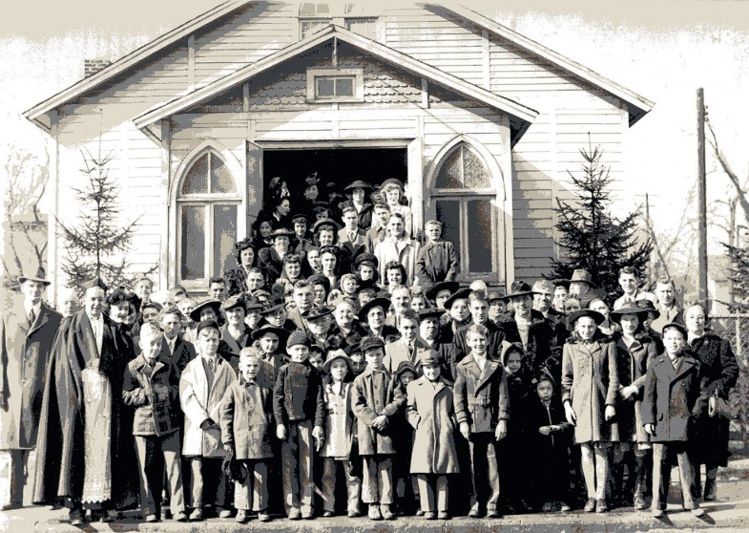
Identifying Oneself
Local Congregation
With A
Notes:
Introduction
Understanding and participating in the structural organization of the Lord’s church is pertinent to living as He desires we live. Because…
Salvation is only IN Christ – Acts 4:12 (Peter speaking to Sanhedrin)
Baptized INTO Christ – Galatians 3:26-27 (We [the many] are IN Christ →)
IN His ONE body – Romans 12:4-5 (Many members, one body)
His body is the CHURCH – Ephesians 1:22-23 (As head of the body, Christ has authority – He controls the body, commands what to do →)
His authority is absolute.
Given ALL authority – Matthew 28:18 (Great commission.)
Sits on a throne – Hebrews 1:8 (Better than angels.)
Promises Salvation to the obedient – Hebrews 5:9 (Initial obedience to the gospel. Then continued obedience in His kingdom. Note: Hebrews written to kingdom citizens!)
With His death, a new covenant was established – Hebrews 9:15
The annulment of the old covenant did not foment chaos. The liberty from that Law does not encourage lawlessness, but conformity to the new law – “not being without law toward God, but under law toward Christ” (1 Corinthians 9:21).
This is why Paul saw the need to write Timothy – 1 Timothy 3:14-15
Yet, in order to understand such instruction, and know how to carry it out, we must know the organization of the church.
Christ is head of the ONE church (Universal – all believers), but we will notice the church organization is not accumulative, but local, and autonomous.

Slide 3
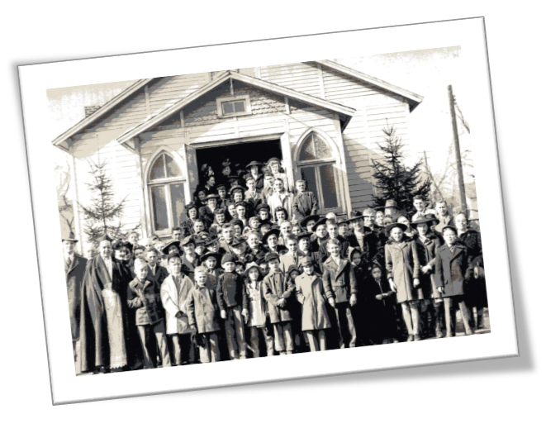
The Beginning of the Church
Added to the Church
– Acts 2:37-41, 47 –
Church Activity
– (v. 42-45) –
Notes:
The Beginning of the church.
Added to the church
The Lord does the adding to the church. It is only He that has the power to do so.
Acts 2:37-41, 47 – The Lord added to the church.
As noted before, baptism is the entrance into the kingdom.
“unless one is born of water and the Spirit, he cannot enter the kingdom of God” (John 3:5).
The Day of Pentecost marked the beginning of the church of Christ.
To this day, the same baptism adds to the same church. There is ONE – Ephesians 4:4-6.
Church Activity (on the local level – Christians in a certain area)
Acts 2:42-45 – The church began to participate together, fulfilling responsibilities to the Lord, and to each other.
Continued in apostle’s doctrine – edification; listening to preaching, and obeying it.
Fellowship – joint participation in spiritual things. Namely being members together of the one body.
Breaking of bread – Lord’s Supper.
Prayers – done together in this sense. “THEY continued”
Sharing/benevolence – provided for the needy saints.
Being a member of the Lord’s church requires adherence to such commands only carried out in a local assembly.
Some do not assemble at all, or only when they wish. This is obviously not acceptable, as many things required of a Christian are acted out in the assembly. (EX: Lord’s Supper)
“not forsaking the assembling of ourselves together, as is the manner of some” (Hebrews 10:25).
A Christian cannot be a Christian without assembling with other Christians in the Lord’s name.
Some wish to have no ties to any one local congregation, but float from place to place, or stay in one place, but never identify themselves as being a part of that congregation.
Is this acceptable?
If not, why not? – The affirmation of this lesson is that identifying oneself with a local group of Christians is necessary to fulfill obligations to the Lord.

Slide 4
Identifying Oneself with a Local Church
Saul and Jerusalem
– Acts 9:18, 26-30 –
Members of One Another
– Romans 12:4-8 –
Notes:
The Identifying of Oneself with a Local Congregation. (Local believers)
Saul and Jerusalem.
Acts 9:18 – Saul was baptized, thus added to the church.
What did Paul do? Did he independently live as a Christian, or did he seek to dwell with others?
Saul knew the importance of identifying himself with saints →
Acts 9:26 – Saul tried to join the disciples.
This was not an attempt to gradual recognition simply over an extended period of stay.
He verbally expressed his desire to be joined among the brethren in Jerusalem.
Acts 9:27-28 – Barnabas helped to clear the matter.
The result – Saul was accepted, as he was a disciple of Christ.
He was with them, “coming in and going out.”
Acts 1:21 – Signifying all the time Jesus was with them. He was their constant companion. (This was a qualification for being an apostle.)
The concept is that Saul was with the disciples in Jerusalem. He had joined them, and so he continued with them.
Members of one another.
Romans 12:4-5 – not only members of Christ’s body, but members of one another.
We, as part of His body, have a relational obligation to Jesus. We are in a relationship with Him, thus must fulfill our responsibilities in such a relationship.
One part of the body is a member of the body, thus a member of whoever else is a part of that body.
Not only do we have an obligation to Christ, but to any who are in Christ.
“there should be no schism in the body, but that the members should have the same care for one another. And if one member suffers, all the members suffer with it; or if one member is honored, all the members rejoice with it.” (1 Corinthians 12:25-26).
Romans 12:6-8 – serving one another with gifts. The members are in the presence of one another to receive, and give these benefits.
But how can one Christian fulfill relational obligations as such to one on another continent?
This introduces the organization of local congregations.
Those responsibilities are toward individuals with a locality. A local assembly.
In order to fulfill this responsibility, one has to be identified with a local group – THIS IS WHAT SAUL DID.

Slide 5
Identifying Oneself with a Local Church
Local Congregations
“To all who are in Rome, beloved of God, called to be saints” (Romans 1:7).
“To the church of God which is at Corinth” (1 Corinthians 1:2).
“To the churches of Galatia” (Galatians 1:2).
“To the saints who are in Ephesus” (Ephesians 1:1).
“To the church of the Thessalonians” (1 Thessalonians 1:1).
“To all the saints in Christ Jesus who are in Philippi, with the bishops and deacons” (Philippians 1:1).
– 1 Peter 5:1-5; Hebrews 13:7, 17 –
– Titus 1:5 –
Notes:
Local congregations.
To the church at:
“To all who are in Rome, beloved of God, called to be saints” (Romans 1:7).
“To the church of God which is at Corinth” (1 Corinthians 1:2).
“To the churches of Galatia” (Galatians 1:2 – more than one congregation).
“To the saints who are in Ephesus” (Ephesians 1:1).
“To the church of the Thessalonians” (1 Thessalonians 1:1).
“To all the saints in Christ Jesus who are in Philippi, with the bishops and deacons” (Philippians 1:1).
Bishops and deacons are offices within the organization of the LOCAL church.
1 Timothy 3:1, 8 – Part of Paul’s instruction to Timothy concerned that organization.
Under delegation of elders.
1 Peter 5:1-5 – Elders are to oversee the Christians who are AMONG THEM.
Likewise, Christians are to submit themselves to the elders in their midst.
Question: How does a Christian fulfill this responsibility without being identified with a local church?
The autonomous rule of the elders suggests they do not have authority over any who ARE NOT AMONG THEM.
Likewise, a Christian is not under such submission to elders of another congregation.
But this all rests on the understanding that an individual has identified themselves with a specific local group, and therefore is consistently “coming in and going out” among them. (How else could this be?)
Hebrews 13:7 – Elders are those who serve as an example.
Those who are subject must observe and follow their example.
This is not an indication of a single act, but a continuous living example there to constantly observe, and an individual there constantly observing.
Hebrews 13:17 – Obedience to elders is necessary. How can one obey without first submitting themselves to their rule?
Scripturally unorganized – No elders, because no qualified men.
Titus 1:5 – Churches in Crete were without elders.
Titus was to “set in order the things that are lacking.”
A church without elders is lacking. It is without fulfillment of intended organization.
However, it was not out of rebellion any more than the first congregation in Jerusalem being without elders.
Although no elders, still congregations.
Was there accountability?
A scripturally unorganized congregation (such as Elm Street) still has the fundamental order of authority to organize by.
“I want you to know that the head of every man is Christ, the head of woman is man, and the head of Christ is God” (1 Corinthians 11:3).
Work still must be carried out. Decisions have to be made. Accountability still exists. Thus, identifying oneself still applies.

Slide 6
Identifying Oneself
Local Congregation
With A
Notes:
Conclusion
In order to fulfill all responsibilities as a Christian one MUST identify themselves with a local group of Christians.
Assumption cannot be made by an extended period of stay. There must be acknowledgement on both ends. (E.g. Elders rule, members submit.) Otherwise:
There cannot be consistent exhortation without consistent assembly (cf. Hebrews 3:12-13).
There can be no accountability to assembly (cf. Hebrews 10:24-25 – Consider who? One another. Where? Where you’ve identified yourself, and with those in the same place.)
There can be no discipline (cf. 1 Corinthians 5; 2 Thessalonians 3:6-12 – Emphasize phrase, “AMONG YOU”).
Evidence for identifying oneself with a local congregation is abundant in scripture. It is the scriptural pattern. If one refuses, he is rebelling against God, and cannot fulfill his duties.

