Slide 1
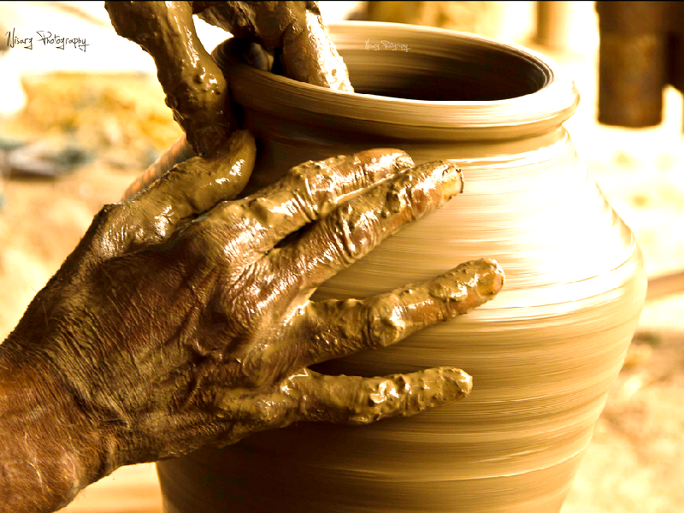
The Potter and the Clay
Jeremiah
18:6
Notes:
God sent Jeremiah to the house of a potter to learn a great lesson (Jeremiah 18:1-11) READ
Vessel disfigured, but remade again into a good vessel by the potter
God is the potter, Israel the clay. God can REMAKE Israel to His liking… (Verse 6)
Primary lesson, repent, and return to a nation acceptable to God…
This illustration has numerous beneficial applications to us today as disciples of our Lord.
Note: Lesson taken from Heath Roger’s book, Portraits of Discipleship (pages 25-28)

Slide 2
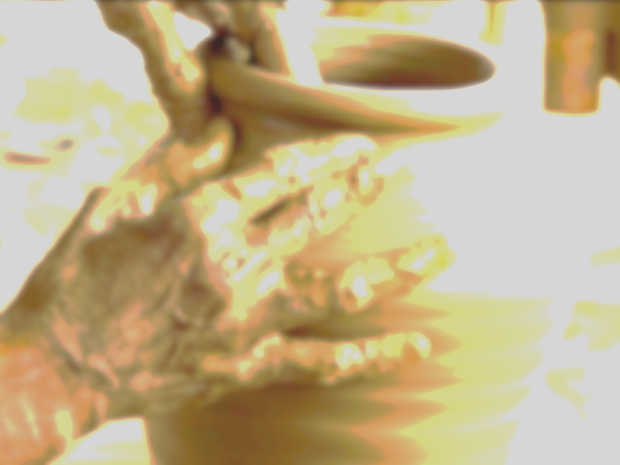
The Potter and the Clay
God is the Potter -
Disciples are the Clay
  Jeremiah 18:6; James 1:21
Notes:
(Jeremiah 18:6), “O house of Israel, can I not do with you as this potter?" says the Lord. "Look, as the clay is in the potter's hand, so are you in My hand, O house of Israel!”
God is in control, he has power over the clay.
We must remember God’s place (He has a design in mind for all of His creation, including us)
(Romans 9:19-24), READ
Note: This potter loves us, knows us, knows what is best for us, and has a plan for us!
We have no power over the potter, and as such, no reason or right to criticize!
A right relationship with God requires us making ourselves clay – be malleable
Have faith/humility/meekness/and a heart of obedience
(James 1:21), “Therefore lay aside all filthiness and overflow of wickedness, and receive with meekness the implanted word, which is able to save your souls.”

Slide 3
The Potter and the Clay
We are molded by the Lord’s teaching
  Romans 12:2; Galatians 4:19;
  Colossians 3:9-10
Notes:
(Romans 12:2), “And do not be conformed to this world, but be transformed by the renewing of your mind, that you may prove what is that good and acceptable and perfect will of God.”
We are not to be conformed to this world
Transformed – (metamorphous) a change of form. We are to change into the form of Christ!
(Galatians 4:19), [Paul, in expression of concern for them] “My little children, for whom I labor in birth again until Christ is formed in you”
Transformation comes through the renewing of mind. (This is true discipleship). Learning and changing.
(Colossians 3:9-10), “Do not lie to one another, since you have put off the old man with his deeds, 10 and have put on the new man who is renewed in knowledge according to the image of Him who created him”
Again, we emphasize that this transformation can occur only with our cooperation! We must humble ourselves to be malleable.

Slide 4
The Potter and the Clay
This molding is a process
  Philippians 3:12-16
Notes:
(Philippians 3:12-16), “Not that I have already attained, or am already perfected; but I press on, that I may lay hold of that for which Christ Jesus has also laid hold of me. ¹³ Brethren, I do not count myself to have apprehended; but one thing I do, forgetting those things which are behind and reaching forward to those things which are ahead, ¹⁴ I press toward the goal for the prize of the upward call of God in Christ Jesus.¹⁵ Therefore let us, as many as are mature, have this mind; and if in anything you think otherwise, God will reveal even this to you. ¹⁶ Nevertheless, to the degree that we have already attained, let us walk by the same rule, let us be of the same mind.”
It takes time for the clay to be worked, turned and molded into a vessel.
This reminds us of our need for God. We can’t become what God wants us to be unless we submit to His will.
This also reminds us of God’s patience with us. He cares for us, if we yield, He will make us what He wants us to be.
Much better than anything we could have become on our own!
(Jeremiah 10:23), “O Lord, I know the way of man is not in himself; It is not in man who walks to direct his own steps.”

Slide 5
The Potter and the Clay
This molding
has a purpose
  2 Timothy 2:20-21
Notes:
(2 Timothy 2:20-21), “But in a great house there are not only vessels of gold and silver, but also of wood and clay, some for honor and some for dishonor. 21 Therefore if anyone cleanses himself from the latter, he will be a vessel for honor, sanctified and useful for the Master, prepared for every good work.”
Our purpose is not to be merely ornamental
We are to be useful, prepared for WORK God has given us to do!
(Purpose of the equipping of the saints) cf. Ephesians 4:11-16

Slide 6
Conclusion
If we have sin in our lives, if our mind is not renewed, God will find us unprepared, uncooperative and unfit for His use.
If we serve God in holiness, readiness and obedience, we have fulfilled His purpose in molding us!
cf. John 15:5-8
Notes:
(John 15:5-8), “I am the vine, you are the branches. He who abides in Me, and I in him, bears much fruit; for without Me you can do nothing. ⁶ If anyone does not abide in Me, he is cast out as a branch and is withered; and they gather them and throw them into the fire, and they are burned. ⁷ If you abide in Me, and My words abide in you, you will ask what you desire, and it shall be done for you. ⁸ By this My Father is glorified, that you bear much fruit; so you will be My disciples.

