Slide 2
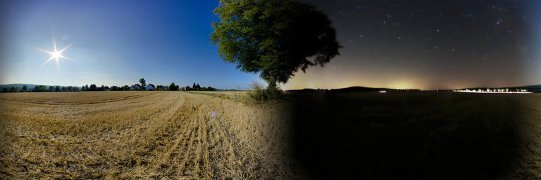
Work – For The Night Is Coming
Ecclesiastes 7:1-4; John 9:1-5
Notes:
Work – For The Night Is Coming
Ecclesiastes 7:1-4; John 9:1-5
Introduction
Death is the reality for every man – to every man there is a physical beginning, and a physical end.
Our physical bodies were not meant to last a long time.
Paul called his body a tent (cf. 2 Corinthians 5:1 – It is temporary.).
Because our life on earth is temporary, and death is a surety for all men, it is of great benefit to consider our present lives through the lens of death (cf. Ecclesiastes 7:1-4).
(v. 1 – Emphasis on those who have passed away) – If they have lived to make a good name for themselves, then death is a good thing.
(v. 2 – Emphasis on those reflecting on the life of one passed away) – Considers the brevity of own life, and provokes serious thought.
(v. 3 – Emphasis on reflection of current state in life) – When considering our own lives in this setting we realize the magnitude of our sin and are sorrowed – leads to repentance.
(v. 4 – Emphasis on those who consider the temporary nature of life) – Those who consider the temporal nature of life, and the fact that it determines our eternity, are wise. Fools live for the passing pleasures of this life.
“So teach us to number our days, that we may gain a heart of wisdom” (Psalm 90:12).
Our purpose in life is to get to work for God (cf. Ecclesiastes 12:13). Because life is so short, we must not waste any time!

Slide 3
Jesus Passing By – Opportunity and Time
The Mindset of Jesus
– John 9:1-5 –
Opportunity Must not be Wasted
– Ephesians 5:15-17; Galatians 6:10; James 4:17 –
Notes:
Jesus Passing By – Opportunity and Time
Jesus’ Mindset (cf. John 9:1-5).
8:59 – After angering the Jews, Jesus’ life was in danger.
He was not specifically looking for anything. He was escaping His enemies.
Opportunity presented itself, and Jesus was wise enough to take advantage. →
9:1-5 – Jesus did not waste time questioning, but took action.
(v. 2) – The disciples asked the wrong question – “Why is this man this way?”
(v. 3-5) – Jesus’ thought delved deeper – “What can be done?”
This was for the purpose of glorifying God.
V. 35-38 – This caused the blind man to see spiritually as well!
Jesus walked the earth with His mind open to opportunity. Any opportunity to further His Father’s will, He took advantage of. He was not here to waste time.
Opportunity must not be squandered.
Ephesians 5:15-17 – The Christian is to be vigilant regarding opportunity.
We must know what to look for – know God’s will.
We must redeem (buy up – utilize) the time, because the evil in the world seeks to destroy, or make few, our opportunities for good.
Galatians 6:10; James 4:17 – Opportunities are presented by God that we might take advantage of them.
When we have opportunity from God to do His will, it is sinful to neglect that opportunity.
This is the reason we are on earth →

Slide 4
We MUST Work…
Light of the World
– John 9:5; Matthew 5:14-16 –
Work is a MUST
– 2 Thessalonians 3:10-11; Ecclesiastes 9:10; Philippians 2:12-16 –
Notes:
We MUST Work…
We are the light.
John 9:5 – Jesus illuminated the world of darkness while He was here.
Every opportunity He had He used.
This is why He came (cf. John 1:1-5).
Matthew 5:14-16 – Jesus is light, thus also are His followers.
We are distinct from the world in our sanctification as His followers.
However, we are to be present in the world, as the light of the world.
This is commanded of us →
Work is a MUST.
2 Thessalonians 3:10-11 – Some among the Thessalonians were complacent, and not working. This is unacceptable.
Ecclesiastes 9:10 – The mindset of a Christian should be to keep busy with work, and do it to the best of our ability. (Life is not for leisure and play.)
Proverbs 6:6-11 – Consider the working ant! (Not to be lazy, but efficiently working.)
Colossians 3:22-24 – We are to work in all things as if we are doing it for and before God. He will judge the sluggish spirit.
Philippians 2:12-16 – We are to work as lights in the world, carrying about our Father’s business. (cf. Luke 2:49 – “Why did you seek Me? Did you not know that I must be about My Father’s business?”)

Slide 5
…While It Is DAY
We must take advantage of the day!
– John 9:4; 2 Corinthians 6:1-2; Ecclesiastes 11:9-12:1 –
Notes:
…While It Is Day.
Jesus recognized the urgency of time. He knew of the brevity of life, and the value of a second, minute, hour, day, etc. He was sure to take advantage of every second He had on earth to do His Father’s will.
We must take advantage of the day.
“Day” represents the present life, where “night” represents the end of life – death.
John 9:4 – “I must work the works of Him who sent Me while it is day; the night is coming when no one can work.”
We must do the works of God NOW. We must not delay to work righteousness. It is our duty.
2 Corinthians 6:1-2 – In order to work for God we must first become His. We are not to delay! Now is the day.
Ecclesiastes 11:9-12:1 – The youth tend to think they have time. They can enjoy youth now, and serve God later. Such thought is vain!

Slide 6
Work – For The Night Is Coming
Ecclesiastes 7:1-4; John 9:1-5
Notes:
Conclusion
It is important that we understand life is short.
Every day we wake up is an opportunity provided by our God.
Either to continue doing His will, and working righteousness.
Or to begin doing His will.
WORK – FOR THE NIGHT IS COMING!

