Slide 2
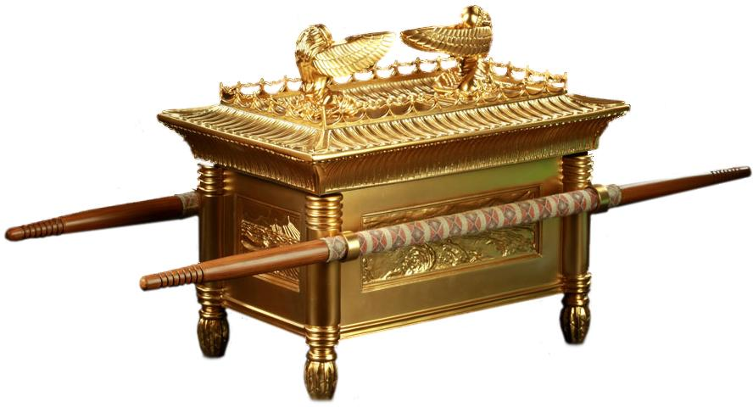
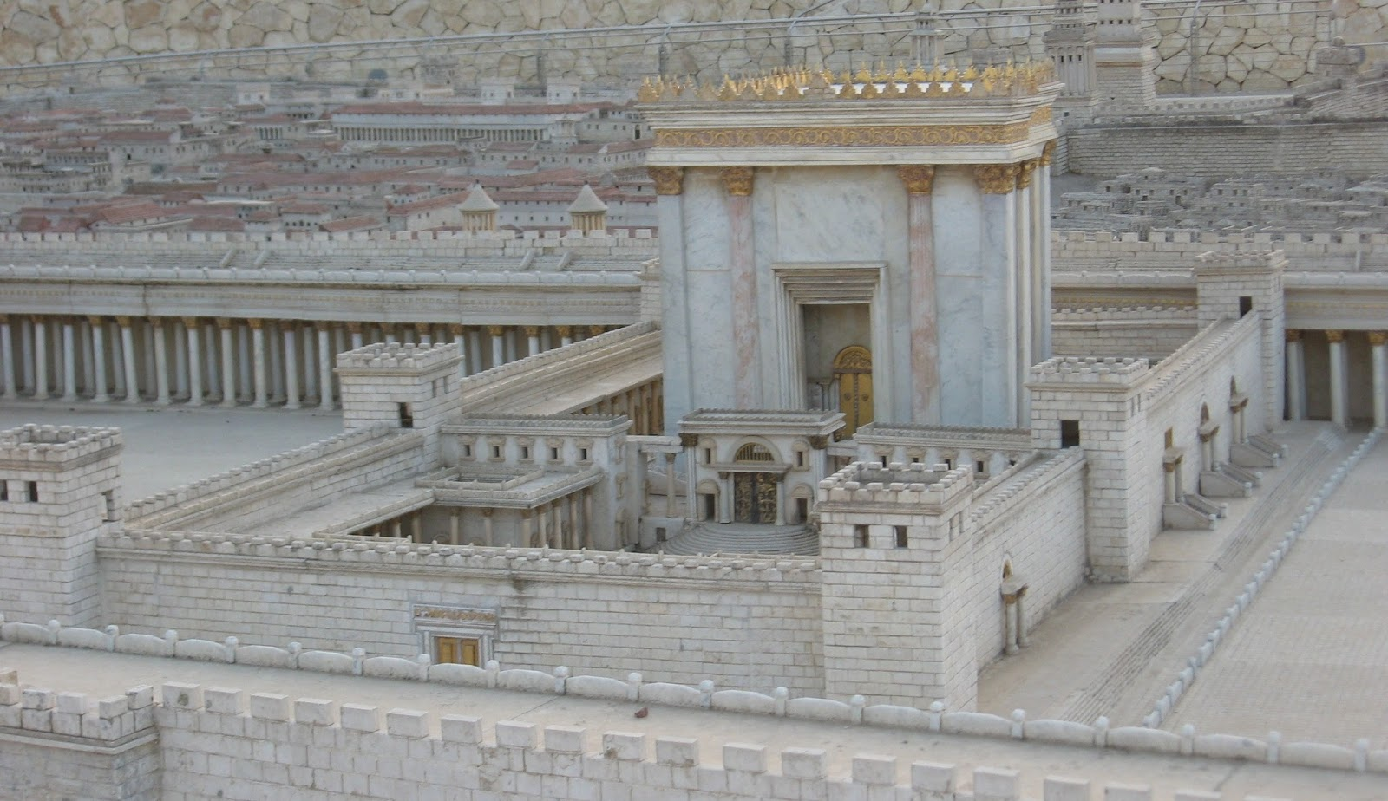
Remember Shiloh!
Jeremiah 7:1-15
Notes:
Remember Shiloh!
Jeremiah 7:1-15
Introduction
The word of the Lord came through the prophet Jeremiah warning the people of their conduct.
They were in danger because of their unrighteousness.
However, despite their unrighteousness, they had a false sense of security because of where they were.
We need not forget, God will punish all evil doers. We must learn from the mistakes of God’s people in the past – Remember Shiloh!

Slide 3
Jeremiah’s Message
Mouthpiece of God
– Jeremiah 1:9-10, 14-19 –
Notes:
Jeremiah’s Message
Setting
Israel (the northern kingdom) had been taken into Assyrian captivity.
Judah remained, but had fallen into a bad state of wickedness despite king Josiah’s attempt to restore true worship – after his death, evil continued its course in Judah.
Nebuchadnezzar – king of Babylon – defeated Assyria, and was making his way to Judah. (cf. Daniel 1:1-2 – God eventually gave Judah into his hand.)
The Lord used Jeremiah to warn the people →
Jeremiah’s duty.
Jeremiah 1:9-10, 14-19 – Jeremiah was to warn Judah of impending doom.
They needed to repent in order for God to hold back His judgments.
One warning God gave by the mouth of Jeremiah concerned a false sense of security the people had →

Slide 4
Jeremiah’s Message
Jeremiah 7
– Repent (v. 1-3) –
– False Trust (v. 4) –
– Conditional Protection (v. 5-7) –
– God Not Pleased (v. 8-10) –
– Remember Shiloh! (v. 11-15) –
Notes:
Jeremiah’s message. (Jeremiah 7:1-15).
Call to repentance (v. 1-3).
Their false trust in their close proximity to the temple (v. 4).
The temple was the dwelling place of God.
It was holy because God symbolically dwelled there.
God’s protection is conditional (v. 5-7).
Their sin needed to be repented of if they wished to be protected by God.
Even then, God was spiritual. His promises, protection, and provisions were conditional upon faithfulness.
God not pleased with their misplaced trust (v. 8-10).
The people practiced sin, even to the point of worshiping Baal.
They thought this was all okay because they would then go to the temple and perform the ceremonial acts of worship – but their worship was hypocritical.
The false prophets then told them they were okay – cf. Jeremiah 6:13-15
God’s warning – go to Shiloh! (Remember Shiloh!) (v. 11-15).

Slide 5
What happened at Shiloh?
Dwelling of Tabernacle
– Joshua 18:1; Judges 18:31; 1 Samuel 2:12, 17, 22, 29 –
Israel Defeated
– 1 Samuel 4:1-4, 10-11 –
Same Will Happen To Judah!
– Jeremiah 7:13-15 –
Notes:
What happened at Shiloh?
Dwelling place of the tabernacle (cf. Joshua 18:1).
Ark of the covenant was in the tabernacle – God spoke to the priests through the wings of the cherubim (cf. Exodus 25:22).
The people began to think they were invincible as long as the ark was with them.
Idolatry began – Judges 18:31
Priests were corrupt, and did not know God, but were serving – 1 Samuel 2:12, 17, 22
Eli did not remove his sons as priests even though they were corrupt – 1 Samuel 2:29
Israel was defeated by Philistines. Sent for ark because they thought it would help them win – 1 Samuel 4:1b-4
They were defeated because of their wicked ways, not because they did not have the ark with them.
The tide did not turn with the ark. They were defeated, and the corrupt priests died – 1 Samuel 4:10-11
God promised He would do the same to Judah – Jeremiah 7:13-15

Slide 6
Application
Security by association is false.
– Romans 11:19-23; Revelation 3:1-6 –
We Can Fall Short
– Hebrews 3:12-14; 2 Timothy 2:14-19 –
Notes:
Application
Christians must not feel secure simply by being members of the church.
Romans 11:19-23 – Unfaithful Jews cut off, believing Gentiles added.
The Jews who rejected God were the natural branches – original people of God.
They were cut off because of their rejection of the Christ.
The Gentiles were grafted in.
However, the Gentiles were not secure simply because they accepted the Christ, and obeyed the Gospel. – They needed to remain faithful!
Revelation 3:1-6 – Church in Sardis.
They were members of the Lord’s body, but their works weren’t perfect.
Unless they repented, and grew, God would not accept them.
Only those who were faithful in that local church would be saved (v. 4).
We can lose our salvation to unfaithfulness.
Hebrews 3:12-14 – We must be steadfast!
2 Timothy 2:14-19 – Those who spread false doctrine, follow false doctrine, and do not depart from iniquity will not be saved.
There are hypocrites in the church. Men who live double lives.
Just because they remain in the church does not mean they are secure.
God knows who is faithful, and only those will be saved in the end.

Slide 7
Remember Shiloh!
Jeremiah 7:1-15
Notes:
Conclusion
We would do well to heed the words of the prophet Jeremiah.
If we do not repent of our sins, and remain faithful to the Lord, we will not be saved.
We cannot expect to make it to heaven simply by means of association.
We must live righteous lives ourselves – “work out your own salvation with fear and trembling” (Philippians 2:12).

