Slide 2
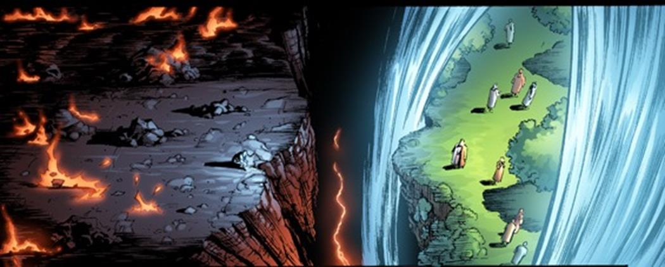
Lessons from the Rich Man
Luke 16:19-31
Notes:
Lessons from the Rich Man
Luke 16:19-31
Introduction
Much can be learned from the story of the rich man and Lazarus (cf. Luke 16:19-31).
Parable or true story?
It is not introduced like most parables (cf. 15:3).
No parable (except this one if it is indeed a parable) gives specific personal names. (Lazarus)
Some suggest it is a parable, but others suggest it is a true story. (Not necessary to be dogmatic either way.)
Whether a true story, or a parable makes no difference. Both teach true principles, and unveil truths concerning life, and God’s will.
While Lazarus is included in the story, the focus is on the rich man. There are things in this story which must be heard and considered! →
Riches Can’t Save You (v. 19, 22b-23 – He was an extremely rich man.)

Slide 3
Lessons from the Rich Man
Riches Can’t Save You
– James 1:9-11; 1 Timothy 6:6-19 –
Family Can’t Save You
– Ezekiel 18:19-20; Matthew 10:34-37 –
Death Solidifies State Before God
– Galatians 6:7-8; Matthew 6:19-21; 2 Corinthians 5:9-10 –
The Dead Desire to Warn
– 1 Corinthians 1:22-25; Romans 1:16 –
Notes:
Riches Can’t Save You (v. 19, 22b-23 – He was an extremely rich man.)
Can’t keep you alive. (physically)
James 1:9-11 – The rich will pass away. This could even occur during his pursuit of riches – they do not keep you alive.
“For as in Adam all die” (1 Corinthians 15:22).
“it is appointed for men to die once, but after this the judgment” (Hebrews 9:27).
No man can escape death ultimately. Not even the rich.
Though man may try, they will never be able to escape death, for it is “appointed for men.”
Can’t save your soul.
1 Timothy 6:6-10
(v. 7) – any benefit we might receive from riches in this life does not exist beyond the grave.
(v. 9-10) – if anything, riches make it more difficult to enter heaven.
6:17-19 – the only way the rich can get to heaven is if their true riches are in heaven.
We may not consider ourselves rich, but compared to others we certainly are. We must not let our physical blessings be twisted into devices of Satan leading to our destruction.
Family Can’t Save You (v. 27-28 – He had family. Likely large – five brothers. Likely big funeral with big family. Those relationships meant nothing when it came to his personal salvation.)
Self-Responsibility
Ezekiel 18:19-20 – Parents can’t obey God for you. Neither can any member of your family.
(v. 22b – “and was buried”) No matter what your family says about you at the funeral, it cannot change the facts of your life. (The opinion of the family does not determine truth.)
God above Family
Matthew 10:34-37 – We must not choose family over Jesus.
Some allow their relationships to negatively affect their relationship with God. This should not be so.
It is likely that the rich man could have been considered by some to be a good ole’ family man – that cannot save you.
Death Solidifies State Before God (v. 24-26 – He was lost while living, and when he died. Therefore, lost in death. NO SECOND CHANCE.)
We Reap What We Sow
Galatians 6:7-8 – if currently sowing flesh when you die, you will reap corruption.
“remember that in your lifetime you receive your good things” (v. 25).
The things he enjoyed weren’t inherently sinful, but that was his mindset – fleshly.
Matthew 6:19-21 – currently laying up heavenly treasure? Or earthly?
It can be said that, wherever your heart is when you die is what you will receive, or reap.
If our heart is truly in heaven, when we die, we will have the hope of heaven.
Death is Final
The rich man could not make things right after death. He was eternally LOST, because he died in a LOST state.
2 Corinthians 5:9-10 – judged by deeds done in the body – if the body is dead, time is up.
The Dead Desire to Warn (Gospel is sufficient) (v. 27-31 – His condition was so terrible he wished to warn his family. The scriptures were there for him, and are there for his brothers.)
The rich man realized (after it was too late) that his riches weren’t worth the torment he would be experiencing for eternity.
We must realize this now, before it is too late to change.
Some hesitate to obey the gospel because they know their passed family members did not do what was necessary. THEY ARE DESIRING TO WARN YOU ABOUT THE TORMENT! BUT THEY CAN’T.
The Gospel is Sufficient
1 Corinthians 1:22-25 – some want something special, not understanding how special the gospel is.
POWER OF GOD unto salvation – Romans 1:16

Slide 4
Lessons from the Rich Man
Luke 16:19-31
Notes:
Conclusion
The story of the rich man is recorded for us to learn!
Do not neglect the warning of this story in scripture!
Will you obey the gospel, and continue to live for God? Or will you live for this life, and be tormented for eternity?

