Slide 2
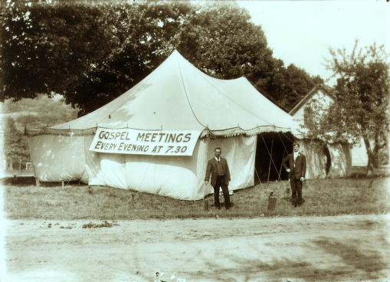
The Relevancy
of Gospel Meetings
Notes:
The Relevancy of Gospel Meetings
Introduction
Gospel meetings have been taking place within the church across the nation for years.
Protracted Meetings – continued over a period of time.
Evangelistic Meetings – designated for evangelism. Reaching denominational people, and those that were not members of the church.
Tent Meetings – Back in the day they often times met in tents in rural areas. (Picture in PPT)
GOSPEL MEETINGS – Scheduled extended period of time dedicated to the preaching of the gospel in a given area.
During the gospel meetings years ago, many souls were converted during each meeting.
Held for a couple of weeks. Some maybe even for a month.
Produced some debates between brethren and members of the denominations.
Now, gospel meetings are shorter (perhaps because of the change in culture, and therefore, a more secular and fast paced society) and less frequent.
Some do not see the purpose in holding gospel meetings.
Are gospel meetings relevant today? (Many would not deny they were 50-60+ years ago.)
Gospel meetings are still relevant, and we must be faithful in attending, and thus supporting, our own meetings in this local congregation. (It is also good, and needed, to attend other congregations’ gospel efforts.)
How are gospel meetings still relevant?
The Relevancy of Gospel Meetings
Biblical Pattern

Slide 3
The Relevancy of Gospel Meetings
Biblical Pattern
– Acts 2:46-47; 14:27; 15:4 –
Preaching Saves
– Ezekiel 37:1-14; 1 Corinthians 1:18, 21; Romans 10:14-15; Ezekiel 3:7-9; 2 Peter 2:5 –
Notes:
The Relevancy of Gospel Meetings
Biblical Pattern
Gospel meetings are not only a matter of human tradition. There is certainly a traditional component within modern times, as there was in the past. However, more importantly, there is a Biblical precedent for gospel meetings.
Acts 2:42, 46-47 – In the infancy of the church they gathered daily to hear God’s word.
Those added to the church continued in the “apostles’ doctrine.” (THE TRUTH WAS NEEDED!)
The temple grounds were expedient for the large group of Christians to meet at the time to worship God, and hear the preaching of the word.
(v. 47b) – In addition to the “about three thousand souls” (v. 41) on the day of Pentecost, more were continually added as a result of these gospel meetings.
Acts 14:27 – Paul and Barnabas gathered the church to give a report concerning their preaching to the Gentiles. (“Stayed there a long time with the disciples” – what were they doing? Laboring in the gospel.)
Acts 15:4 – After hearing of Judaizing teachers at Antioch, they (Paul and Barnabas) went to Jerusalem to teach the truth concerning the matter of Gentile converts. (Did not have to keep the OT.)
Really, any time in the NT when men gathered to hear the gospel it could be called a “Gospel Meeting.” (Many of which were for extended periods of time.)
Preaching Saves
Ezekiel 37:1-14 – A vision concerning the restoration of the remnant of Israel.
Israel is in captivity. They are without hope.
They are dead. (Dry bones.)
God restores life through the preaching of the word (prophecy – inspired preaching).
Dry bones – dead spiritually; hopeless; what can help? What can work?
Preaching of the word of God – gives life!
Same today. We may feel gospel meetings are not affective. Less people are interested, but falling upon an honest heart, God’s word has the power to give life!
We should be eager and willing to take advantage of such opportunities to save souls!
1 Corinthians 1:18, 21 – foolishness of message preached saves!
Romans 10:14-15 – How shall they hear without a preacher?
Gospel meetings serve as an opportunity for lost souls to hear the preaching of the message.
How shall they hear without a preacher? So we send for preachers, and have preachers sent!
What if they don’t want to hear it? (Like most in the world today. Sadly, like some brethren – rather not use free time to hear preaching, or just don’t like the message.)
Ezekiel 3:7-9 – God knew they wouldn’t hear.
2 Peter 2:5 – People didn’t listen to Noah.
Our job is to proclaim the Gospel of Jesus Christ. It needs to be heard, especially by those who don’t want to hear!
Contending for the Faith

Slide 4
The Relevancy of Gospel Meetings
Contending for the Faith
– Jude 3; Galatians 2:1-5 –
Sustaining the Brethren
– Acts 20:25-28; 2 Peter 1:8-15 –
Notes:
Contending for the Faith
Jude 3 – We must defend the truth against false teaching!
“the house of God, which is the church of the living God, [is] the pillar and ground of the truth” (1 Timothy 3:15).
Galatians 2:1-5 – Paul did not yield submission to false teachers. He confronted false doctrine! (Likely reference to same Jerusalem council in Acts 15).
Sustaining the Brethren
Acts 20:25-28 – Paul to the Ephesian elders.
With them for 3 years (v. 31).
Preached the gospel continually to them.
Left nothing out. (Whole council.)
Warning against false teachers (v. 29-31).
“blood of all men” at stake! (SPIRITUAL LIFE)
We need God’s word continually! NEVER CAN GET ENOUGH!
2 Peter 1:8-15 – Peter wished to remind the brethren.
(v. 8-11) – If you add to your faith (grow in the gospel – take on Divine nature) you will gain entrance into heaven.
(v. 12-15) – We need reminders of things we already have heard! (EVERYONE DOES!)
Have you heard this before? Most have! YOU NEED TO HEAR IT AGAIN!
You need to be at our upcoming gospel meeting, and you need to invite others to come with you!

Slide 5
The Relevancy
of Gospel Meetings
Make sure you are here for ours!
November 13-18
Notes:
You need to be at our upcoming gospel meeting, and you need to invite others to come with you!
Conclusion
Are Gospel Meetings relevant? They are as relevant now as they ever have been, and they will continue to be relevant until Jesus comes again!
You have the responsibility to attend the upcoming Gospel Meeting.
We must seek and save the lost! INVITE SOMEONE!
Perhaps most importantly, YOU NEED TO HEAR THE PREACHING OF THE GOSPEL!

