Slide 2
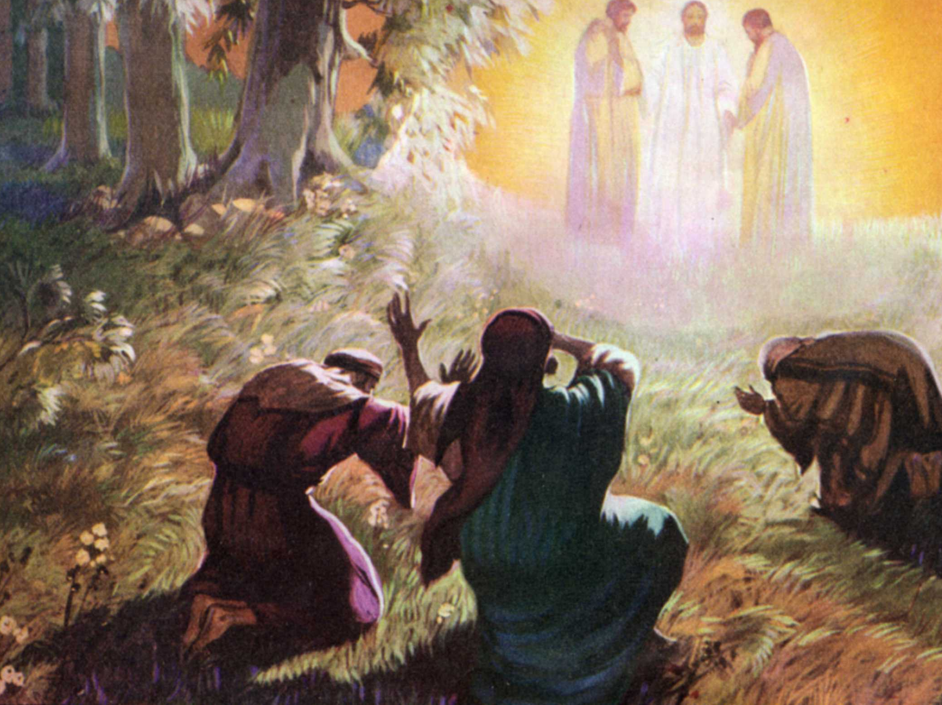
The Transfiguration of Jesus
Matthew 17:1-9
Notes:
The Transfiguration of Jesus
Matthew 17:1-9; Mark 9:2-8; Luke 9:28-36
Introduction
Matthew 17 records an incredible event in the life of Jesus of which 3 of His disciples were witnesses.
(v. 1) – Jesus took Peter, James, and John. (cf. 2 Peter 1:16-18 – “we…were eyewitnesses of His majesty…when we were with Him on the holy mountain.”)
(v. 2) – transfigured – metamorphoō – transform; change into another form. (face like sun, clothes white as light)
“His clothes became shining, exceedingly white, like snow, such as no launderer on earth can whiten them” (Mark 9:3).
“the appearance of his face was altered, and His robe became white and glistening” (Luke 9:29).
Compare to – “He has no form or comeliness; and when we see Him, there is no beauty that we should desire Him” (Isaiah 53:3).
The form Jesus took on the mount was the form of Divine Glory – “eyewitnesses of His majesty” – 2 Peter 1:16).
(v. 3) – appearance of Moses and Elijah.
They were talking →
“Spoke of His decease which He was about to accomplish at Jerusalem” (Luke 9:31).
(v. 4) – Peter’s impetuous suggestion. (Tried to honor God, but suggested something God did not desire.)
“he did not know what to say, for they were greatly afraid” (Mark 9:6 – spoke without reason because afraid. Instead of standing quiet and still.).
“not knowing what he said” (Luke 9:33 – Did not understand the implications of his suggestion.).
He might have simply thought this would honor Jesus with the other two.
However, this would honor the other two, while putting Jesus on an even plane as them, thus, dishonoring Jesus. (For He is greater! →)
(v. 5-9) – God’s voice came from the cloud and said to hear His Son, Jesus.
This represents the ascendency of Jesus over Elijah and Moses.
The disciples are to hear Jesus, not Elijah or Moses.
What was the significance of this incredible event? →
Six Days Earlier (cf. 17:1)

Slide 3
Six Days Earlier
Pharisees and Sadducees Seek Signs (16:1-4)
Peter’s Confession (16:13-20)
Peter’s Rebuke (16:21-23)
Jesus’ Call (16:24-28)
Notes:
Six Days Earlier (cf. 17:1)
Pharisees and Sadducees Seek Signs (16:1-4)
(v. 1) – wanted a sign from heaven to prove His Divine identity as the Christ, the Son of God.
They asked this “testing Him.” (Tempting Jesus)
No sign, which would be in addition to many proofs already provided, would convince them. →
(v. 2-3) – Jesus showed the folly, and hypocrisy in their request.
They looked at the “signs” of the sky to determine the forecast.
Yet, when they see Jesus, hear His teaching, and see His miracles performed, they still fail to realize His identity!
(v. 4) – They are wicked, and adulterous!
Their failure to recognize Jesus is not for lack of sign, and evidence.
They love their traditions, and ways of life more than God’s revelation.
(v. 4b) – The only “sign from heaven” that He would give to confirm His identity was that of Jonah.
(cf. 12:38-40) – spoke before concerning the same thing – death, burial, resurrection.
“declared to be the Son of God with power according to the Spirit of holiness, by the resurrection from the dead” (Romans 1:4 – identity confirmed by this sign).
Jesus would die, be buried, but have victory over death in the resurrection – this would once and for all declare His identity.
Peter’s Confession (16:13-20)
(v. 13-16) – Peter declared what all the prophecies, signs, and teachings pointed to.
Jesus was no simple man.
Jesus was the Christ who was prophesied about, the Son of God.
(v. 17-20) – The truth of Jesus’ identity is the foundation on which His kingdom is built.
(v. 18) – “Hades,” or the grave, would not prevail against the kingdom. (Power/victory over death) (Hades – unseen; place of departed spirits; grave)
(v. 19) – Authority in heaven, where Jesus will be following His resurrection.
Peter’s Rebuke (16:21-23)
(v. 21) – Jesus spoke of the horrors He would go through at the hands of the Jewish leaders, but also of His resurrection.
(v. 22-23) – Peter failed to see the necessity of such, and thought he was doing a good thing by saying Jesus would not have to suffer such.
(v. 23) – Jesus understood this to be a ploy of Satan on His way to the cross.
Peter needed to understand his place, and the necessity of Jesus’ death.
Jesus’ Call (16:24-28)
(v. 24-26) – Jesus, already noting His suffering, reveals the necessity of the suffering of His disciples.
(v. 27) – If His disciples wish to gain reward, they must suffer for Jesus’ sake.
The end of suffering for Jesus is reward.
Just as Jesus would overcome, so will His disciples if they are willing to suffer.
(v. 28) – There were those there who would see such victory in the coming of the kingdom.
Lessons from the Transfiguration (cf. 17:1-9)

Slide 4
Lessons from the Transfiguration
Victory of Jesus
– 17:1-3; 16:27; Colossians 3:4; 1 John 3:2 –
Authority of Jesus
– 16:22-23; 17:4-6; 28:18 –
Notes:
Lessons from the Transfiguration (cf. 17:1-9)
Victory of Jesus
(v. 1-3) – transfiguration that shone Jesus majesty and glory – His divinity.
(v. 3) – He spoke with “Moses and Elijah.”
Moses – lawgiver.
Elijah – prominent prophet (Victory on Mount Carmel over prophets of Baal – 1 Kings 18)
Law and Prophets spoke of the Messiah, and His suffering, death, and even resurrection. (Through prophecy, types, and shadows.)
“Spoke of His decease which He was about to accomplish at Jerusalem” (Luke 9:31).
Not just of the decease, but of the resurrection!
Jesus’ was transfigured – glorious state assumed after resurrection and ascension – stark contrast against scene of the cross.
(cf. 16:27) – if we take up our cross – willingness to suffer by following Christ – we will be rewarded in the end.
“When Christ who is our life appears, then you also will appear with Him in glory” (Colossians 3:4).
“Beloved, now we are children of God; and it has not yet been revealed what we shall be, but we know that when He is revealed, we shall be like Him, for we shall see Him as He is” (1 John 3:2).
In the transfiguration is the victory of Jesus despite His death – WITH THE VICTORY OF JESUS THERE IS VICTORY IN JESUS!
Yet, we must follow HIM! →
Authority of Jesus
(cf. 16:22-23) – Peter failed to realize this was Jesus’ necessary duty.
Peter may have had an honorable attitude in a way, but in reality it was opposition to Jesus!
He needed to fall in line with God’s will!
(17:4-6) – Peter’s proposal, and God’s decree.
(v. 4) – Once again, Peter seems to have an honorable attitude, but it is all reality in opposition to God’s will.
(v. 5) – HEAR HIM! – Jesus authority is ascendant to that of the Law and Prophets.
“Moses and Elijah…appeared in glory” (Luke 9:30-31).
Luke also records that after the voice said, “Hear Him!”, “Jesus was found alone” (Luke 9:36).
There was a place, glory, and authority for the Law and the Prophets, but that pales in comparison to that of Christ!
The reason for Peter’s rebuke of Jesus after He discussed His suffering in chapter 16 was his unwillingness to submit to Jesus’ teaching concerning the suffering and death of the Messiah.
If they wanted the reward, victory, glory, they would need to hear HIM and follow HIM!
So it is today – “All authority has been given to Me in heaven and on earth” (Matthew 28:18).

Slide 5
The Transfiguration of Jesus
Matthew 17:1-9
Notes:
Conclusion
The transfiguration of Jesus in Matthew 17 is wonderful to behold.
Many things can be learned from this account.
Jesus was going to be victorious over the death He had to die.
He has all authority, and we are to “Hear Him” if we wish to be rewarded, and gain victory as well.

