Slide 2
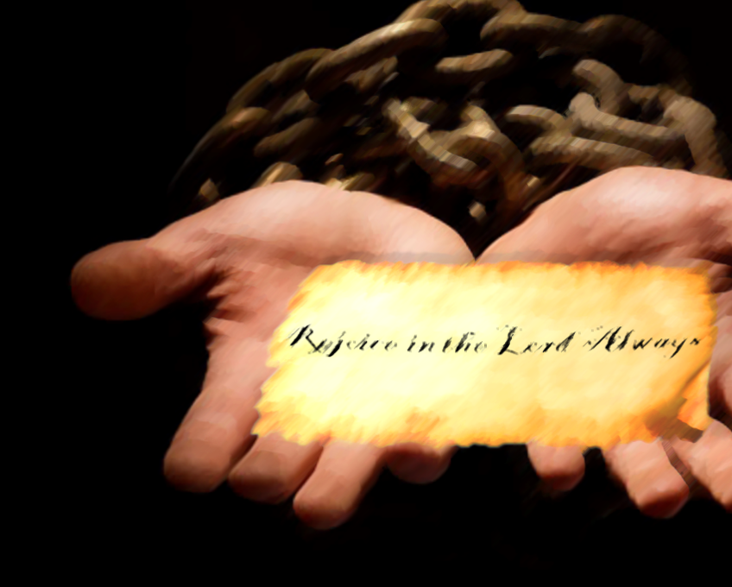
Rejoice in the Lord Always
Philippians 4:4
Notes:
Rejoice in the Lord Always
Philippians 4:4
Introduction
“Rejoice in the Lord always. Again I will say, rejoice” (Philippians 4:4).
This is a command given by inspired Paul.
Joy is supposed to be characteristic of a Christian.
Christians are not a people overwhelmed by mundanity, and sorrow. They are quite the opposite.
Our lives need to illustrate this point. We must always be rejoicing as Christians, no matter the circumstance.
How can we always rejoice?

Slide 3
How can we always rejoice?
Joyless Circumstances
– Romans 12:15; 1 Corinthians 12:26 –
The Constant Cause – the Lord
– Acts 16:20-25; Philippians 3:1, 7-14 –
Notes:
How can we always rejoice?
Joyless Circumstances
“Rejoice with those who rejoice, and weep with those who weep” (Romans 12:15).
“And if one member suffers, all the members suffer with it; or if one member is honored, all the members rejoice with it” (1 Corinthians 12:26).
There are circumstances which do not give cause for joy.
Paul’s command in Philippians 4:4 is not something which depends on physical circumstances, or else it would not be possible to fulfill.
“my chains” (Philippians 1:13, 14).
The apostle Paul wrote this epistle to the Philippians while in prison – most likely in Rome.
The epistle has a positive and joyous tone despite Paul’s literal “chains.”
How, and why was this so? →
The Constant Cause – “in the Lord”
In order for rejoicing to “always” be an option, there must “always” be something to rejoice about – a constant.
This must be something which is independent of all outward circumstances. Something which cannot be changed, and does not rise and fall with the occurrences of life.
“in the Lord” – The Lord is the cause, and object of our rejoicing.
“in the Lord” – the area of rejoicing.
If we know the Lord – who He is, what He has done – there is cause to rejoice.
If we are “in the Lord,” i.e. in the relationship with Him which He offers, there is always cause to rejoice.
Acts 16:20-25 – Paul and Silas put into prison in Philippi after casting a “spirit of divination” out of a girl.
Used by her masters to make a profit.
They were mad, and had them thrown into prison.
(v. 22-23) – the were beaten.
(v. 24) – thrown into prison.
(v. 25) – Yet, they were singing and praying. Why?
The One to whom their songs were addressed can answer the question – “to God.”
They were “making melody in [their] heart to the Lord” (Ephesians 5:19 – They had a constant to be thankful for, and to rejoice in.).
Philippians 3:1, 7-14 – Paul could always rejoice, because he followed Christ, and Christ gave him hope.
(v. 7-11) – True joy was in Christ, so he gave up all things for Him.
This not only included his gain as a Hebrew, but sin, and even his own comfort as he conformed to Christ’s death.
(v. 10-11) – power of resurrection in being freed from sin, thus given hope of salvation.
(v. 12-14) – He could rejoice always because of that which was in his future.
(v. 20-21) – By being conformed to Christ’s death in baptism, and continued faith, he had a hope of heaven.
(v. 21) – transformation of “lowly body” – transient, fragile – to “glorious body” – everlasting, wonderful.
(4:11b-13) – Because of Christ – the constant cause for joy in Paul’s life – he was capable of constant contentment – in bad and good.
Thus, he rejoiced, and calls all Christians to do the same!
Things in Which We Should Rejoice

Slide 4
Things in Which We Should Rejoice
Maintaining Joy
– Philippians 4:8-9 –
Worthy of Rejoicing
Gospel Success – Philippians 1:12-18
Fellowship in the Gospel – Philippians 1:3-5; 4:10, 14-17
Notes:
Things in Which We Should Rejoice
Maintaining Joy
In order to fulfill the command to always rejoice, we must dwell on things, and see the value in things, which are connected with “the Lord” and His cause.
Philippians 4:8-9 – When we fill our minds with these things we cannot help but to be joyous people. In doing so the Lord is present with us.
The apostle Paul made mention of some things which were worthy of rejoicing over in his epistle to the Philippians →
Worthy of Rejoicing (In Philippians)
Gospel Success – 1:12-18
(v. 13) – The reason for his imprisonment (faith in Christ) was made known to men in Rome (guards, and all the rest).
This would show them the validity of Paul’s faith, and therefore the legitimacy.
It would cause questions to be asked, and opportunity for the gospel message to be preached.
(v. 14) – Paul’s great example of faith emboldened other Christians to preach as well.
(v. 15-18) – Despite the attempt for some to cause Paul harm, he still rejoiced because the message of salvation was preached.
Fellowship in the Gospel – 1:3-5
The Philippians shared with Paul in the gospel from the beginning of the church when Christ was first preached there, all the way up to the point of his writing the Philippian letter. THIS WAS CAUSE FOR THANKSGIVING, AND GAVE HIM GREAT JOY.
4:10 – Part of this fellowship was their financial aid given to him in the gospel.
He rejoiced in that they cared for him.
(v. 14-17) – He rejoiced further in the good it would be for them as Christians. (In caring for Paul, they laid up heavenly treasures – it pleased the Lord. V. 18)
4:1 – The Philippians were a joy to Paul as they stood firm in the faith. He wanted nothing more than to see them dwell in the Lord, and therefore get to heaven.

Slide 5
Rejoice in the Lord Always
Philippians 4:4
Notes:
Conclusion
“Rejoice in the Lord always. Again I will say, rejoice” (Philippians 4:4)!
In the Lord, there is always a cause for rejoicing.
We must be a joyous people as Christians.
We must seek out things worthy of rejoicing, and take joy in them.

