Slide 2
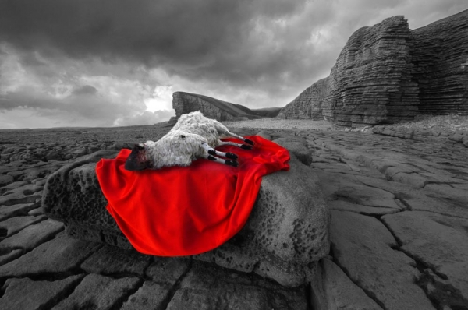
The Lamb of God
John 1:29
Notes:
The Lamb of God
John 1:29
Introduction
John’s exclamation in John 1:29 was one of excitement, fulfillment, and provision. Jesus is referred to as “the Lamb” numerous times in scripture.
This title given Jesus is significant. It plays a vital role in our salvation. We must know Him as “The Lamb of God.”
Let us consider Jesus as “The Lamb of God.”
Where is the Lamb?

Slide 3
Where is the Lamb?
Abraham and Isaac
– Genesis 22; 12:1-3; Romans 4:18-22; Hebrews 11:17-19 –
The Lamb led to the Slaughter
– Isaiah 53 –
Notes:
Where is the Lamb?
Abraham and Isaac
Genesis 22:1-2 – God tested Abraham’s faith by commanding him to sacrifice Isaac.
Genesis 12:1-3 – Promises given Abraham – Land, Nation, Seed (Needed a son.)
Romans 4:18-22 – He had a great faith in God’s promise despite the seemingly unfavorable circumstances.
Now God would give him the ultimate test →
Genesis 22:3-8 – Abraham did as he was told, and had faith in God’s provision.
Isaac asked an important question, “Where is the lamb?”
Abraham had faith in God to provide (v. 8).
V. 9-14 – Abraham passed the test, and God provided a ram for the sacrifice.
Hebrews 11:17-19 – The Hebrew writer said Abraham concluded God would raise up Isaac.
Genesis says that Abraham assured Isaac that God would provide a lamb.
Perhaps he had faith God would do so, but was determined to offer Isaac anyway, knowing God had the power to make it right.
However, Abraham also had faith that God would provide a Lamb that would be the fulfillment of the Seed promise (cf. v. 13 – He saw this afar off, and moved in faith.). (Even Abraham, long before Christ, looked for the Lamb of God in faith.)
Lamb Led to the Slaughter
Just like God provided a sacrifice to spare Isaac, so He provided a Lamb to spare us.
Isaiah 53 – The ultimate sacrifice was prophesied about by Isaiah.
(v. 4-6) – Our sins were the cause of His death. The reason He had to die.
(v. 7) – He went to the slaughter without arguing, or threatening and reviling in return.
There are other passages we could point to in the OT concerning the Lamb Who was to come. (Passover) You can imagine the excitement of John when he beheld “the Lamb of God.”
Behold! The Lamb! (cf. John 1:29)

Slide 4
Behold! The Lamb!
Behold!
– Galatians 3:24; John 20:30-31; 1:11 –
THE Lamb!
– Hebrews 10:1-4, 10-14 –
Of God
– Matthew 21:33-39 –
Who takes away sin!
– Psalm 51:3-4; Hebrews 9:13-14; 10:22 –
Notes:
Behold! The Lamb! (cf. John 1:29)
Behold!
Isaac asked the question, “where is the Lamb?” John answered that question (cf. John 1:29).
Galatians 3:24 – The law was to bring us to the Christ. It pointed to the Christ.
“For Christ is the end of the law for righteousness to everyone who believes” (Romans 10:4).
John rightly identified the man Jesus as the Lamb of God who was to come.
John 20:30-31 – Jesus provided ample proof that He was that Lamb.
John 1:11 – However, despite the overwhelming evidence, those who should have known best did not receive Him.
THE Lamb…
Jesus was not just A lamb, but He was, and is, THE Lamb.
Hebrews 10:1-4 – Every year sacrifices were made that reminded of sins, but were insufficient to satisfy God’s wrath.
Hebrews 10:10-14 – Jesus was the once for all sacrifice for sins.
Of God.
Just as God was the One who provided the ram for Abraham in Isaac’s stead, so God was the One who provided Jesus.
“For God so loved the world that He gave His only begotten Son, that whoever believes in Him should not perish but have everlasting life” (John 3:16).
Matthew 21:33-39 – God sent His Son knowing that He would be rejected, and become the ultimate sacrifice for the sins of the very ones who rejected Him. →
Who takes away the sin of the world!
When we sin, our consciences bear the guilt of that transgression, and are forever tainted without the needed precious blood.
Psalm 51:3-4 – David felt the weight of sin on his conscience.
Hebrews 9:13-14 – The blood of Christ cleanses our conscience of the guilt of sin.
Hebrews 10:22 – For this reason we can draw near to God in full assurance and confidence.
Worthy is the Lamb!

Slide 5
The Lamb of God
Worthy is the Lamb!
– Revelation 5; Philippians 2:5-11 –
Hide us from the Lamb!
– Revelation 1:4-8; 6:12-17 –
Notes:
Worthy is the Lamb!
“Where is the Lamb?” is answered by John in his exclamation, “Behold! The Lamb of God,” and our response should be, “Worthy is the Lamb!”
Revelation 5 – Because of what Jesus – the Lamb of God – accomplished for us, He is worthy of eternal praise and glory.
The question concerned the will of God – who can understand it, disclose its contents, and fulfill its requirements?
Jesus, the Lamb, is worthy to open it, and is therefore worthy of praise!
Philippians 2:5-11 – Jesus, the Lamb of God, is worthy of praise. Every knee should bow!
However, not every knee will bow in this life, for not all men choose to serve Christ →
Hide us from the Lamb!
“As I live, says the Lord, every knee shall bow to Me, and every tongue shall confess to God” (Romans 14:11).
The Lamb is worth of worship from everyone.
The Lamb requires worship from everyone.
However, not everyone wants to give Him the reverence and praise that is due His name.
Eventually, they will bow, but it will be too late to receive His favor.
Revelation 1:4-8 – Those who are not ready for His coming will mourn when He arrives.
Revelation 6:12-17 – When the great day comes of Jesus’ return, those who have rendered the worship that is due Him will rejoice, and those who did not will desire to be hidden.
In that day the Lord will be no respecter of persons.
He will not consider your station in life. (v. 15)
He will only consider whether you have accepted or rejected the Lamb of God.

Slide 6
The Lamb of God
John 1:29
Notes:
Conclusion
Knowing Jesus as “the Lamb of God” is of utmost importance.
We must recognize Him as the One Who was prophesied about, and give Him the worship and service that is due His name.
We should be thankful for His Sacrifice He made for our sins.
We should consistently remember and consider who He is as “the Lamb of God.”

