Slide 2
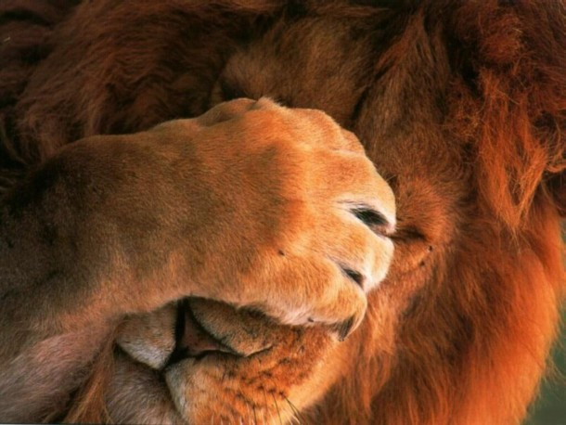
From Cowardice to Boldness
Hebrews 10:32-39
Notes:
From Cowardice to Boldness
Hebrews 10:32-39
Introduction
While Christians are to be a meek, gentle, and loving people, they cannot afford to be soft, timid, and cowardly. (Meekness often described as strength harnessed.)
Cowardice is condemned in scripture, while boldness is required and encouraged.
The Hebrew writer reminded his audience of this truth (cf. Hebrews 10:32-39):
Evidently they were experiencing persecution due to their faith.
This caused them to shrink to the point of forsaking the assembly (cf. v. 25).
The writer warned them about this willful sin (cf. vv. 26-31).
He then encouraged them to remain confident as opposed to drawing back.
NOTE:
(v. 35) – confidence – parrēsia; all out-spokenness, i.e. frankness, bluntness, publicity; by implication, assurance: — bold (x -ly, -ness, -ness of speech), confidence, x freely, x openly, x plainly(-ness). (ASV – “boldness”)
In context, the call is for them to not throw away the boldness, or confidence they had once before in professing and living their faith during persecution.
It takes boldness to confess the name of Christ in word and action in a world of people who do not believe.
(vv. 38-39) – God does not have pleasure in the cowardly – those who draw back – and those who draw back do so to their own perdition, or destruction!
We must come to understand the need for a shift From Cowardice to Boldness.
From Cowardice

Slide 3
From Cowardice…
Cowardly – deilos; from 1402a (dread); timid, i.e. (by implication) faithless: — fearful. (Strong)
Condemned
– Revelation 21:8; Matthew 10:32-33; John 12:42-43; Mark 4:35-41 –
Contagious
– Deuteronomy 20:1-4, 8 –
Notes:
From Cowardice
It is condemned.
Revelation 21:8 – the first in a list of sins.
Cowardly – deilos; from 1402a (dread); timid, i.e. (by implication) faithless: — fearful. (Strong)
“The word denotes ‘cowardice and timidity’ and is never used in a good sense” (Vine’s comments on the noun form – deilia).
Along with the other heinous sins, cowardice is deserving of the second death.
God has no pleasure in those who “draw back” (Hebrews 10:38).
Matthew 10:32-33 – We cannot shrink in cowardice and fail to confess Christ before men.
John 12:42-43 – Men had belief in Jesus after the proof in the miracle of raising Lazarus from the dead, and the triumphal entry, but they did not confess Him because they were cowards – they feared.
Mark 4:35-41 – On the boat in the tempest.
Fearful – deilos. (cowardly – timid)
They had not yet reached the faith toward which Jesus was leading them.
Their lack of faith lead to cowardice – if they believed in Jesus as the Son of God they would have not shrunk beneath the tempest.
It is contagious.
There cannot be cowardice among God’s people. We must strengthen each other, or else we weaken each other.
Deuteronomy 20:1-4, 8 – Instructions in the law concerning preparations for battle.
(vv. 1-4) – When approaching enemies in Canaan, DO NOT: be afraid, be faint, tremble, be terrified – FOR GOD IS WITH YOU.
“For God has not given us a spirit of fear, but of power and of love and of a sound mind” (2 Timothy 1:7).
Cowardice or fear does not come from God. It should not be present when God is present.
(vv. 8) – The fearful and fainthearted should not be there, because that will spread to their brethren.
Cowardice spreads to those around.
“We’re only as strong as our weakest link.”
Instead of being cowardly we are to be bold. →
To Boldness

Slide 4
…To Boldness
Confidence/boldness – parrēsia; all out-spokenness, i.e. frankness, bluntness, publicity; by implication, assurance: — bold (x -ly, -ness, -ness of speech), confidence, x freely, x openly, x plainly(-ness).
Required
– Hebrews 3:6, 12-14; 4:14-16; 10:19-22; Acts 2:29; 4:8-20 –
Contagious
– Acts 4:23-31; 8:1-4 –
Notes:
To Boldness
It is required.
Hebrews 3:6, 12-14 – We are of the household of God if we hold fast our “confidence” – boldness.
The implication is that if we “cast away” our confidence we will not have the privilege of being of that household.
We must not depart from God in cowardice, but press on in confidence – boldness. (That is, if we wish to be a partaker with Christ in the heavenly kingdom.)
Hebrews 4:14-16 – The accomplishment of Jesus, and His provision for us as High Priest does not, and should not lead to cowardice (like the Hebrews had at the time), but boldness.
It was wrong for them to draw back from what was so richly offered to them through Christ.
Despite persecution, or any other thing, they should BOLDLY approach the throne for help.
Cf. Hebrews 10:19-22 – Expresses the same sentiment. The work of Jesus as High Priest, and the benefit we receive from it should lead us to boldness.
Ender the Holiest – heaven itself.
This takes BOLDNESS in the face of all the adversity we will face.
Needed by the apostles to preach the gospel, and live for Christ:
Acts 2:29-32 – The claim of Jesus’ resurrection took boldness to proclaim.
“freely” – parrēsia; all out-spokenness, i.e. frankness, bluntness, publicity; by implication, assurance: — bold (x -ly, -ness, -ness of speech), confidence, x freely, x openly, x plainly(-ness). (ASV – “boldness”)
Acts 4:8-13 – Peter after being put in custody by the Sanhedrin for preaching Jesus.
(v. 13) – boldness – NOTE: IT WAS APPARENT!
(v. 18-20) – were told not to speak in Jesus’ name, but answered boldly that they would continue to do so.
Just like cowardice is contagious, so is boldness →
It is contagious.
Acts 4:23-31 – After Peter and John were released by the Sanhedrin, they went to the rest of the apostles to tell them what had happened.
(v. 29) – They prayed for boldness to preach.
(v. 31) – Despite the threats, and the news of what had recently happened to Peter and John, they preached with BOLDNESS.
Acts 8:1-4 – The great display of boldness by Stephen in his martyrdom led those who saw it to great boldness in spreading the word.
We must not be cowardly people, but confident, bold people of God. We must know how to grow that boldness! →
Growing Boldness (cf. Hebrews 10:32-39)

Slide 5
Growing Boldness
Hebrews 10:32-39
Remember the beginning of your faith. (vv. 32-33)
– 1 Thessalonians 1:6-8 –
Remember the reward for endurance and boldness. (vv. 34-35)
– 1 Peter 1:6-9 –
Remember those before you who have been bold. (vv. 36-39)
– James 5:10-11 –
Notes:
Growing Boldness (cf. Hebrews 10:32-39)
Remember the beginning of your faith (vv. 32-33).
When we obeyed the gospel of Christ we were awakened to a great confidence and boldness. We were able and willing to endure hardship!
1 Thessalonians 1:6-8 – The Thessalonians received the word of God in great affliction (persecution), and taught it to others as well. (Their faith was made known.)
Remember what boldness you had before to endure such hardship. Your faith was fresh and strong!
Remember the reward for endurance and boldness (vv. 34-35).
The hope we are given activates us to great boldness! If we endure we will be rewarded!
1 Peter 1:6-9 – We rejoice in our hope even though we go through trials. This tests our faith, and by enduring we will receive salvation!
Like Stephen and others, if we remember the reward promised to us we will stand before any threat in boldness.
Remember those who have been bold, and endured themselves (vv. 36-39).
(vv. 37-38) – quote from Habakkuk 2:3-4.
Context in Habakkuk – the prophet in dismay because of the prosperity of the idolatrous Chaldeans, and the oppression of the righteous in Israel.
God assures Habakkuk that this will only happen for a short while before He avenges His people.
The need – steadfast and enduring faithfulness to God.
To the Hebrews – continuing faith during severe persecution and opposition until Christ comes with their reward.
It is profitable to learn, and receive encouragement from those who have displayed an enduring, and bold faith in the past.
James 5:10-11 – Take the prophets and Job as examples!

Slide 6
From Cowardice to Boldness
Hebrews 10:32-39
Notes:
Conclusion
It is of vital importance that we see the sin in cowardice, and the severe need for boldness.
We must have confidence in God, and be emboldened to continually stand for, and stand in, the truth.

