Slide 2
Three Deaths at Calvary
Luke 23:32-49
Notes:
Three Deaths at Calvary
Luke 23:32-49
Introduction
The primary facet of the crucifixion accounts in the gospels is the redemptive work of Jesus on the cross.
It is that which we celebrate and remember every Lord’s day (cf. Acts 20:7).
However, as we all know, Jesus was not the only one to die at Calvary that day.
(v. 32) – There were also two others.
All scripture is inspired of God (cf. 2 Timothy 3:16-17).
The plenary verbal inspiration (every word is God-breathed) of scripture implies that every piece of the crucifixion record carries some weight in significance.
There is much we can learn from the THREE deaths at Calvary – not only Jesus’ death, but the two robbers with Him.
Let us consider the Three Deaths at Calvary.
All Died Because of Sin (All Similar)

Slide 3
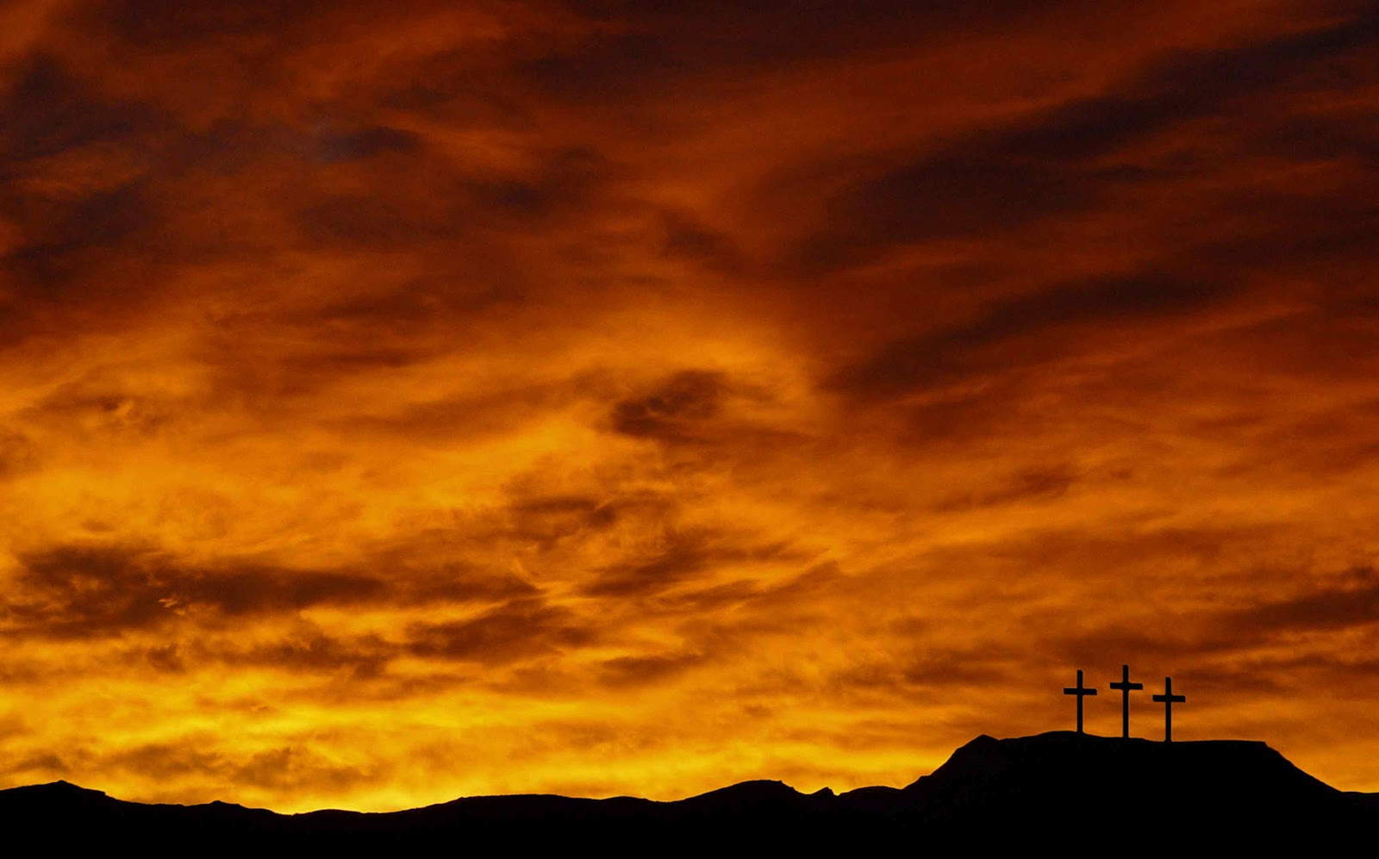
All Died Because of Sin
Physical Death because of Adam’s Sin
– 1 Corinthians 15:20-22 –
Physical Death because of Personal Sin
– Proverbs 1:18 –
Physical Death because of Another’s Sin
– Acts 7:51-53 –
Notes:
All Died Because of Sin (All Similar)
Physical Death because of Adam’s Sin
1 Corinthians 15:20-22 – by man (Adam) came death.
The death considered is physical.
The context is considering the general resurrection from the dead – bodily.
Our first body dies, and we are raised with a new body – “It is sown a natural body, it is raised a spiritual body” (v. 44a).
The three who died on crosses at Calvary all died in part because of Adam’s sin – physically died.
Even if they did not have their lives shortened by execution, they would have eventually died.
Physical death is a result of the sin of one man – Adam. (His specific sin resulted in physical death.)
Immediately we see the consequences of sin are FAR REACHING.
Physical Death because of Personal Sin (Robbers)
The criminals died as a direct result of their personal sin.
Luke calls them “criminals,” but Matthew and Mark identify them as “robbers.”
Robbers – lēstēs – a robber, brigand, one who plunders openly and by violence. (Vine).
“Not to be confounded with kleptēs (thief), one who takes property by stealth.” (Thayer)
This is the word used for the thieves in the parable of The Good Samaritan. – “who stripped him of his clothing, wounded him, and departed, leaving him half dead” (Luke 10:30).
This was how they lived – their occupation – their sin hurt others, but their sin eventually caught up with them.
“Your sin will find you out” (Numbers 32:23). (Moses to Israelites)
Solomon considering those who “make haste to shed blood” – “But they lie in wait for their own blood, they lurk secretly for their own lives” (Proverbs 1:18).
Sin has consequences – sometimes death.
Physical Death because of Another’s Sin (Jesus)
Acts 7:51-53 – Stephen to the Sanhedrin Council.
They MURDERED (sin) a JUST man – Jesus.
Jesus died because of their sin.
Sin is a terrible thing. It causes much harm, as its consequences are FAR REACHING. However, the worst consequence of sin is SPIRITUAL DEATH (cf. Romans 6:23).
This leads us to the most notable death at Calvary →
Three Deaths at Calvary (All Different)

Slide 4
Three Deaths at Calvary
Death FOR Sin
– Isaiah 53:5; Luke 23:44-46; Romans 5:6-11 –
Death TO Sin
– Luke 23:39-43; Luke 13:5; Galatians 6:14 –
Death IN Sin
– John 8:21-24; 5:39-40; Luke 9:23-26 –
Notes:
Three Deaths at Calvary (All Different)
Death FOR Sin (Jesus)
The gospel Paul (and the other apostles) preached – “Christ died for our sins according to the Scriptures” (1 Corinthians 15:3).
Isaiah 53:5 – His death was vicarious – He died in our stead, i.e. for our sins we have committed.
Luke 23:44-46 – When Jesus died, the veil of the temple was torn in two.
Matthew and Mark’s record states this occurred after Jesus died.
This was symbolic of what was accomplished in Jesus’ death.
“The veil shall be a divider for you between the holy place and the Most Holy” (Exodus 26:33).
Hebrews 9:6-10, 24 – The veil symbolized a separation from the Holiest of All – heaven itself, where God dwells.
Isaiah 59:2 – Sin separates us from God, and Jesus’ death bridges the gap.
Hebrews 10:19-22 – The new and living way (NT) He consecrated through the veil – His flesh – is available to us.
The separation between God and man is taken away in Jesus’ death for sin!
Romans 5:6-11 – We were enemies of God, deserving of His Divine wrath, but Jesus’ death for sin reconciles us to God!
Death TO Sin (Penitent Robber)
“Even the robbers who were crucified with Him reviled Him” (Matthew 27:44).
“Even those who were crucified with Him reviled Him” (Mark 15:32b).
Both robbers were guilty of joining the crowd in blaspheming Jesus. However, Luke’s gospel account records an important event. →
Luke 23:39-43 – While one thief continued to revile, the other realized his sin, and repented.
(v. 40) – Indicated a fear of God.
“Same condemnation” – civil judgment or sentence. (Even Jesus, although unjustly.
He was not concerned with the civil judgment as much as the Divine judgment he knew would come subsequently to his death.
“But the mercy of the Lord is from everlasting to everlasting on those who fear Him” (Psalm 103:17).
Like many men, the thief began to think of what comes after death as it neared, and trembled in fear.
(v. 41) – Realized his sin.
He was not indifferent about his sin, nor did he refuse to acknowledge it.
The whole conversation considered, from his rebuke of the other thief, to his appeal to Jesus, shows he was sorry for his sin, and recognized how terrible it was.
Even though he would not live longer to show a changed life in action, his life was changed, his mind was converted.
(v. 42) – Showed faith in Jesus, calling Him “Lord,” and appealed to Him for salvation.
He had faith that Jesus would still establish His kingdom, and rule over it.
He did not think Jesus would be defeated by death, and recognized His position to forgive, and reward.
(v. 43) – Jesus promised him salvation.
“unless your repent you will all likewise perish” (Luke 13:5) – Repentance is required by the Lord for salvation.
“[Jesus] bore our sins in His own body on the tree, that we, having died to sins, might live for righteousness – by whose stripes you were healed” (1 Peter 2:24).
Galatians 6:14 – We are to crucify the world to ourselves.
We no longer live for the world – it is considered a shame to us, and we reject it.
This is necessary to receive salvation.
The thief crucified the world to himself when he showed his opposition to the mocking of Jesus, and recognized his sin.
Death IN Sin (Impenitent Robber)
The records never state that the other thief stopped his mocking, or showed any signs of penitence. We gather from this that when he died, he died IN sin.
Consider the scene of the cross – “And when they had come to the place called Calvary, there they crucified Him, and the criminals, one on the right hand and the other on the left” (Luke 23:32).
The penitent thief had no advantage over the impenitent thief.
They were equal distance away from the One who could save them.
The impenitent thief showed a hardness of heart – all that led to the one thief’s penitence was available for the other to be led to penitence.
The one died IN sin for no other reason than a hardness of heart.
John 8:21-24 – The consequence of the Pharisees unbelief in Jesus.
Shortly after the Pharisees attempted to trap Jesus, finding something with which to accuse Him (cf. 8:1-12).
(v. 23-24) – The crux of the matter is their unbelief in His proclaimed nature – the Son of God, the Christ.
Jesus will tell His disciples later, “I am the way, the truth, and the life. No one comes to the Father except through Me” (John 14:6).
(v. 21) – Jesus spoke of His departure (after His death) back to the Father – They cannot go where He will go – why? Because they do not believe in Him.
Jesus is the only way to the Father, for He is the only way to be forgiven of sins.
The Christ would come to redeem, and He is the Christ – Yet, they did not believe in Him.
“you will seek Me, and will die in your sin” – What about, “seek and you will find?” (Matthew 7:7)
Cf. John 5:39-40 – The Jews who rejected Jesus searched the scriptures with a mindset to acquire life by the letter of the law.
They missed the point of the Law – “our tutor to bring us to Christ” (Galatians 3:24).
The Law testified of the Christ, but when He came – Jesus – they rejected Him.
In this way, would they seek, yet not find and die in their sins – they seek a different way, instead of accepting and following the ONLY WAY!
Luke 9:23-26 – We must accept and follow the ONLY WAY – the way of Jesus.
He requires us to DIE TO SIN.
We cannot seek to save our lives – continue in the pleasures of sin.
If we do, we will be rejecting Christ, and we will die in our sins.
If we die in our sins – because we do not want to take up our cross, and sacrifice our lives for Christ – we will lose our souls! (JUST LIKE THE IMPENITENT THIEF.)

Slide 5
Three Deaths at Calvary
Luke 23:32-49
Notes:
Conclusion
There is much to learn from the scene of Calvary.
There were three deaths there which we can all learn great lessons from:
Jesus died FOR our sins.
One thief, recognizing who Jesus was, died TO his sins and turned to Christ for salvation.
The other thief refused to die TO sins, and instead died IN sin – losing his soul.
We need to recognize what Jesus has provided for us in His death on the cross, and do as the penitent thief did – die TO sin, and turn to Christ.

