Slide 2
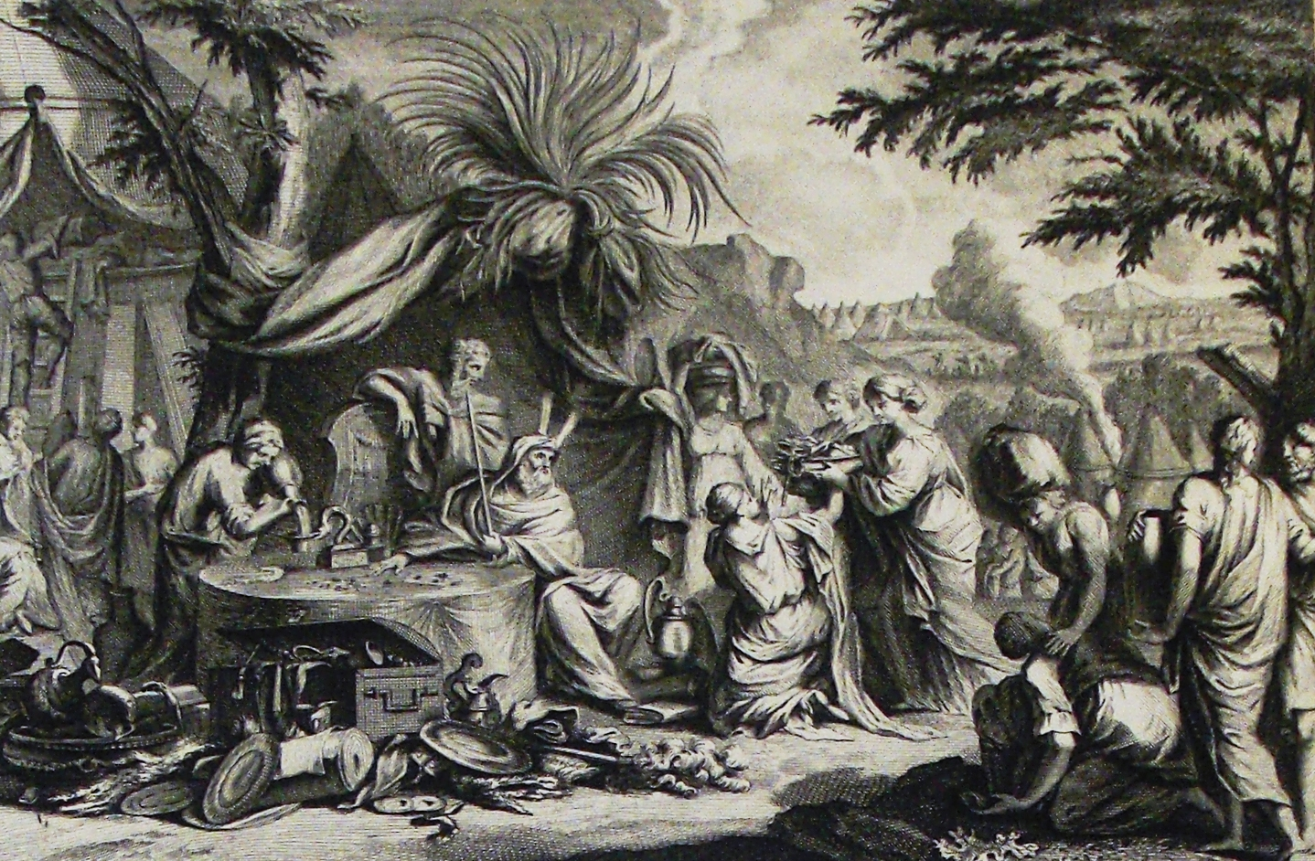
Offerings for the Sanctuary
Exodus 25:1-9; 35:20-29; 36:1-7
Notes:
Offerings for the Sanctuary
Exodus 25:1-9; 35:20-29; 36:1-7
Introduction
Most times the Israelites are used as an example, it concerns their disobedience – what we shouldn’t do (“Now these things became our examples, to the intent that we should not lust after evil things as they also lusted” (1 Corinthians 10:6).
However, there were times when the Israelites did as they were told, and sometimes went above and beyond in terms of zeal and diligence.
One of those times concerned the offerings requested by God for the sanctuary.
We would do well to consider their actions, and quality of heart during this time.
Offerings for the Sanctuary

Slide 3
Offerings for the Sanctuary
The Sanctuary
– Exodus 19:3-6; 25:1-9 –
Offerings of the Israelites
– Exodus 35:20-29; 36:2-7 –
Notes:
Offerings for the Sanctuary
The Sanctuary
Exodus 19:3-6 – The Israelites were oppressed by the Egyptians, and God delivered them.
His promise was that they would be a “special treasure…above all people,” and “a kingdom of priests and a holy nation.”
This was contingent upon their obedience.
He gave them laws to obey, and WAS READY TO MAKE HIS DWELLING AMONG THEM APPARENT – A VISUAL OF THAT WHICH WAS ALREADY TRUE. →
Exodus 25:1-9 – God commands Moses to request that the Israelites bring a free-will offering of the materials specified.
(vv. 8-9) – These materials would be assembled in the way God specified to make His sanctuary – “that I may dwell among them.”
Sanctuary – a consecrated place or thing – set apart, holy.
This would be a constant reminder of the HOLINESS of God to the Israelites.
There were strict guidelines concerning all things of the Sanctuary for the Israelites to follow, and failure to do so earned severe consequences.
The importance of the Sanctuary led the Israelites to an outstanding participation in the free-will offering (v. 2). →
The Offerings of the Israelites
Exodus 35:20-29 – After Moses brought the request of the Lord to the children of Israel as he had been commanded, the people responded.
(vv. 20-21) – As soon as Moses was finished listing the needed materials, they departed to gather them and bring the back. (No apparent delay, or indication of hesitancy to give.)
“whose heart was stirred” – the need for materials for something as important as the Sanctuary moved them.
“whose spirit was willing” – there was not feeling of constraint, but pure willingness. They wanted to contribute to the cause!
The reoccurring idea was that it was a FREE-WILL OFFERING, and that the Israelites were MORE THAN HAPPY TO CONTRIBUTE.
Exodus 36:2-7 – The Lord appointed artisans for the construction of the Sanctuary, and the people brought more than enough materials.
(vv. 2-5) – The artisans were brought the free-will offerings every morning, and they constructed the Sanctuary.
The offerings began to be so abundant that they had to tell Moses it was too much.
“much more than enough for the service of the work”
(vv. 6-7) – Moses had to command the Israelites to stop bringing offerings!
They exceeded expectations, and brought enough, “indeed too much” materials.
This shows how moved they were to do the work, and the liberality they expressed in their giving.
New Testament Giving

Slide 4
New Testament Giving
The Command
– 1 Corinthians 16:1-4 –
The Expectation
– 2 Corinthians 8:1-7; 9:5-7 –
Notes:
New Testament Giving
The Command
1 Corinthians 16:1-4 – The apostle Paul gave an inspired command to the churches of Galatia to take up a collection, and to the Corinthians. The pattern continues for us.
(v. 2) – This is done of the first day of the week. (Every week – same logic as the Lord’s Supper. Cf. Acts 20:7).
“storing up as he may prosper” – when one prospered financially from the Lord, they were to set aside a part of that to give back.
No percentage specified, but the concept is “as he may prosper,” i.e. if one makes more than another, he is able to give more than another.
NOTE: If your prospering changes (increases) there is a need to reevaluate, and give more.
Uses of the Lord’s money:
Relieving needy saints: “collection for the saints;” “bear your gift to Jerusalem”
Evangelism (supporting an evangelist): cf. Philippians 4:14-17 – sharing in a monetary sense – they gave Paul money as a church, i.e. from the collection.
The Expectation
2 Corinthians 8:1-7 – The giving of the Macedonians. (Notice, as was with the Israelites, the focus is the WAY and MANNER in which they gave.)
Again, collection for needy saints.
(vv. 2-4) – They were POOR and AFFLICTED yet gave LIBERALLY. (Even IMPLORED Paul and the apostles to be able to participate in giving, despite their own poverty.)
(v. 5) – They went above and beyond Paul’s expectations!
Remember the widow and her 2 mites: “she out of her poverty put in all the livelihood that she had” (Luke 21:4).
(vv. 6-7) – Paul was using the Macedonians as an example for the Corinthians to follow. →
2 Corinthians 9:5-7 – The Corinthians were to give as the Macedonians, and in this way.
(v. 5) – as a matter of generosity, not a grudging obligation.
(v. 6) – We prosper from giving, and should be moved to give more! (“Not that I seek the gift, but I seek the fruit that abounds to your account” – Philippians 4:17).
(v. 7) – It is something we “purpose in our heart.”
We do not simply pull the money out that we happen to have at the time on Sunday morning.
We understand the importance of this, and plan, purpose, to give!
The Lord requires Christians who “prosper” to set aside a portion for the work of the Lord every first day of the week.
This is not simply a request, but a command.
However, it is free-will with regard to the amount given.
We are to do so with a cheerful heart!
This is an opportunity to contribute to the work of the Lord – A VERY IMPORTANT WORK!

Slide 5
Offerings for the Sanctuary
Exodus 25:1-9; 35:20-29; 36:1-7
Notes:
Conclusion
The Israelites set the bar high with regard to giving – during the erection of the Sanctuary.
We should seriously, and prayerfully consider the way in which they gave, along with the way in which the NT saints gave.
God has been very gracious to us and liberal in His giving. We should be more than willing to do the same for Him!

