Slide 2
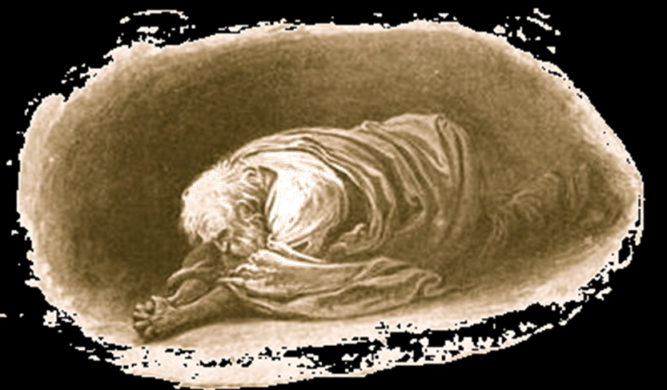
Forgiveness Under the
Old Testament
Psalm 32
Notes:
Forgiveness Under the Old Testament
Psalm 32
Introduction
Psalm 32 is “A Psalm of David. A Contemplation” – contemplation – Maschil – instructive. (It is instructive to those who read it.)
What does it teach?
(vv. 1-2) – The man who is forgiven by God is “blessed” – in the sense of condition, prosperous.
(vv. 3-5) – God’s hand is heavy upon the sinner. The only way to relief is confession, and asking for forgiveness. God forgave the sin of David.
(vv. 6-7) – Everyone who seeks forgiveness must pray to God for it. He will deliver you.
(vv. 8-9) – God will lead us down the path of righteousness, but we must know His word to know the way. We must willingly, and consciously follow Him.
(vv. 10-11) – The Lord’s forgiveness, and further protection causes immense joy!
Psalm 32 clearly teaches that God forgave the sins of those who asked for forgiveness – this, under the Old Testament.
Some may teach that there was no forgiveness under the Old Testament, for Jesus had not yet been given as the perfect sacrifice.
Some cannot comprehend how God could forgive men of their sins when Jesus had not yet died on the cross for the sins of mankind.
This lesson will seek to clarify forgiveness period, but with a special focus on the concept of Forgiveness Under the Old Testament.
Some Problems (Part 1)

Slide 3
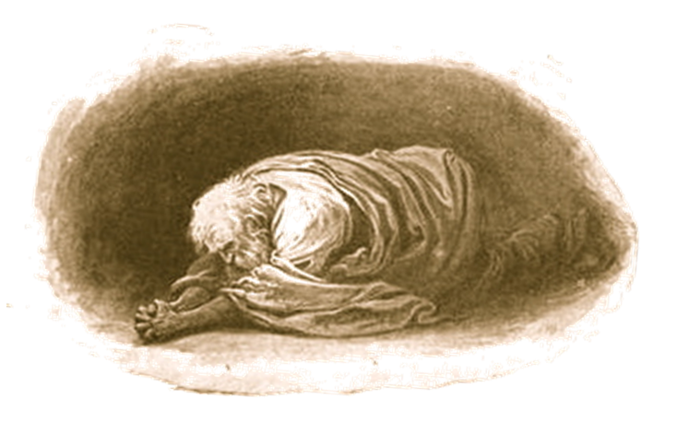
Some Problems
No Forgiveness = Not Saved
– Isaiah 59:1-2; Romans 6:23 –
No Death of Jesus = No Remission
– Hebrews 9:22; 10:4-18; 9:15 –
Notes:
Some Problems (Part 1)
No Forgiveness = Not Saved
Isaiah 59:1-2 – Sin separates us from God.
Separation from God is spiritual death – “For the wages of sin is death” (Romans 6:23).
If you die in this state – not being forgiven, thus, spiritually dead – your eternal separation from God is sealed.
Jesus’ telling of the Rich Man and Lazarus.
“And besides all this, between us and you there is a great gulf fixed, so that those who want to pass from here to you cannot, nor can those from there pass to us” (Luke 16:26 – Abraham to the rich man.).
NOTE: This was under the Old Testament, and Lazarus was in a saved state – forgiven.
Were those exemplars of faith in Hebrews 11 in this state when they died?
No Death of Jesus = No Remission
Hebrews 9:22 – Shedding of blood necessary for remission – pardon, deliverance – from sin.
10:4 – The blood of animals is not sufficient for this.
10:5-18 – The sacrifice of Christ was the ONLY sacrifice that could solve the problem of sin, and grant remission of said sins.
(v. 11) – Sacrifices offered by priests not pointless, but cannot take away sin.
(v. 12) – Jesus’ death did what their sacrifices could not do.
However, there were those who lived before Jesus. What about them? →
9:15 – Jesus’ death was for them as well. (More will be said concerning this idea later, but let us leave this here shortly and return to it later.)
Justification by Faith

Slide 4
Justification by Faith
Paul Quotes Habakkuk 2:4
– Romans 1:16-17; Galatians 3:10-12 –
Paul’s use – faith is the principle of justification, thus, spiritual life.
Notes:
Justification by Faith
Paul Quotes Habakkuk 2:4
“Behold the proud, his soul is not upright in him; but the just shall live by his faith” (Habakkuk 2:4).
This is quoted one other time in the New Testament by the Hebrew writer (cf. Hebrews 10:38 – we will discuss that shortly).
Paul’s use of the OT verse is a more extensive application of the verse than that of the Hebrew writer’s use, which keeps the use more simply to the context of Habakkuk. (NOTE: Paul’s use is not an abuse of the text, it simply delves deeper into the thought and its implications by the context of his arguments.)
Romans 1:16-17 – Faith is the principle of justification (how men are justified), the gospel of Christ being the object of that faith.
(vv. 1-6) – Paul consecrated by God to the preaching of the gospel.
Gospel – good news.
Good news – of Jesus Christ.
Jesus Christ – declared to be the Son of God by His resurrection.
“power of God to salvation for EVERYONE WHO BELIEVES” – what must they believe? – The message of the gospel, Jesus Christ is the Son of God who died for the sins of mankind.
Galatians 3:10-12 – Justification/salvation is not found in the Law of Moses, rather, the principle of justification is faith. (Also dealt with extensively by Paul in Romans.)
Three arguments (all similar) that justification is not according to the Old Law:
(v. 10) – Everyone under the law is cursed, for all have broken the law.
(v. 11) – The scripture (cf. Habakkuk 2:4, among many others) teaches that justification is by faith.
Just – Men become just by faith.
Live – spiritually – spiritual life.
Through faith justification is reached, which is the state of spiritual life.
Faith in what, or who? → (vv. 13-14) – Jesus and His sacrifice.
(v. 12) – The only way to achieve justification under the Old Law is to keep it perfectly.
Paul’s use of Habakkuk 2:4 = FAITH is the key to justification, thus, spiritual life. (God’s intention from the beginning.)
NOTE: We understand this is the theme of the New Testament.
NOTE: This was even true before the New Testament – which was Paul’s point in Romans and Galatians.
Context of Habakkuk 2:4

Slide 5
Justification by Faith
Context of Habakkuk 2:4
(1:1-4) – Wickedness in Judah.
(1:5-6) – Wicked Judah disciplined by God.
(1:12-13) – Habakkuk does not understand.
(2:1-4) – God replies to Habakkuk, telling him to live by faith.
(3:16-19) – Habakkuk does just that.
Must have faith in God even when lacking full understanding.
Notes:
Context of Habakkuk 2:4
Habakkuk – a discussion between the prophet Habakkuk and God concerning God’s use of the more wicked Chaldeans’ as a means of disciplining the lesser, yet still wicked, nation of Judah.
(1:1-4) – Wickedness in Judah and Habakkuk’s erroneous view that God is indifferent about it. (NOTE: there is not justice. The righteous are suffering at the hands of those who are wicked.)
(1:5-6) – God is not ignoring the injustice, but intends to discipline Judah by “raising up the Chaldeans.”
(1:12-13) – Habakkuk’s tone changes in recognition that God is not ignoring the wicked, but will punish them. However, he questions God’s use of the Chaldeans to carry out this discipline.
(v. 13) – Even when God says He will punish wickedness by using the Chaldeans, Habakkuk is not satisfied.
The Chaldeans are MORE WICKED than those in Judah – HOW COULD GOD USE THEM?!
(2:1-4) – Habakkuk waits for God’s reply concerning his objection to God using those more wicked to discipline the less wicked Israelites.
(vv. 2-3) – God commands Habakkuk to write the vision (His explanation) down, and that it will come quickly.
(v. 4a) – God will use the wicked and proud Chaldean ruler to discipline the wicked in Judah. (Also, God recognizes he is evil and arrogant, and will bring judgment upon him for it, and for his severe treatment of God’s people.)
(v. 4b) – Those who are righteous/just in Judah WILL SUFFER ALONG WITH THE WICKED in their punishment, but they must CONTINUE TO TRUST IN GOD.
Faith – ’emûnâ; or (shortened) אֱמֻנָה ’emunah, em-oo-naw«’ feminine of 529; literally firmness; figuratively security; morally fidelity.
More than simply belief, but TRUST IN GOD to the extent of UNWAVERING OBEDIENCE – moral fidelity.
“Therefore the law is powerless, and justice never goes forth” (1:4 – concerning the wicked in Judah) – BUT THE JUST/FAITHFUL MUST CONTINUE TO SUBMIT TO THE LAW IN THEIR TRUST IN GOD.
Even when man does not understand what God says, does, and requires he must TRUST IN HIM, or, live by faith.
(3:16-19) – The end of Habakkuk’s final response in the form of a psalm (all of chapter 3) shows the proper response to God’s use of the wicked Chaldeans to discipline Judah.
(v. 16) – God’s will made Habakkuk tremble – it is terrifying!
(vv. 17-10) – However, no matter how bad it gets, Habakkuk will TRUST, HAVE FAITH IN, GOD who is his strength.
Habakkuk 2:4’s meaning in context – The just people of God must have unwavering faith in God even when they do not fully understand His ways and will at the time.
This means continue in obedience to God – which shows our trust in Him.
Also, as Paul used this verse, this is what God requires for us to be justified in His sight. (If Habakkuk stopped trusting in God, thus stopped obeying God, he would no longer be justified before God.)
Hebrew Writer Quotes Habakkuk 2:4

Slide 6
Justification by Faith
Hebrew Writer Quotes Habakkuk 2:4
– Hebrews 10:36-39 –
This is illustrated in chapter 11.
Note Abraham – vv. 10, 16, 17-19
However – vv. 39-40; 9:15
Notes:
Hebrew Writer Quotes Habakkuk 2:4
Hebrews 10:32-35 – Context of suffering. The Hebrew Christians were being persecuted, and they were leaving their faith in Christ. (Remember you endured before, so endure now!)
(vv. 36-39) – Even in the midst of suffering, what God requires of His people, “the just,” is that they live by faith!
This is in the same way as it is used in Habakkuk – unwavering obedient faith to God even in times of hardship, which may not be fully understood. (SEE chapter 12 – discipline is for your good, they did not comprehend this at the time.)
(vv. 37-38) – Quotation of Habakkuk 2:3-4. (Concerned the coming of God’s judgment against the wicked, and the vindication of His faithful people, but in Hebrews the coming of God in final judgment, thus, reward as well.)
This is illustrated, and the Hebrew writer exhorts his readers, by alluding to men of faith in chapter 11 (of which are men who lived well before the coming of Christ):
Note first, that these men are counted as righteous by God because of the faith they had (this is how Paul used Habakkuk 2:4 – faith is the principle to being counted as righteous):
“By faith Abel…obtained witness that he was righteous” (v. 4).
“By faith Enoch…had this testimony that he pleased God” (v. 5).
“By faith Noah…became heir of the righteousness which is according to faith” (v. 7).
“And all these, [have] obtained a good testimony through faith” (v. 39).
To be counted as righteous before God is to be forgiven of sins. (These all were in this state before Christ’s death.)
(vv. 1-2) – Their faith was in things not yet attained, that could not be seen with their physical sight.
Some of these things of which faith was the “substance” and “evidence” were lesser things they would see in their lifetime.
Example: Noah with the flood. His faith was the “evidence” of the flood, and the “substance” of God’s deliverance.
However, there is always with the people of God the BIGGER PICTURE (Their faith in God always concerned something greater) →
(v. 6b) – The faith is in God’s rewarding of the faithful – Ultimately the GREAT spiritual reward →
Consider Abraham:
(v. 10) – Obeyed God when called to “go out,” because he had faith in a spiritual city.
(v. 16) – They desire a heavenly country.
This is talking about SALVATION WITH GOD IN HEAVEN FOR ETERNITY.
This being contingent on a particular promise of God, also in which Abraham placed his faith:
(vv. 17-19) – God commanded Abraham to sacrifice Isaac – his only son.
The difficulty of the test reaches beyond the already extreme expectation to sacrifice HIS ONLY CHILD by Sarah.
(v. 18) – It is in Isaac that Abraham’s seed shall be called. (cf. Genesis 21:12 – After Sarah told him to cast out Hagar and Ishmael, he was displeased, but God assured him it was through Isaac, not Ishmael.)
Cf. Romans 9:5-9 (v. 5 concerning physical Israel) – Paul quotes this in Romans to indicate the spiritual seed THROUGH CHRIST.
THE POINT: Abraham’s faith concerned God’s ability to raise Isaac up, not simply to give him his physical nation, but THAT THE CHRIST WOULD STILL COME THROUGH HIS SEED.
Ultimately, Abraham’s, and all the others’ faith in Hebrews 11, was in the ultimate provision of THE REDEEMER, THE MESSIAH, by God for their salvation.
NOTE HOWEVER vv. 39-40:
“obtained a good testimony through faith” – were counted as righteous – forgiven of sins – ultimately on account of their faith in the promises of God concerning REDEMPTION.
(v. 39b-40) – However, their completion (“perfect”) in matters of their REDEMPTION is not apart from ours (those under the NT).
They could not be saved by different means than we are saved. →
Hebrews 9:15 – Christ’s death was necessary for them as well!
They were forgiven, or counted as just/righteous by God, for their faith IN THE FRUITION OF THIS NECESSARY PROMISE.
His death brought in the NT – “Mediator of the new covenant.”
Yet, His death was for those under the OT.
Thus, “THAT THEY SHOULD NOT BE MADE PERFECT APART FROM US” (11:40).
God put righteousness to the account of men on account of the faith they had in the REDEMPTIVE PROMISES CONCERNING THE CHRIST.
However, how could God be just in forgiving them, thus counting them righteous, before Jesus’ sacrifice occurred? →
God is Just and the Justifier (PART 2)

Slide 7
God is Just and the Justifier
Justified Through Faith in Jesus
– Romans 3:21-26; 5:1-2 –
Propitiation – hilastērion – relating to appeasing or expiating, having placating or expiating force, expiatory. (THAYER)
Notes:
God is Just and the Justifier (PART 2)
Justified Through Faith in Jesus
Romans 3:21-25a, 26 (Get to v. 25b later) – God justifies those who have faith in Jesus.
(vv. 21-22a) – God’s plan of justification through faith in Jesus was something the Law and Prophets attested to.
Law – Used types and shadows of better things to come.
Prophets – Prophesied of the coming Christ through whom salvation would come.
(vv. 24-25a, 26b) – God can justify men who have faith in Jesus because of what His death accomplished. →
Propitiation – hilastērion – relating to appeasing or expiating, having placating or expiating force, expiatory. (THAYER)
In other words, sin provokes the wrath of God (judicial wrath), and that wrath must be satisfied →
“For the wages of sin is death, but the gift of God is eternal life in Christ Jesus our Lord” (Romans 6:23).
(v. 24) – This expiatory death of Jesus is God’s free gift, i.e. we are “justified freely by His grace.” →
5:1-2 – We access this grace by our faith in Jesus.
This was examined, and explained by the faith of Abraham.
Abraham lived and died before Jesus came! →
Justified Through Faith in Jesus Before Jesus

Slide 8
God is Just and the Justifier
Justified Through Faith in Jesus Before Jesus
– Romans 4 –
“Passed over” sins (3:25) – Paresis – pretermission, passing over, letting pass, neglecting, disregarding. (THAYER)
“Passed over” to the “propitiation by His blood.”
Notes:
Justified Through Faith in Jesus Before Jesus
The Justification of Abraham (Romans 4):
(vv. 1-8) – Abraham was justified, not by being sinless, but through faith.
(vv. 4-5a) – “him who works”/”does not work” – not discounting obedience, but “work” as in the perfect keeping of law.
(vv. 6-8) – From Psalm 32. God imputes righteousness (credits righteousness to someone’s account) through faith.
(vv. 13-15) – His faith which was accounted for righteousness was in the promise. What is the “promise?”
“that he would be heir of the world” (How?) →
Not the “land promise” (Confined to one part of the world.)
Not the “nation promise” (Confined to one nation, one people.)
The Seed promise:
“And in you all the families of the earth shall be blessed” (Genesis 12:3b).
“Ask of Me, and I will give You the nations for Your inheritance, and the ends of the earth for Your possession” (Psalm 2:8 – Concerning the Messiah and His kingdom.).
Romans 9:6-8 – Those who are the children of promise are of the Seed of Abraham.
It is of a spiritual nature – those who are counted as righteous by faith.
(vv. 17-22) – Abraham’s faith was not simply that God would be able to make him a great nation, but was ultimately in God making him a “father of many nations,” i.e. faith in the Seed promise.
Through Abraham’s seed the Christ would come and bless the world.
Those who had faith in Him would be the children of the promise. (“walk in the steps of the faith which…Abraham had”)
Thus, Abraham would be a “father of many nations.”
In order for this to happen, Abraham had to bear a son through Sarah. →
(vv. 19-22) – His faith did not waiver in this promise of God, the promise of the Messiah.
Thus, “it was accounted to him for righteousness.”
Abraham may not have known every detail of the Christ as do we, (which is why Hebrews says, “God having provided something better for us”), but he had faith in God’s promise concerning Him. (As discussed in Part 1)
NOTE: Abraham could not be justified by works because, like every man, he had sinned. How could God count him righteous by faith if Christ had not yet died for his sins? →
God passed over sins:
Romans 3:25-26 – Paul says that God passed over sins that were committed.
“previously” – Before the coming, and death of Christ.
“passed over” – What does it mean?
Paresis – pretermission, passing over, letting pass, neglecting, disregarding. (THAYER) (NOTE: God did not neglect or disregard sin, but He did pass over it.)
KJV – “to declare his righteousness for the remission of sins that are past, through the forbearance of God”
Bad translation – paresis does not mean remission. (Paresis is only used ONCE, that is in this passage.)
Remission – “and without shedding of blood there is no remission” – aphesis; freedom; (figuratively) pardon. (Strong)
Remission cannot occur without the shedding of blood, i.e. Christ’s blood.
“passed over” is a good translation.
Paresis – a passing by of debt or sin. (VINE)
“For the wages of sin is death” (Romans 6:23).
God “passed over” that sin, as He did not render unto it what it is due, BUT THE SIN DID NOT GO UNADDRESSED →
“Passed over” to the “propitiation by His blood:”
“Passed over” does not mean forgiven, but the men were forgiven as God looked to the “propitiation” of Jesus’ sacrifice.
In other words, God “passed over” the sins committed BEFORE Christ to the “remission” that is in the “shedding of [the] blood” of Christ.
“There needed a signal manifestation of the righteousness of God, on account of the long praetermission or passing over of sins, in his infinite forbearance, with no adequate expression of his wrath against them, during all those long years which preceded the coming of Christ; which manifestation of God’s righteousness found place, when He set forth no other and no less than his own Son to be the propitiatory sacrifice for sin.” (Trench, Richard. "Trench's New Testament Synonyms :: xxxiii. ἄφεσις, πάρεσις.)
How did God “pass over” the sins to the “propitiation” of Christ’s blood that would not happen until many years in the future?
Some would say God made a gamble.
This is nonsense! God KNEW it would happen, as if it already did happen! →
The Promises of God:

Slide 9
God is Just and the Justifier
Justified Through Faith in Jesus Before Jesus
– Romans 4 –
“Passed over” to the “propitiation by His blood.”
Promises of God – Hebrews 6:13-18
Men were justified before Christ (yet, not independent of Him) – Hebrews 12:22-24; Matthew 8:11
Notes:
The Promises of God:
Hebrews 6:13-18 – Abraham used as example to show the assurance of God’s promises.
(v. 15) – This is a promise Abraham received in a partial sense. (THE FULL PROMISE FINDS ITS FRUITION IN CHRIST, WHICH ABRAHAM DID NOT SEE IN HIS LIFETIME ON EARTH.)
(v. 18) – It is impossible for God to lie!
When God made the seed promise, it was impossible that this promise would fail to come to fruition.
“I know that You can do everything, and that no purpose of Yours can be withheld from You” (Job 42:2).
IT IS WITH THIS PRINCIPLE THAT GOD WAS ABLE TO FORGIVE MEN OF THEIR SINS BEFORE CHRIST’S DEATH, FOR CHRIST’S PROPITIATORY DEATH WAS ALWAYS CERTAIN.
Men noted as justified before the dispensation of Christ:
While there is an obvious explanation as to how men were justified, and how God could be just in justifying them before the death of Christ, the mere fact that they are stated as being righteous should attest to the fact. →
Hebrews 12:22-24 – The Hebrew writer exhorts his readers with the nature of Mount Zion in contrast to Mount Sinai.
“spirits of just men made perfect”
These are those who lived before Christ, who were “not…made perfect apart from us.”
After witnessing the faith of the Gentile Centurion – “And I say to you that many will come from east and west, and sit down with Abraham, Isaac, and Jacob in the kingdom of heaven” (Matthew 8:11).
He would not include such men had they died in an unsaved/unjustified state.
Their “faith [was] accounted for righteousness” (Romans 4:5).
Application for us?

Slide 10
God is Just and the Justifier
Justified Through Faith in Jesus Before Jesus
– Romans 4 –
Application for us – Hebrews 12:1-2
Notes:
Application for us?
Hebrews 12:1-2 – Let us gain encouragement from the record of their faithfulness, and run the race of faith ourselves.
We must look to Jesus as they did. (We have “something better” than many of them, in that we know more about Jesus and His redemptive work, but they still looked to the Christ.)

Slide 11
Forgiveness Under the
Old Testament
Psalm 32
Notes:
Conclusion
The scriptures are abundantly clear concerning the justification of men before Christ’s death.
However, they were not justified separate, and without Christ’s death.
We must live by faith in Christ as well if we seek to be justified.

