Slide 2
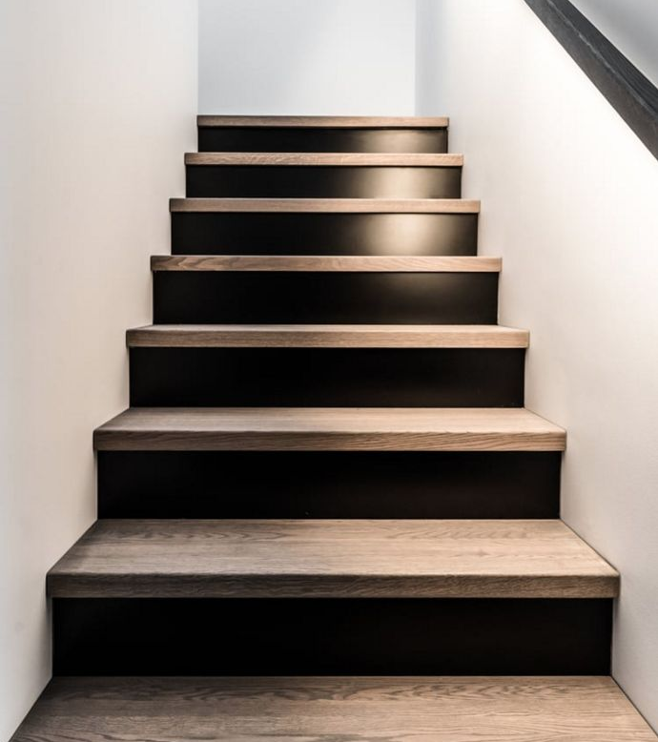
In the Upper Room That They All May Be One
John 17

Slide 3
Jesus’ Prayer
For Himself (vv. 1-5)
For The Apostles (vv. 6-19)
For All Believers (vv. 20-26)
“That They All May Be One”
– cf. 1 Corinthians 1:10-13 –

Slide 4
In the Upper Room That They All May Be One
John 17

