Slide 1
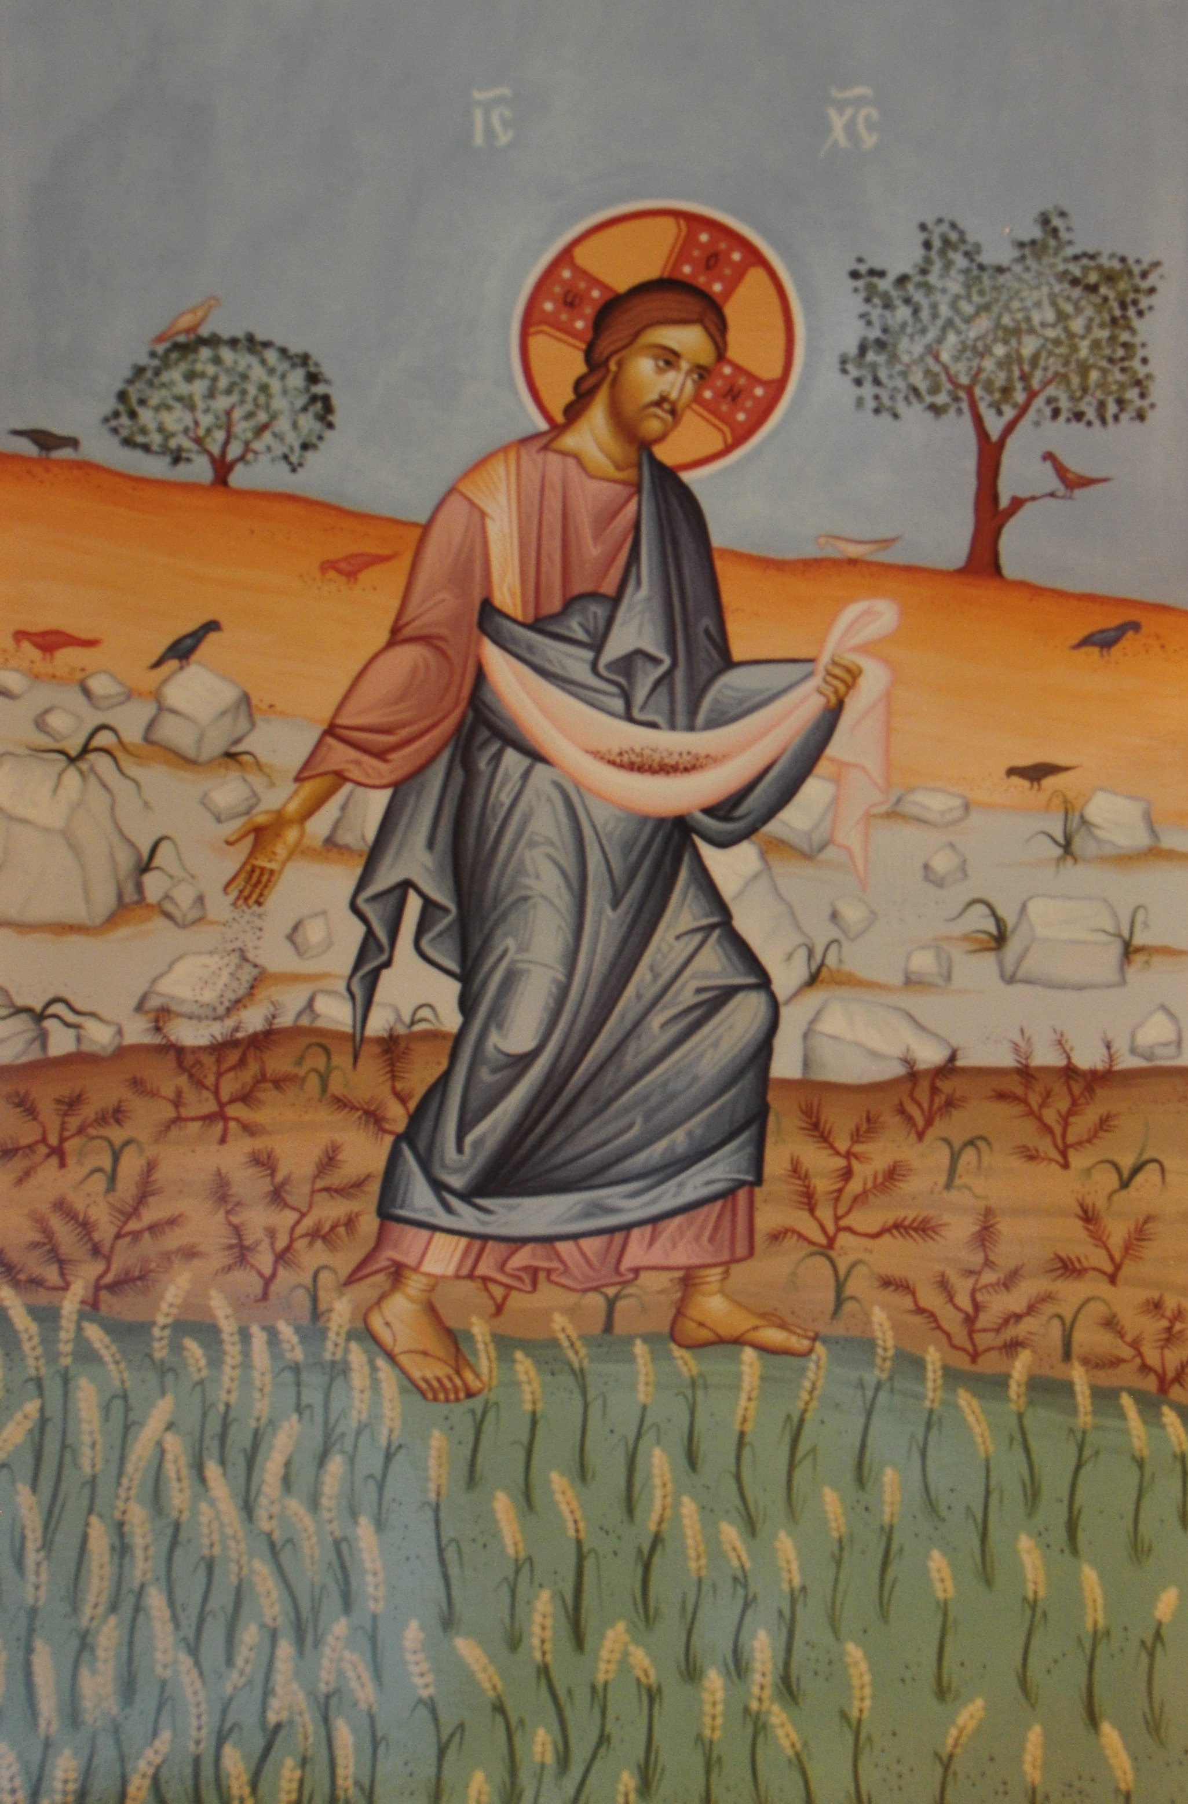
Perspective for the Sower
Positively Sowing the Word

Slide 2
Perspective for the Sower
The power is in the Word
God’s Word is powerful Ro 1:16; He 4:12-13
Conversion requires God’s Word 1Pe 1:23-25; 2:2-3
We must present the whole Gospel 1Co 15:1-4; Ro 2:4; 11:22
Results depend on the soil
If rejected, the soil is at fault Mt 10:14; Ac 13:46
We succeed every time we sow the seed!
Conversion is an extra joy

Slide 3
Perspective for the Sower
We are simply seed throwers
We don’t have to prepare the soil Lk 8:5-15
God gives the increase 1Co 3:5-7
He can use defective sowers 1Co 2:1-5; Ph 1:15-18
Often, one sows and another reaps
As Jesus taught His disciples Jn 4:35-38
We may never see the fruit of our labors
We may make it easier for others 1Co 3:6

Slide 4
Perspective for the Sower
God’s providence is at work
He knows the searching heart 2Chr 16:9; Ac 18:9-11
Those who hunger will be filled Mt 5:6; 7:7-8
We are God’s fellow workers 1Co 3:5-9
God opens doors for prepared workers
Doors of opportunity 1Co 16:9; 2Co 2:12
He uses those who are prepared 2Ti 2:19-21
Both individuals and congregations Re 3:8

Slide 5
Perspective for the Sower
Prayer availeth much
That promotes God’s providence Co 4:3
Between praying searcher and servant Ac 10:1-4,9
Do we pray for opportunity to sow?
We reap what we sow
As taught by Paul 2Co 9:6
To reap more, we must sow more
Goals should be how many taught, not converted

Slide 6
Perspective for the Sower
The power is in the Word
Results depend on the soil
We are simply seed throwers
Often, one sows and another reaps
God’s providence is at work
God opens doors for prepared workers
Prayer availeth much
We reap what we sow

Slide 7
Perspective for the Sower
“Therefore, my beloved brethren, be ye stedfast, unmoveable, always abounding in the work of the Lord, forasmuch as ye know that your labor is not in vain in the Lord.” ~ 1Co 15:58

