Slide 2
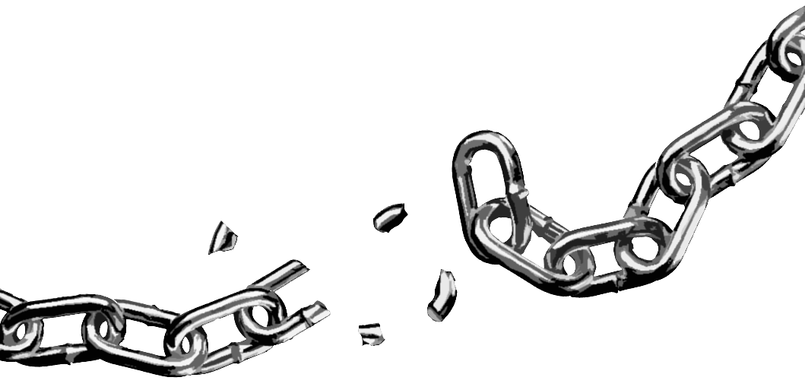
The Word of God is Not Chained
2 Timothy 2:9
Notes:
The Word of God is Not Chained
2 Timothy 2:9
Introduction
Paul’s second letter to his son in the faith, Timothy, is filled with exhortations.
2 Timothy 2:1 – be strong in the grace!
Paul alluded to his suffering for the Lord, and encouraged Timothy to join him in it (cf. 2 Timothy 1:8).
This would take strength! He needed encouragement to stand firm.
2 Timothy 2:8-13 – The resurrection of Christ strengthens us in hope of our own resurrection.
(v. 9) – Paul was chained in prison (suffered) for preaching the gospel.
(v. 10) – He endures such for the salvation of souls – His own included.
(vv. 11-13) – Our salvation is certain, for “He cannot deny Himself,” i.e. He cannot contradict His character and promises.
While Paul was chained, he took solace in the fact that “the word of God is not chained” (2 Timothy 2:9).
This is a most important truth.

Slide 3
Why is it not chained?
It is of God
2 Timothy 3:16; 2 Peter 1:20-21 – Inspiration
Job 42:2 – Purposes of God
Acts 5:33-39 – Cannot overthrow what is God’s
It has Transformative Power
Acts 3:18-20; 5:28-29, 40-42 – Courage and conviction of Peter and John
Notes:
Why is it not chained?
It is of God
2 Timothy 3:16 – Scripture is inspired of God.
2 Peter 1:20-21 – Men who wrote scripture were merely used as the pen of God, or as His mouthpiece.
Scripture is not the philosophy of men.
Scripture’s origin is the mind of God.
“I know that You can do everything, and that no purpose of Yours can be withheld from You” (Job 42:2).
God’s word states His purpose – to redeem mankind.
God WILL redeem man – Those who follow His word will not fail in that area, because God CANNOT FAIL.
Acts 5:33-39 – Gamaliel’s advice to the Jewish leaders and Sadducees.
Context: Peter and John released from prison by an angel, and continued to do that which the Jewish leaders commanded them not to do – speak in the name of Jesus.
(vv. 36-37) – Revolts led by men failed, their ideologies with them.
(vv. 38-39) – Leave the men alone – Of men? – it will come to nothing; Of God? – cannot overthrow it.
Gamaliel’s advice may not have been good – if false, they needed to combat it. If true, they needed to obey it.
However, his logic was sound – God’s purposes CANNOT be thwarted.
Which is related to another reason why God’s word is not chained →
It has Transformative Power
God’s word cannot be chained because God won’t let it be, but also because those convicted by it won’t let it be – God working through them.
Acts 3:18-20 – The initial arrest of Peter and John.
Despite their arrest, the apostles were not silenced.
They were convicted of their message, and sought to please God rather than men.
Acts 5:28-29 – After second arrest, and release by the angel from prison.
Put in jail again, and went out and did the very thing that got them arrested.
(vv. 40-42) – After Gamaliel’s advice, beaten, but went away rejoicing and STILL preaching!
God’s word transforms those who are faithful enough to submit to it. IT TAKES THE COWARDLY AND MAKES THEM COURAGEOUS! (Among many other facets of transformation…)
In what sense is it not chained?

Slide 4
In what sense is it not chained?
In its Relevance
Isaiah 40:8 – Timeless
Galatians 5:22-23 – Fruit of the Spirit
Romans 3:23; 1:16 – Need for Salvation
In its Proclamation
Philippians 1:12-18 – Preached by Paul in prison; preached by those without.
Notes:
In what sense is it not chained?
In its Relevance
“The grass withers, the flower fades, but the word of our God stands forever” (Isaiah 40:8).
It is timeless.
Societies and governments rise and fall, cultural influences pulse with change, and things die off.
God’s word not only stays the same, but remains prominent and relevant.
Its contribution to societies – cf. Galatians 5:22-23 – Fruit of the Spirit.
The fruit of the Spirit is the fruit produced by the HS in the life of one governed by His revelation – the word of God.
(v. 23) – No law is against such.
Societies which keep such principles in place, and reward such behavior while punishing the opposite do God’s bidding, and as such prosper.
“For he is God’s minister to you for good” (Romans 13:4) – Rulers, i.e. governing authorities.
More importantly – Romans 3:23; 1:16 – All have sinned and fall short of God’s glory, and continue to need saving – THIS WILL ALWAYS BE TRUE.
God’s word is the only way men will be saved.
The Spirit’s revelation is the last of God, thus, will ALWAS BE RELEVANT.
In its Proclamation
As stated before with Peter and John before the Sanhedrin…
Cf. Philippians 1:12-13 – Even when Paul was imprisoned he was able to reach men with the gospel.
“I suffer trouble as an evildoer, even to the point of chains; but the word of God is not chained” (2 Timothy 2:9).
(v. 13) – As he spoke to the “palace guard” while in prison, it became evident to them that he was put in prison for preaching – Thus, Paul influenced many with the gospel EVEN WHILE BEING IMPRISONED TO SHUT HIM UP.
(vv. 14-18) – By his example, Paul emboldened many to preach the gospel.
(v. 16) – Some preached the gospel in pretense, wanting to harm Paul in some way by doing so. (Perhaps attempting to provoke jealousy in Paul.)
(v. 18) – EVEN HYPOCRISY CANNOT CHAIN THE GOSPEL.
In its Efficacy

Slide 5
In what sense is it not chained?
In its Efficacy
1 Thessalonians 2:13; Acts 20:32 – Promoting growth
2 Corinthians 10:3-6; Jude 3; 1 Peter 3:15 – Defeating error
In its Judgment
John 12:48 – Jesus’ word will judge
Hebrews 4:11-13 – Power of word in judgment
Notes:
In its Efficacy
In promoting growth:
“but grow in the grace and knowledge of our Lord and Savior Jesus Christ” (2 Peter 3:18).
1 Thessalonians 2:13 – The word of God received by the Thessalonians worked in them – toward the doing of God’s will, and growing in His work.
Acts 20:32 – Paul to the Ephesian elders – God’s word would be that which caused them to grow. (be built up)
In defeating error:
2 Corinthians 10:3-6 – Spiritual warfare waged with spiritual weapons.
Primary weapon against error – “and [take] the sword of the Spirit, which is the word of God” (Ephesians 6:17).
Such spiritual weapons decimate error.
Jude 3 – We are commanded to contend for the faith.
1 Peter 3:15 – We simply need to be prepared to give an answer.
If we prepare ourselves by gaining the knowledge of God’s word, we will succeed.
NOTHING CAN STAND OPPOSED TO THE TRUTH, AND REMAIN STANDING.
In its Judgment
“He who rejects Me, and does not receive My words, has that which judges him – the word that I have spoken will judge him in the last day” (John 12:48).
Jesus “committed Himself to Him who judges righteously” (1 Peter 2:23) by His word.
He knew His enemies would be judged in the end.
The word of God IS NOT CHAINED IN ITS JUDGMENT IN THE END.
Hebrews 4:11-13 – It will penetrate and saw asunder any façade a man may put forth.
The word of God will not fail to expose our sin.
We will be judged by what we have done according to God’s word.

Slide 6
The Word of God is Not Chained
2 Timothy 2:9
Notes:
Conclusion
We should be impressed with the fact that “the word of God is not chained” (2 Timothy 2:9).
However, beware, IT CAN BE CHAINED PERSONALLY – cf. 1 Thessalonians 5:19-22 – DO NOT quench the Spirit, but obey.

