Slide 2
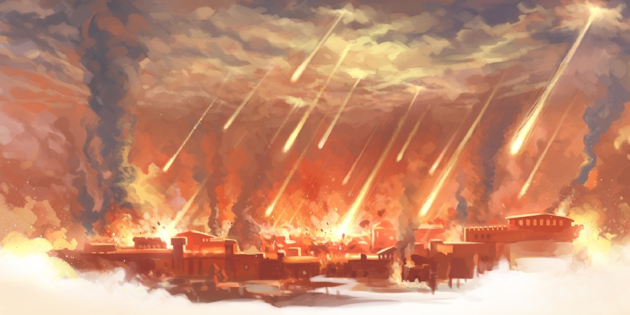
Urging Lot
Genesis 19:15
Notes:
Urging Lot
Genesis 19:15
Introduction
The cry of justice reached the ears of the Lord concerning Sodom and Gomorrah (cf. Genesis 18:20-21 – The unrighteousness of the cities was great, and such required punishment).
Abraham interceded for the cities, asking that God spare them for any righteous inhabitants, lest the righteous be destroyed with the wicked (cf. Genesis 18:22-23).
Abraham started at 50, to 45, 40, 30, 20, 10.
Abraham did not find the needed number, and God sent two angels to Sodom to inquire into the state of the city.
They were going to “spend the night in the open square” (19:2), but Lot, knowing the depravity of the city, insisted they stay in his home.
The men attempted to lay carnally with the men called angels, exposing once and for all the depravity of the city, but the angels struck them with blindness (cf. Genesis 19:11).
Genesis 19:12-29 – The judgment on Sodom and Gomorrah.
(vv. 15-17) – The angels urged Lot to take his family, and leave the city, lest he be destroyed with the unrighteous.
The urgency in their message is overwhelming. Lot needed to get out, and they made sure he did!
We, as the angels did with Lot, need to have a sense of urgency with each other and the world concerning certain important matters. →
The Righteous Need Urging

Slide 3
The Righteous Need Urging
Our Duty to Urge Each Other
Hebrews 3:12-15; 10:24-25 – Exhortation to steadfastness.
James 5:19-20 – Turning the erring away from sin.
To Fulfill Our Christian Duties
Ephesians 2:10 – Created for good works.
John 9:4 – Work while you can.
Titus 3:8 – Such is profitable for you.
Notes:
The Righteous Need Urging
Our Duty to Urge Each Other
Hebrews 3:12-15 – Exhortation to steadfastness in Christ.
We need to urge each other toward faithfulness, and away from sin.
For this reason – 3:16-4:2 – Those who were saved before, who reverted to disobedience lost their souls.
cf. Hebrews 10:24-25 – This, in part, can be accomplished by assembling with the saints.
It is important that we watch for those who are struggling, and drifting, and that we URGE THEM to return to the Lord:
James 5:19-20 – We can, and must, save their soul from death!
The angels saw the doom closing in on Lot and his family, and urged them to leave so as to avoid it!
To Fulfill Our Christian Duties
We must urge each other to do that which God requires us to do.
Ephesians 2:10 – We are a spiritual creation for good works.
John 9:4 – Jesus understood the urgency of the matter pertaining to His duty to God.
We are put on this earth to serve God.
We have a limited time to be given to such work.
Titus 3:8 – We should be CAREFUL…
CAREFUL suggests the matter is serious!
Doing such is profitable for men – “godliness is profitable for all things, having promise of the life that now is and of that which is to come” (1 Timothy 4:8).
Neglecting such is damaging to our soul – BE CAREFUL TO MAINTAIN!
To Avoid Bad Company

Slide 4
The Righteous Need Urging
Our Duty to Urge Each Other
To Fulfill Our Christian Duties
To Avoid Bad Company
2 Peter 2:7-8 – Righteous Lot tormented.
Ephesians 4:16 – Spend time with those who build up.
1 Corinthians 15:33 – Corrupts good habits.
Notes:
To Avoid Bad Company
Lot is described by the Holy Spirit as righteous, even though he dwelt in such an unrighteous land:
2 Peter 2:7a – God delivered righteous Lot.
However, being surrounded by such ungodly people had a negative effect on him – 2 Peter 2:7b-8.
Lot was burdened with the amount of immorality around him as he sought to live righteously.
We should urge each other to spend time with those who will build up, instead of tear down – cf. Ephesians 4:16
1 Corinthians 15:33 – Such company with wicked people can not only be discouraging, but can wear us down to corruption.
The Unrighteous Need Urging

Slide 5
The Unrighteous Need Urging
Our Duty to Urge Them
Mark 16:15-16 – Great commission.
2 Peter 2:5 – Even when they don’t listen.
The Message of Urgency
Acts 22:16; 8:36-38; 16:30-33 – Urgency of the gospel.
Gal. 6:7-8; 2 Peter 2:6; Jude 5-7; 2 Thess. 1:8-10 – Punishment for sin is certain.
2 Peter 3:9, 15; Matt. 24:42-44 – God’s longsuffering is temporary.
Notes:
The Unrighteous Need Urging
Our Duty to Urge Them
Mark 16:15-16 – We are charged with the responsibility to tell men how to be saved, but also tell them how they will be condemned (thus, what to avoid.).
2 Peter 2:5 – Like with Noah, this is even necessary if none will listen.
We must warn them of destruction even when they ignore, and refuse to believe.
Remember the song, “You Never Mentioned Him To Me,” and do not let it be true of yourself!
The Message of Urgency
Urgency of the Gospel
Acts 22:16 – Ananias to Saul – WHY ARE YOU WAITING? (It is a matter of urgency!)
Ananias was sent to instruct Paul.
There was no need to wait.
To those who have heard the gospel – You know what you need to do, why are you waiting?
Acts 8:36-38 – The eunuch asked what hindered him – answer – NOTHING – if you know the truth, there is NO reason to wait, and EVERY reason to hurry!
Acts 16:30-33 – The Philippian Jailer.
(v. 33) – same hour of night – IMMEDIATELY.
He asked what he needed to do, was told what he needed to do, and immediately went and did so!
YOU MUST HASTEN TO OBEY THE GOSPEL BECAUSE →
Punishment of Sin is Certain
Galatians 6:7-8 – God is not mocked! (Nobody will be an exception, for any reason, to the rule!)
2 Peter 2:6; Jude 5-7 – Sodom and Gomorrah, along with many others, are examples of the fact that punishment for sin is CERTAIN!
2 Thessalonians 1:8-10 – Those who do not obey the gospel WILL BE DESTROYED!
AS THE ANGELS URGED LOT, SO WE URGE YOU!
The Longsuffering of God is Temporary
2 Peter 3:9, 15 – Do not mistake the longsuffering of the Lord as slackness, but consider it as your salvation.
IT IS ONLY YOUR SALVATION IF YOU TAKE ADVANTAGE OF IT! OBEY!
BEWARE, HIS LONGSUFFERING IS TEMPORARY – Matthew 24:42-44 – The day of the Lord is coming!

Slide 6
Urging Lot
Genesis 19:15
Notes:
Conclusion
Destruction was coming upon Sodom and Gomorrah, so the angels of the Lord urged Lot to hurry!
We should urge one another to do God’s will, so that when the day comes we are not found wanting.
The unrighteous should be urged to obey the gospel before it is everlastingly too late!

