Slide 2
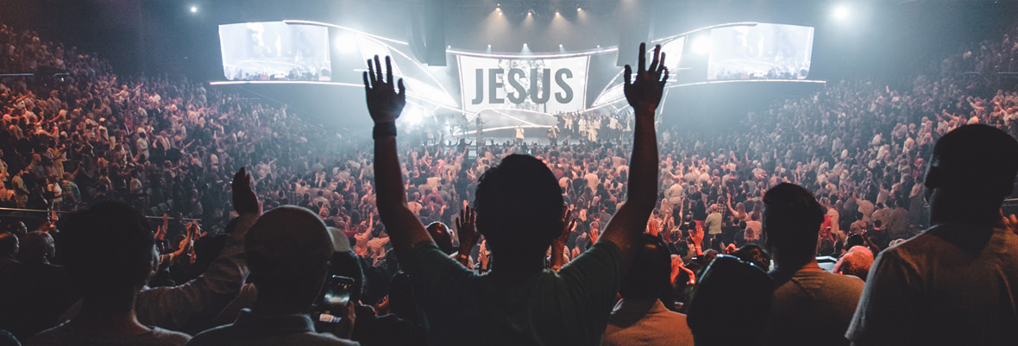
What Unauthorized Worship Indicates
“God is Spirit, and those who worship Him must worship in spirit and truth.” – John 4:24
Notes:
What Unauthorized Worship Indicates (John 4:24)
Introduction
Jesus told the Samaritan woman at the well what would constitute acceptable worship before God in His coming kingdom (cf. John 4:24).
Spirit – sincere worship from the heart.
Truth – according to God’s word.
A glimpse into the denominational world manifests either an ignorance of the sentiments of this verse, or an indifference toward it.
This is especially noticeable during the holidays.
The phrase, “Put Christ back in Christmas” suggests Christ was put in Christmas in the first place.
None with authority put Christ in Christmas – God, Jesus, Holy Spirit, apostles, prophets.
Men put Christ in Christmas without authority from God.
Nothing concerning Christmas can be found in the Bible.
Nothing concerning the religious observance of Jesus’ birth by the 1st century church can be found in the Bible.
We are not even told when Jesus was born. (Not year, month, and certainly not the day.)
However, most who call themselves Christians engage in such religious observances without Scriptural authority.
Christmas is just one example. Worship which is not “in truth” is regularly practiced by those in the world. Such participation in unauthorized worship indicates:
Ignorance About the Purpose of Worship – Do Reverence to God

Slide 3
Ignorance About the Purpose of Worship – Do Reverence to God –
What Unauthorized Worship Indicates:
Worship – "’to make obeisance, do reverence to’…It is used of an act of homage or reverence” (Vine).
Psalm 89:7 – God is to be feared/revered.
Approaching God
Exodus 3:1-6 – Moses at burning bush.
Hebrews 12:28-29 – Christians.
Notes:
Ignorance About the Purpose of Worship – Do Reverence to God
Worship
Worship – proskuneō – (from pros, "towards," and kuneo, "to kiss").
“prop. To kiss the hand towards one, in token of reverence” (Thayer).
"’to make obeisance, do reverence to’…It is used of an act of homage or reverence” (Vine).
Worship is a display of reverence toward God.
Reverence means “profound respect, affection, veneration” (Webster).
Psalm 89:7 – God is worthy of our reverence.
This is because of who God is →
Context: (vv. 1-10), He is the Almighty Creator, who is faithful and loving, thus, worthy to be feared, and held in reverence →
Approaching God
Moses approaching God:
Exodus 3:1-6 – While in Midian after killing the Egyptian and fleeing.
Holy ground – because God was there!
Proper reaction – treat it as holy, i.e. revere God who is before you!
Christians approaching God:
Hebrews 12:28-29 – Hebrew writer concerning approaching Mt. Zion instead of Mt. Sinai
(v. 29) – The God we serve is the same whom the Israelites serve – we should approach Him accordingly.
Approaching God should be understood as a unique, and grave matter. (Not approached in laxity, and indifference.)
God is not to be approached and worshiped casually.
God cannot be shown reverence with unauthorized worship, or disobedience. →
Ignorance About God’s Desire for Us – Obedience of Faith

Slide 4
Ignorance About God’s Desire for Us – Obedience of Faith –
What Unauthorized Worship Indicates:
God Desires Our Obedience
Colossians 3:17 – In whatever we do.
Romans 1:5; 16:26 – Obedience of faith.
Obedience in Worship – Spirit and Truth
1 Samuel 15:20-23 – King Saul disobeys.
Also indicates a lack of love – John 14:15
Notes:
Ignorance About God’s Desire for Us – Obedience of Faith
God Desires Our Obedience
Many who worship God do so without considering what God has authorized, or has not authorized. They do not consider authority as a pertinent matter.
Colossians 3:17 – WHATEVER is all encompassing – including everyday life, and especially worship.
Consider the focus of Christmas:
Focus on BABY Jesus – appealing because babies are cute, cuddly, and gentle.
Baby Jesus grew to be the MAN Jesus whom God has given authority – cf. Acts 2:36; Matthew 28:18.
“But why do you call Me ‘Lord, Lord,’ and not do the things which I say?” (Luke 6:46)
Faith and works (obedient faith) – People emphasize faith to the exclusion of works, but James wrote “faith by itself, if it does not have works, is dead” (James 2:17).
Romans 1:5; 16:26 – Paul’s apostleship was to the end of bringing men to obedience to the faith. (“obedience of faith” NASB)
It is impossible to worship God acceptably, i.e. demonstrate reverence before Him without obedience! →
Obedience in Worship – Spirit and TRUTH
Many emphasize worship in spirit, but neglect worship in truth – Jesus said, “in spirit AND TRUTH” (John 4:24). (Both are of equal importance.)
King Saul is an example of how God views unauthorized worship:
1 Samuel 15:20-21 – Saul’s response to Samuel telling him he disobeyed God.
God told Saul to utterly destroy the Amalekites, all of their possessions, and their king, Agag.
Saul spared Agag, and the best of the sheep and oxen.
(v. 21) – He thought it would be pleasing to God if he offered sacrifice to God, even though it was a result of his disobedience.
1 Samuel 15:22-23 – Samuel’s response to Saul.
What is God’s desire for us? (v. 22 – obedience)
(v. 23) – Shows how bad disobedience is. How much God abhors it!
We must not be guilty of that which Jesus said the Pharisees were guilty of (cf. Matthew 15:7-9).
Worship that is not obedient also INDICATES A LACK OF LOVE FOR GOD (cf. John 14:15).
People claim to be expressing their love to God when they worship Him in ways that the Bible does not authorize.
In reality “their heart[s] [are] far from [God]. And in vain they worship [Him]” (Matthew 15:8-9).
A Lack of Comprehension of God’s Judgment

Slide 5
A Lack of Comprehension of God’s Judgment
What Unauthorized Worship Indicates:
God’s Promise of Judgment
Acts 17:30-31 – Has appointed a day.
Romans 2:6-11 – His judgment is just.
What of those who offered profane worship?
Leviticus 10:1-3 – Nadab and Abihu.
Matthew 7:21-23 – Jesus to the lawless.
Notes:
A Lack of Comprehension of God’s Judgment
God’s Promise of Judgment
Acts 17:30-31 – Paul warned the men of Athens about God’s impending judgment.
It is certain!
He has appointed a day!
Romans 2:6-11 – His judgment is just.
(v. 6) – It will be according to each man’s deeds.
(v. 11) – God will show no partiality in this judgment.
He has given us the means by which we can appear before Him as blameless in that day – “He who rejects Me, and does not receive My words, has that which judges him – the word that I have spoken will judge him in the last day” (John 12:48).
What of those who offered profane worship?
Acts 17:22-23, 30 – The subject of Paul’s sermon in Athens was the worship of God.
(v. 23) – They worshiped Him without knowledge – “they have a zeal for God, but not according to knowledge” (Romans 10:2).
(v. 30) – Thus, their worship was wrong, and they needed to repent.
Why was repentance necessary? – “unless you repent you will all likewise perish” (Luke 13:5).
Unauthorized worship is that which will DESTROY YOU! →
Nadab and Abihu:
Leviticus 10:1-3 – The priests were leading in worship, offering sacrifices to God.
God had given them SPECIFIC instructions.
(v. 1) – The fire they used was unauthorized, thus strange.
(v. 2) – They were killed for it.
NOTE THE REASON GIVEN BY MOSES:
(v. 3) – God must be regarded as holy!
The worship offered by those in the denominations today is no different, and unless they repent, their end will be the same →
Matthew 7:21-23 – Jesus requires obedience, and will punish “lawlessness.”

Slide 6
What Unauthorized Worship Indicates
“God is Spirit, and those who worship Him must worship in spirit and truth.” – John 4:24
Notes:
Conclusion – We must remember what pleases God. He desires our worship to be in “spirit and truth” (John 4:24). We should especially keep this in mind during times like the holiday season, because we might be asked why we do not have a Christmas program of some sort. (cf. 1 Peter 3:15 – prepared to give an answer.)

