Slide 2
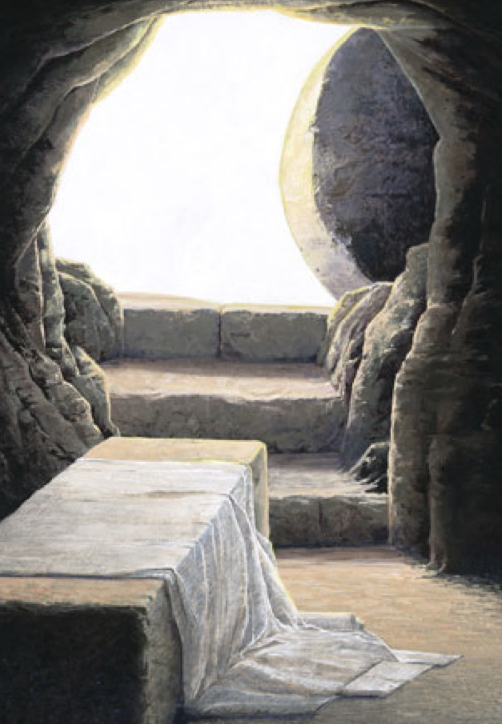
The Power of His Resurrection
Philippians 3:10
Notes:
The Power of His Resurrection
Philippians 3:10
Introduction
The apostle Paul left all he gained and knew to “know Him and the power of His resurrection” (v. 10).
He counted all he gained as “rubbish” that he could possess “the knowledge of Christ Jesus” (v. 8).
“The power of His resurrection” is a key facet of Christianity, and to our success as children of God. It was so important that Paul left ALL just to better know it.
Let us consider the power of His resurrection.
The Power of His Resurrection…

Slide 3
The Power of His Resurrection…
Predicted
Psalm 16:8-11 – Messianic psalm.
Matthew 12:38-40 – Sign of Jonah.
Notes:
The Power of His Resurrection…
Predicted
Psalm 16:8-11 – The HS directed David in prediction of the Lord’s resurrection.
The Messiah would be subjected to an ignominious death, but would not be left in the grave.
(v. 8) – Christ always had the Father before Him – i.e. to do His will.
(v. 9) – In doing so, He was glad, and was secure because of hope.
(v. 10) – His hope was that of His resurrection by God from the dead.
(v. 11) – He would die no more.
Matthew 12:38-40 – Men wanted a sign to believe, and Jesus said the only sign given them would be that of Jonah.
Like Jonah was in the great fish, Jesus would be in the tomb for 3 days, then raised.
“So the Lord spoke to the fish, and it vomited Jonah onto dry land” (Jonah 2:10) – God would raise Jesus from the tomb.
Fulfilled

Slide 4
The Power of His Resurrection…
Predicted
Fulfilled
Mark 16:1-7 – Tomb found empty.
1 Corinthians 15:5-8 – Eyewitnesses.
Notes:
Fulfilled
Mark 16:1-7 – The prophecy was fulfilled. The two Mary’s found Jesus’ tomb empty. The angel said He is risen.
1 Corinthians 15:5-8 – After His resurrection…seen by many – eye witnesses.
Preached

Slide 5
The Power of His Resurrection…
Predicted
Fulfilled
Preached
Acts 2:29-36 – Peter on Pentecost.
1 Corinthians 15:1-4, 12-19 – Keystone of Christianity.
Notes:
Preached
Acts 2:29-36 – After quoting Psalm 16:8-11, Peter explained in the first gospel sermon recorded for us.
The Psalm did not speak of David. He is dead.
The Psalm spoke of Jesus! He is now at God’s right hand reigning!
1 Corinthians 15:1-4, 12-19 – The resurrection of Christ is the keystone of Christianity. If it is debunked, all of Christianity crumbles!
Romans 1:3-4 – Resurrection declares Jesus is God’s Son with POWER!
The Eunuch said, “I believe that Jesus Christ is the Son of God” (Acts 8:37), but if Christ is not risen then he should not believe.
…Working in the Lives of Christians

Slide 6
…Working in the Lives of Christians
Salvation from Sin
Romans 4:22-25 – Believe in resurrected Lord.
Colossians 2:11-13 – Belief exhibited in baptism.
Colossians 3:1-4 – Seek things above.
Notes:
…Working in the Lives of Christians
Salvation from Sin
Romans 4:22-25 – Speaking of Abraham’s example of faith.
If we trust in God who raised Jesus from the dead, we too will be justified.
We must believe in the resurrected Christ. Then God will raise us from being dead in sin.
Colossians 2:11-13 – We exhibit such faith by submitting to baptism.
It is faith in God’s ability to raise you from being dead in sin because of the fact that He raised Christ from the dead.
Baptism is an appeal to God for a good conscience “through the resurrection of Jesus Christ” (1 Peter 3:21).
Christians are those who have experienced the power of His resurrection in their own spiritual resurrection from death in sin. Now they are seated with Christ in heavenly places.
Colossians 3:1-4 – Those who are raised must seek, and set their minds on things above.
They “walk in newness of life” (Romans 6:4).
Living for Christ

Slide 7
…Working in the Lives of Christians
Salvation from Sin
Living for Christ
Ephesians 1:19-21 – Know the power.
Acts 5:29-32; 2 Corinthians 4:13-14 – Power seen with apostles.
2 Corinthians 12:7-10; 4:7-11 – Power to endure.
Notes:
Living for Christ
The knowledge of the power of His resurrection is something we must grow in as we seek to live for God. We are to strive obediently as we “wait for [God’s] Son from heaven, whom He raised from the dead, even Jesus who delivers us from the wrath to come” (1 Thessalonians 1:10).
Ephesians 1:19-21 – Paul prayed that the Ephesians would come to know more intimately the power that works in their lives, such power that raised Jesus from the dead. (We, too, must strive to know this more intimately!)
The knowledge that Christ conquered death, and the same is promised to us is EMPOWERING – cf. Acts 5:29-32 – Such knowledge is what gave the apostles boldness to preach in the face of opposition.
Paul put it this way – cf. 2 Corinthians 4:13-14 – Paul believed, and therefore spoke, because of the knowledge of His resurrection.
The knowledge of His resurrection gives us power/strength to endure anything:
2 Corinthians 12:7-10 – Paul’s thorn in the flesh, and grace sufficient for him to endure.
(v. 9) – The Lord’s grace gave Paul strength to endure – grace – the Divine favor bestowed by the Lord in His death and resurrection – assurance and hope of eternal life!
This assured knowledge empowered Paul to endure!
(vv. 9-10) – It is made “perfect,” or complete in weakness – that is when it is realized the most – when we are most aware of our impotence, and dependence upon the Lord’s promises.
Such power is most realized in hardship – thus, “all who desire to live godly in Christ Jesus will suffer persecution” (2 Timothy 3:12).
2 Corinthians 4:7-11 – The life of Jesus is manifested in our flesh as we endure hardship though the POWERFUL KNOWLEDGE OF HIS RESURRECTION.
“For this reason I also suffer these things; nevertheless I am not ashamed, for I know whom I have believed and am persuaded that He is able to keep what I have committed to Him until that Day” (2 Timothy 1:12).
Glorified with Christ

Slide 8
…Working in the Lives of Christians
Salvation from Sin
Living for Christ
Glorified with Christ
2 Timothy 2:8-13 – We shall live with Him.
1 Corinthians 15:20-23, 50-58 – Resurrection and transformation.
Notes:
Glorified with Christ
2 Timothy 2:8-13 – Paul’s encouragement to Timothy to endure.
(v. 8) – Remember the resurrection.
(vv. 11-13) – Understand the surety that is in such truth – WE SHALL LIVE WITH HIM!
“For we believe that Jesus died and rose again, even so God will bring with Him those who sleep in Jesus” (1 Thessalonians 4:14).
1 Corinthians 15:20-23 – Christ is the firstfruits, which means we will follow!
1 Corinthians 15:50-58 – Not all will be raised, for not all will be dead. But ALL WILL BE CHANGED!
(v. 58) – This assurance is the motivating force behind our lives of service to God.
If we are to be steadfast, we MUST KNOW THE POWER OF HIS RESURRECTION.

Slide 9
The Power of His Resurrection
Philippians 3:10
Notes:
Conclusion
The resurrection of Jesus Christ from the dead is of utmost importance.
We are helpless to work the works of God if Jesus is not raised from the dead.
With the knowledge of His resurrection we will be empowered to do those things which God requires, and to be found by Him without spot, and blameless.
Do you believe?

