Slide 2
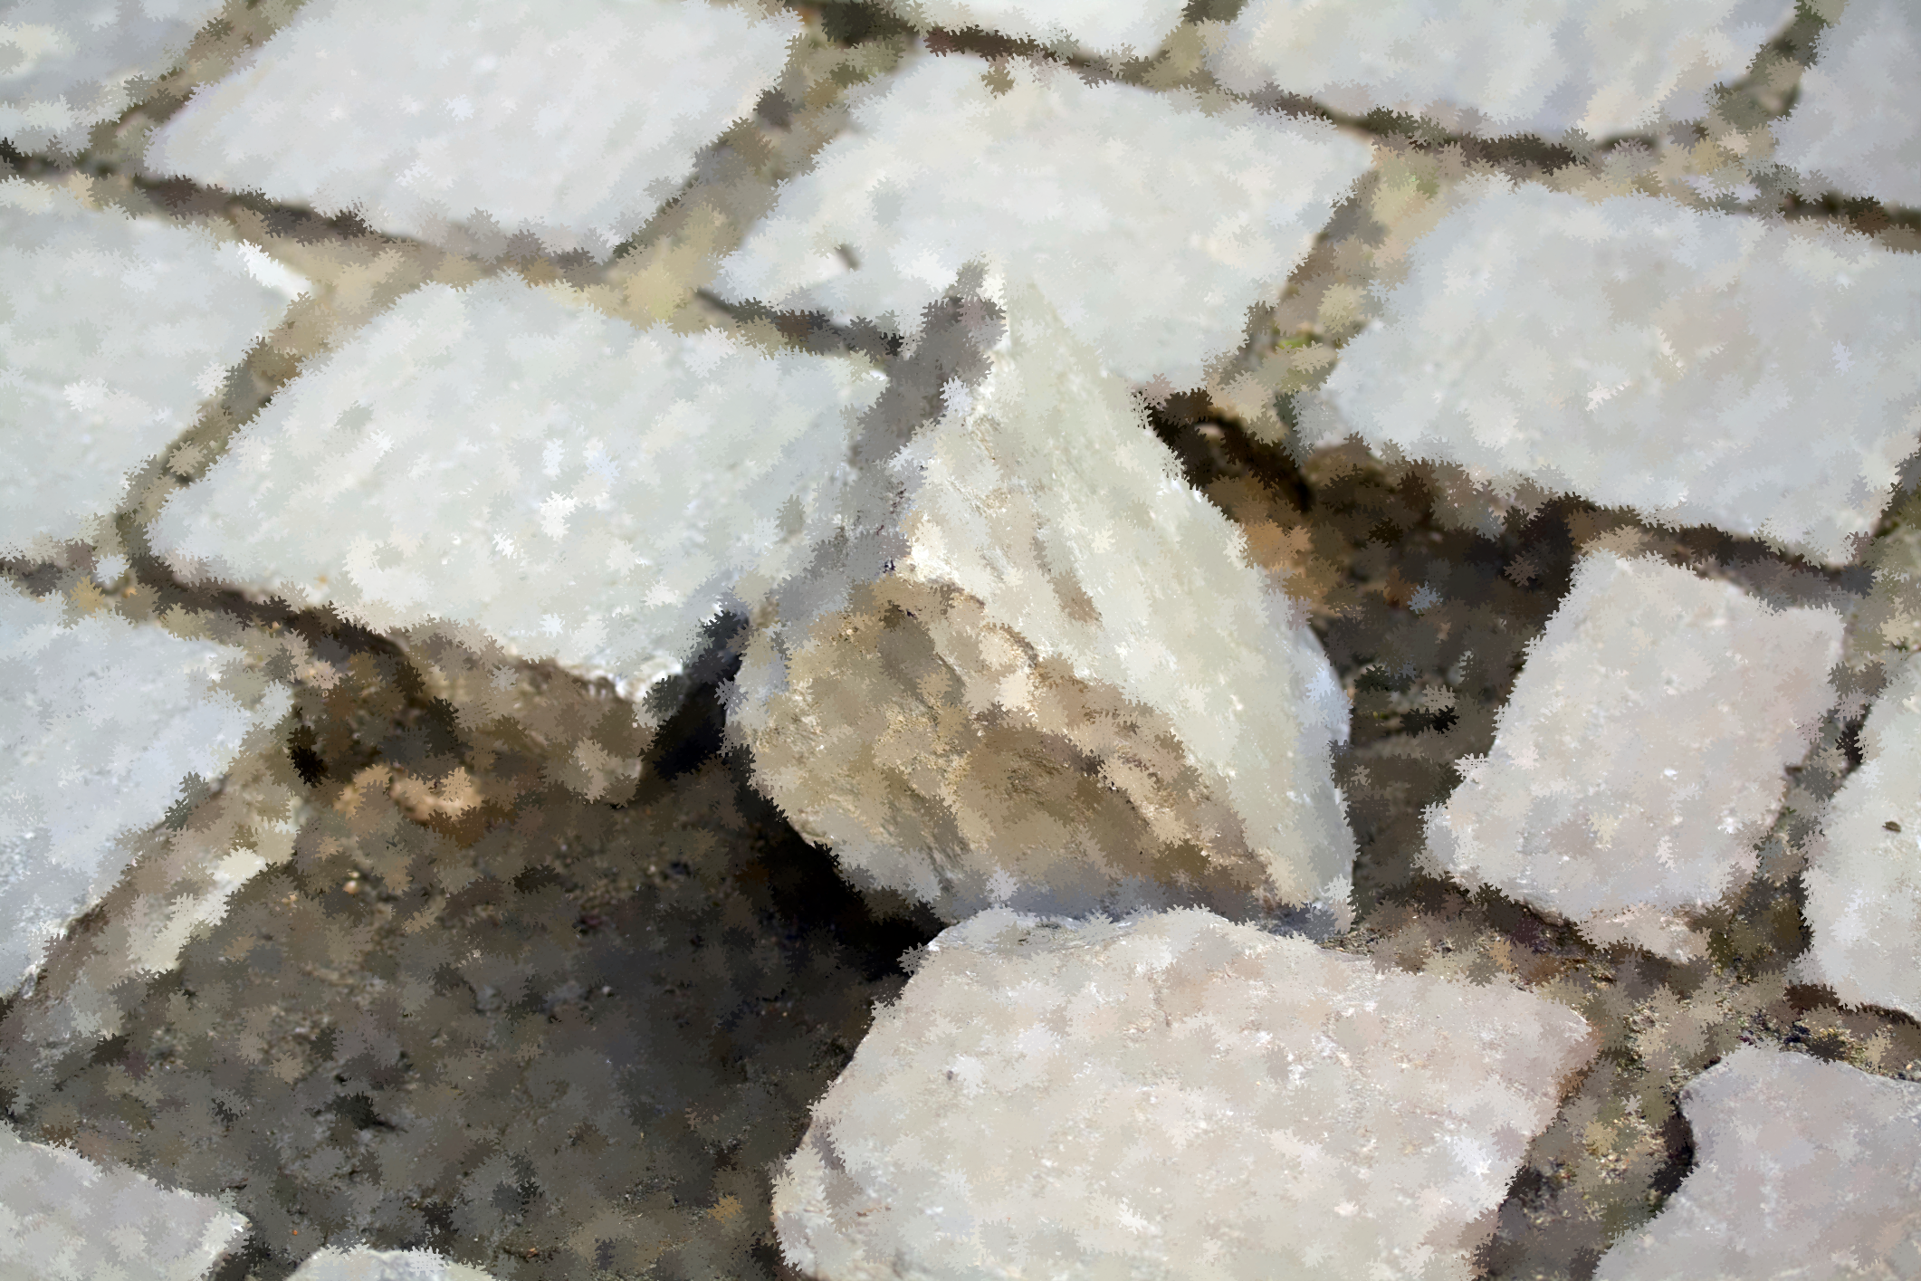
“A stone of stumbling and a rock of offense”
1 Peter 2:4-8
Notes:
“A stone of stumbling and a rock of offense” 1 Peter 2:4-8
Introduction
The entire thrust of scripture is the salvation of man.
This salvation would be founded/built upon One of whom God had prophesied – the Messiah – building up a “spiritual house,” “the house of God” (1 Timothy 3:15).
(v. 6) – Chief cornerstone – cf. Isaiah 28:16.
(v. 7) – Builders rejected that stone (Jews) – cf. Psalm 118:22.
(v. 8) – Was a source of harm for them as they stumbled on the stone – cf. Isaiah 8:14.
What does it mean that Christ is the “chief cornerstone?” In what way was He rejected? How was He “a stone of stumbling and a rock of offense?”
Jesus is “a stone of stumbling and a rock of offense” to many who do not even know it. They think they consider Him as “precious” when in reality they have “rejected” Him, Him being an occasion for “stumbling” and “offense” toward them, thus, becoming their ruin.
The Rejected Stone is Made the Cornerstone

Slide 3
The Rejected Stone is Made the Cornerstone
The Chief Cornerstone (1 Peter 2:6)
Isaiah 28:16 – Tried, precious, sure.
Matthew 16:15-19 – Upon this rock…
Luke 6:46-49 – Laid the foundation on the rock.
Notes:
The Rejected Stone is Made the Cornerstone
The Chief Cornerstone (v. 6)
1 Peter 2:6 – Those who believe/trust in the Cornerstone will not be “put to shame” (LXX – and Peter’s use).
Isaiah 28:16 – “will not act hastily” – i.e. will have no fear, as one who makes haste often does. (Misplaced his trust, thus, is ashamed, and hastens to get away and hide.)
His hope will not be put to shame, or disappointed – it will not be all for nothing.
Cornerstone – the principle stone on which the corner of an edifice would rest.
Such was integral to the structural integrity of the building.
A faulty cornerstone, or one simply removed, would mean ruin for the structure.
“It governs all the angles and all the lines of both the foundation and the building and is thus placed at the head of the corner, i.e., to form the projecting (not the inner) angle.” (Lenski) (The whole building affected by it.)
Jesus would be that stone for the spiritual edifice of the kingdom of God, as Isaiah puts it – “Behold, I lay in Zion a stone for a foundation, a tried stone, a precious cornerstone, a sure foundation; whoever believes will not act hastily” (Isaiah 28:16).
NOTE: Not just any, arbitrarily chosen stone, but a “tried stone,” “elect,” “precious,” and “sure.”
Jesus used such imagery of Himself being a rock, a foundation, a cornerstone:
Matthew 16:15-19 – The fact of Peter’s confession (Not Peter, is he “sure,” “tried” found not wanting?) – Jesus is the Christ, the Son of the living God – is the rock on which the church (Kingdom, the building of prophecy which the builders sought) is built, that not even death can penetrate.
(v. 19) – The keys were given to Peter and the apostles (subsequently to all believers) – Their words were those settled in heaven – cf. Ephesians 2:19-22 (in line with the corner) – apostolic word = word of Christ.
1 Corinthians 2:2; 3:11 – This is what Paul, along with the other apostles, preached.
Luke 6:46-48 – This is that which Paul preached because the “rock” of Christ’s word is the ONLY sure foundation. (v. 49 – not be put to shame like the one who does not build on this foundation.)
The Stone Rejected (v. 7)

Slide 4
The Rejected Stone is Made the Cornerstone
The Chief Cornerstone (1 Peter 2:6)
The Stone Rejected (1 Peter 2:7)
John 1:10-11 – Not received by His own.
John 12:31-50 – Believed, but did not believe.
1 Peter 2:1-8 – Reject and disobey His word.
Psalm 118:22-24; Acts 5:29-31 – Foolish to reject Him.
Notes:
The Stone Rejected (v. 7)
1 Peter 2:7 – The stone which was rejected in the building process God has chosen to be the MOST IMPORTANT – and become He will, and has. (The rejection of the stone could not alter the stone’s place in the building of God.)
Rejecting Jesus:
John 1:10-11 – He came to His own creation, and not even his own people (Jews) received Him.
Parable of minas – “But his citizens hated him, and sent a delegation after him, saying, ‘We will not have this man to reign over us.’” (Luke 19:14).
The Messiah Jesus claimed to be was not the Messiah they envisioned:
John 12:31-41 – The people understood Jesus’ reference to being lifted up as one of death, but they did not like the idea of a dying Messiah. (Signs performed, but obstinacy toward His words →)
John 12:42-50 – They believed in Jesus (as the signs validated His claims), but the problem was the teaching (His word).
(vv. 42, 47) – Believed, but not believed? – A matter of a working faith in accord with Christ’s word – did not confess Him…
Their rejecting Him ultimately came down to rejecting His teaching!
To reject Jesus is ultimately to reject His word! This is the context of 1 Peter 2 →
1 Peter 2:1-3, 7, 8b – Audience = people born through the word of God.
Exhortation – continue to grow. (NOTE: desire word, if tasted that “the Lord is gracious.”) – “have tasted the heavenly gift…and…the good word of God” (Hebrews 6:4-5).
(v. 4) – How are they coming to Him? – vv. 2, 3 – desiring the word, having tasted the graciousness of the Lord (Where? In the word.).
(vv. 7-8) – “You who believe” is the antitheses of “disobedient…disobedient to the word.”
To DISOBEY THE WORD is to REJECT JESUS (the stone).
Folly in rejecting the stone (Jesus) – “Has become the chief cornerstone”:
Cf. Psalm 118:22-24 – This is God’s will, His design, and we should rejoice in His design! (For, “he who believes on Him will by no means be put to shame” 1 Peter 2:6).
Cf. Acts 5:29-31 – This was Peter’s mindset, and understanding.
NOTE: If the REJECTED STONE has been chosen by God to be the CHIEF CORNERSTONE, rejecting Him cannot be without DIRE CONSEQUENCE.
“A stone of stumbling and a rock of offense” (v. 8)

Slide 5
The Rejected Stone is Made the Cornerstone
The Chief Cornerstone (1 Peter 2:6)
The Stone Rejected (1 Peter 2:7)
“A stone of stumbling and a rock of offense” (1 Peter 2:8)
Isaiah 8:11-15 – Fear and trust in God…or else.
Matthew 21:42-46 – To reject the cornerstone is to be destroyed by the cornerstone.
Notes:
“A stone of stumbling and a rock of offense” (v. 8)
1 Peter 2:8 – Rejecting the stone which God has made the chief cornerstone was not a simple matter of inconsequential preference.
Stumbling stone/offense (cannot walk around it, but in rejecting Him necessarily there is confrontation) – not simply a little stumble and move on, but something HIGHLY DESTRUCTIVE.
For one through whom comes an offense (occasion for stumbling) – “It would be better for him if a millstone were hung around his neck, and he were thrown into the sea, than that he should offend one of these little ones” (Luke 17:2 – because it destroys them spiritually.).
Isaiah 8:14 – Peter quoted, context gives the idea – ultimately, it is attributed to Jesus, the Messiah.
Context: Isaiah sent by God to Ahaz, king of Judah, who is threatened by Syria and Israel.
God would not allow Syria and Israel to triumph over Judah, and Ahaz needed to trust in God.
However, Ahaz sought an alliance with Assyria, but Isaiah informed him that such would mean destruction.
Then Isaiah tells what the Lord spoke to him saying:
(vv. 11-12) – “conspiracy” – confederacy, an alliance with Assyria – do not trust in Assyria like the others.
(v. 13) – Instead, fear God – trust in Him.
(vv. 14-15) – To trust in God is for Him to be a “sanctuary,” a refuge.
However, those who trust in Assyria instead, God will be their destruction!
Like a snare is to an animal, they will be destroyed.
Assyria turned against Ahaz and Judah – He should have trusted in God!
NOTE: Ahaz rejected God’s plan, and went his own route. Such became his destruction! (So it is with the Jews rejecting the cornerstone God has set – it becomes their destruction, even though it could be their salvation!) →
Matthew 21:42-46 – Rejecting the cornerstone is not inconsequential, rather, it is fatal!
After the parable of the vinedressers – vv. 40-41 – What will the master do with the vinedressers who killed his son?
Jesus makes application – vv. 42-46 – They rejected Him, whom God had set as the Cornerstone, and therefore, instead of being their salvation He would be their destruction!
To reject Jesus’ word is to reject Jesus – this is not without consequence!
He can be your “sanctuary” and salvation by heeding His word.
Or He can be your destruction by rejecting His word… →
“A stone of stumbling and a rock of offense” to those who reject:

Slide 6
“A stone of stumbling and a rock of offense” to those who:
Reject His Plan of Salvation
Acts 16:29-34 – Philippian jailer.
Ephesians 2:8 – Grace (God), Faith (Man)
Romans 10:17 – Faith’s origin.
Mark 16:15-16 – Obey the gospel.
2 Thessalonians 1:8 – Obey the gospel or else…
Notes:
“A stone of stumbling and a rock of offense” to those who reject:
His Plan of Salvation
False view of God’s sovereignty:
That, because God is sovereign, there is NO part man can play in their salvation, because then God is not in complete control.
Conclusion – Man’s salvation is WHOLLY through grace. (I.E. man has no part to play.)
Irony – but man must have faith. (But that’s it!)
Cf. Ephesians 2:8 – Wholly by grace, but solely through faith? (Self-contradictory)
What does the Bible say?
Acts 16:29-31 – Philippian Jailer asked what HE MUST do.
Denominations – “Jailer, you can’t do anything! God must save you wholly by grace.”
Paul and Silas – v. 31 – Believe on the Lord.
Denominations – “Okay, but it is still wholly by grace, but solely through faith. All you have to do is believe!”
Is it wholly grace, or solely faith? – NEITHER – “For by grace you have been saved through faith” (Ephesians 2:8). (Grace – God’s part; Faith – man’s part)
Denominations – “But it is still faith ONLY. That’s what Paul and Silas said!”
What did they say? – v. 31 – “Believe on the Lord Jesus Christ” – What does that constitute? →
Cf. Romans 10:17 – Faith comes by hearing God’s word (cf. Romans 1:16 – the gospel)→
“Faith without works is dead” (James 2:26).
V. 32 – Then they taught him God’s word! – What did it say?
Vv. 33-34 – Must have said something about needing to be baptized!
Cf. Mark 16:15-16 – Great commission given.
“he rejoiced, having believed in God” – after what? Being baptized!
The “cornerstone” that is Christ, and His word that God has laid requires obedience to the gospel to be saved – that is rejected by many, and they will be crushed in the end when they are judged by His word, because they did not submit to it – He will come “in flaming fire taking vengeance on those who do not know God, and on those who do not obey the gospel of our Lord Jesus Christ” (2 Thessalonians 1:8).
His Plan of Marriage

Slide 7
“A stone of stumbling and a rock of offense” to those who:
Reject His Plan of Salvation
Reject His Plan of Marriage (Matt. 19)
(v. 3) – Their desire.
(vv. 4-6) – God’s original design.
Malachi 2:13-15 – God is witness.
(v. 7) – Pharisees’ response.
(vv. 8-9) – Jesus’ response.
Deuteronomy 24:1-4 – Permitted to curb divorce.
(v. 10) – Disciples’ reaction.
Notes:
His Plan of Marriage
Men approach marriage as a disposable institution. (Like plastic cups/plates – use one, throw it away, and get a new one.)
But what does Christ say?
Pharisees test Jesus (cf. Matthew 19):
(v. 3) – Their initial thought, and desire for marriage.
“testing Him” – They were not seeking truth, but were trying to get Jesus to contradict Himself, and the Law – “is it Lawful?”.
1st occasion – Matthew 12:10-12 – Concerning healing on the Sabbath.
2nd occasion – On divorce…
3rd occasion – Matthew 22:15-22 – Concerning paying taxes to Caesar.
(v. 7) – They had this ready to respond with to whatever Jesus said.
This is what many do concerning questions about marriage and divorce.
Their question is not without ulterior motive – they usually have a hypothetical in their back pocket – a “but what if?”...
(vv. 4-6) – Jesus’ response looked back to God’s intention for marriage from the beginning.
(vv. 4-6a) – These two (male and female) have made the decision to join in the covenant relationship of marriage.
They are no longer two.
They are one. (As one is not separated from himself, so one is not to separate from their spouse – for they are one.)
(v. 6b) – While this is between a man and a woman, God is a witness to this union, and is the binding Agent.
“what God has joined together” – it was not simply that the two joined to each other, but God joined them.
God has joined them because they had the right to join together.
Their covenant is not only with each other, but with God – cf. Malachi 2:13-15.
Israelites left their marriages to be joined to heathen nations. For this reason, God did not accept their worship, though it was filled with emotion (v. 13).
“The Lord has been witness” – i.e. He is part of the covenant!
(v. 14b) – SHE is your wife by covenant – NOBODY ELSE – AND GOD IS WITNESS.
(v. 7) – Pharisees response.
Indeed, Moses “permitted.”
However, GOD had never INTENDED.
But, the Pharisees have REJECTED GOD’S WORD, and wish to be able to DIVORCE FOR ANY CAUSE.
(v. 8-9) – Jesus’ rebuttal.
(v. 8) – BECAUSE OF YOUR HARDNESS OF HEARTS.
Idea – Men hardened their hearts to God’s intention from the beginning – one man, one woman, for life – and began practices contrary to it!
Polygamy – Genesis 4:19
Concubinage – Genesis 16:1-2
Divorce – Not as certain as to its beginning, but a distortion of God’s design of marriage →
Deuteronomy 24:1-4 – Permitted because of hardness, but never God’s intention.
Divorce was already prevalent.
To curb the problem of divorce, this precept was given. (v. 4 – Must NOT take her back – best think twice before doing this.)
“’For the Lord God of Israel says that He hates divorce, for it covers one’s garment with violence,’ says the Lord of hosts.” (Malachi 2:16).
(v. 9) – What Jesus says – He is laying down HIS law – God has set Him as the “cornerstone” with “all authority” and what He says goes – and it is in line with God’s design from the beginning.
Rule – one man, one woman, for life.
1 Exception – divorce for the cause of fornication.
Marry one who is divorced? – Commits adultery.
(v. 10) – Disciples’ reaction.
Their thought was not to find another exception to the rule!
Their thought was to make sure they are able to remain faithful to God!
This is God’s law on marriage – Jesus has spoken, and that settles the matter!
Many, like the Pharisees, wish to adopt another view/law of marriage – THEY DO THIS TO THEIR OWN DESTRUCTION – “’A stone of stumbling and a rock of offense.’ They stumble, being disobedient to the word’” (1 Peter 2:8).

Slide 8
“A stone of stumbling and a rock of offense”
1 Peter 2:4-8
Notes:
Conclusion – The applications to this idea of Jesus being cornerstone, and those who reject Him do so to their own destruction are endless. If any facet of the word of Christ is rejected, then Christ is rejected, but this is not inconsequential. Men do so on many topics to their own destruction! We must do all in accordance with Christ’s authority (cf. Colossians 3:17).

