Slide 2
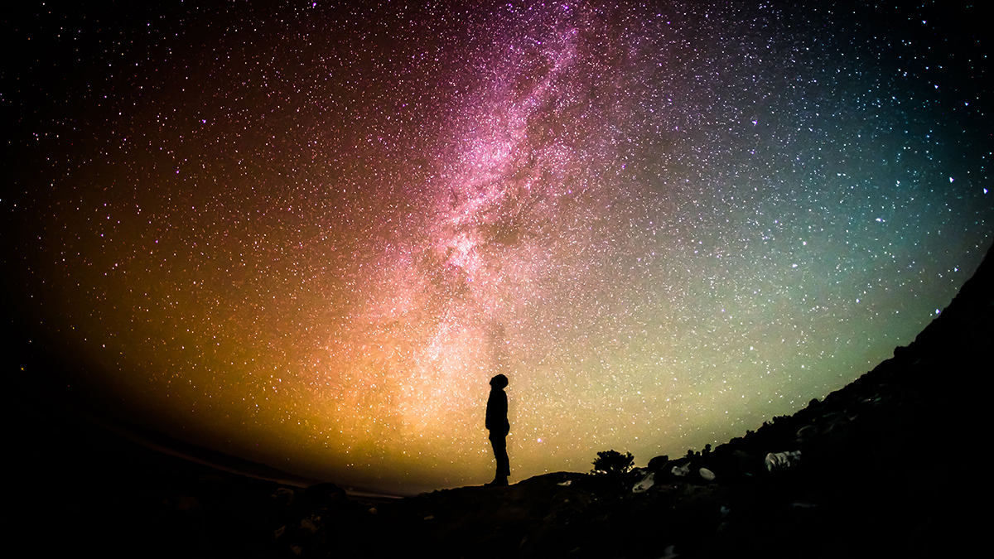
And His name will be called
EVERLASTING FATHER
Isaiah 9:6
Notes:
And His name will be called Everlasting Father
Isaiah 9:6
Introduction
Isaiah prophetically gives the Messiah the name, “Everlasting Father.”
How is the “Son” called the “Father?”
What does “Everlasting Father” designate?
What significance is His being the “Everlasting Father” toward us?
Everlasting Father

Slide 3
Everlasting Father
Use of “Father”
Matthew 28:19 – One of the Divine Three.
Genesis 4:19-21; John 8:44 – The originator, or possessor of something.
Jesus, Everlasting Father – 1 John 5:11
Everlasting Father
John 10:10 – That they may have life.
John 17:1-3 – This is eternal life…
Notes:
Everlasting Father
Use of “Father”
“Father and of the Son and of the Holy Spirit” (Matthew 28:19) – Not all same, but share same nature – how is the Son called “Father?”
Genesis 4:19-21 – Jabal and Jubal were called “father.”
The beginning of mankind – new things unfolding.
Jabal – father, or originator/author of those who lived nomadic lifestyles and maintained a living through pastoral occupation.
Jubal – father, or originator/author/inventor of stringed and wind instruments.
John 8:44 – Jesus to the Jews says they are of the devil, who is the “father of lies.”
“speaks from his own resources” – does not go anywhere else, because it all started with him.
God can’t lie, so it came from somewhere else.
Lied to Eve in the beginning – “You will not surely die” (Genesis 3:4).
Jesus – “And this is the testimony: that God has given us eternal life, and this life is in His Son” (1 John 5:11).
He is the Father of Eternity in that He is the possessor of it, and can grant it to others as well – not simply the concept of “eternity,” or “everlasting,” but the life which inhabits such.
“eternal life” is in Jesus – “In Him was life” (John 1:4).
He has eternal life in Himself – it starts with Him – He is the “Everlasting Father”
Everlasting Father
“I have come that they may have life, and that they may have it more abundantly” (John 10:10b).
What life?
Romans 6:23 – Shows that the life offered through Jesus is that of an eternal nature.
“For what is your life? It is even a vapor that appears for a little time and then vanishes away” (James 4:14) – temporary. But there is a life which knows not time, i.e. it is eternal.
John 17:1-3 – We do not “know” life, i.e. eternal life, except through “knowing” God and Jesus.
Created with life – not just physically, but the “eternal life,” i.e. SPIRITUAL LIFE.
“Let us make man in Our image, according to Our likeness” (Genesis 1:26) – Sets us apart from animals that are not given the life we are as man – i.e. fellowship with the Divine Nature.
Departed from characteristics of God – cf. Romans 3:23 – departed from “eternal life.” (Wages of sin? Death – spiritual)
Must be shown the way back – so, the “Everlasting Father” was sent →
Eternity Tabernacled

Slide 4
Eternity Tabernacled
Established an Eternal Kingdom
Isaiah 9:6-7 – Eternal Messianic Kingdom
John 1:1-5, 14 – Eternity enters into time.
Matthew 16:18 – Kingdom established.
Notes:
Eternity Tabernacled
Established an Eternal Kingdom
Isaiah 9:6-7 – The establishment and continuation of the Messianic kingdom.
Child is born – but He is called “Everlasting Father,” so His birth is not His beginning.
Gov’t upon His shoulders – He is the foundation.
(v. 7) – The kingdom’s nature is eternal – “no end…forever”
Peace – between God and man in the Messianic kingdom.
This peace is life – eternal, spiritual life.
This all rests upon Him being the “Everlasting Father.”
John 1:1-5, 14 – Eternity entered into time.
(vv. 1-5) – In Him was life – eternal life – with the Father in the beginning.
(v. 14) – became flesh and “dwelt among us:”
“dwelt” – skēnoō – to fix one's tabernacle, have one's tabernacle, abide (or live) in a tabernacle (or tent), tabernacle. (Strong)
“And let them make Me a sanctuary, that I may dwell among them” (Exodus 25:8 – tabernacle as a sanctuary).
David sought to make God a house – “For I have not dwelt in a house since the time that I brought the children of Israel up from Egypt, even to this day, but have moved about in a tent and in a tabernacle” (2 Samuel 7:6).
The “Eternal Father” took up a temporary dwelling in the flesh among His creation.
John 14:6 – Tabernacled among us in order to manifest the way through Him to life everlasting with the Father.
In HIM is life everlasting – IN HIM is IN HIS BODY, the church:
Matthew 16:18 – As Isaiah 9:6-7 said, He was sent to establish a kingdom – His church – because He is the “Everlasting Father,” death (Hades – the grave) could not thwart His plans.
Members of the church are IN HIM, for it is His body – cf. Ephesians 1:22-23 – therefore they possess life.
Secures Eternity for its Citizens

Slide 5
Eternity Tabernacled
Established an Eternal Kingdom
Secures Eternity for its Citizens
The “Everlasting Father” is not bound by time, nor its effects.
John 11 – Resurrection of Lazarus.
Hebrews 2:14-15 – Destroyed the one with power of death.
Romans 8:35-39 – Nothing can separate us.
1 Thessalonians 4:16-18 – Always be with Lord.
1 Corinthians 15:54-57 – Victory.
Notes:
Secures Eternity for its Citizens
Upon entrance into His kingdom, the “Everlasting Father” serves as the great protector and preserver of our spiritual life until it is consummated in eternal glory.
This was shown in the tabernacle state of our Lord:
NOTE: “Everlasting” means that He is not bound by time, nor any of time’s effects.
Death and Resurrection of Lazarus (John 11):
(vv. 1-7) – Lazarus was sick, and JESUS DELAYED.
(vv. 11-16) – Because of his sickness, and the Lord’s delay, LAZARUS DIED.
(vv. 38-39) – Jesus led to tomb, but informed of the DECAY OF LAZARUS’ BODY.
(vv. 40-44) – Jesus RAISED LAZARUS FROM THE DEAD.
Notice what TIME CAUSES, and how ETERNITY OVERCOMES:
Jesus delayed – meaning allowed more time to pass.
Lazarus died – his sickness had too much time without intervention.
Lazarus decayed – even relatively short time had taken its toll on Lazarus’ body as it rot, and stank.
JESUS RAISED LAZARUS – in this one act JESUS ERASED TIME AND ITS DAMAGE.
HOW? – (vv. 21-27) – He is the resurrection and life – the Son of God, “Everlasting Father,” come into the world.
The resurrection of Lazarus, and other exhibitions in Jesus’ life emphasized His nature, and that which He offers to us.
Especially His death and resurrection.
“through death He might destroy him who had the power of death, that is, the devil, and release those who through fear of death were all their lifetime subject to bondage” (Hebrews 2:14-15).
The “Everlasting Father” will not allow time itself, nor anything bound by time to snatch us out of His hand:
“And I give them eternal life, and they shall never perish; neither shall anyone snatch them out of My hand” (John 10:28).
Romans 8:35-39 – Nothing can separate us from the love of Christ.
These things concern the created, not eternal – “nor any other created thing.”
As long as we are IN THE ETERNAL, i.e. the “Everlasting Father,” nothing can separate us from Him.
When He comes again to gather us home, we shall have LIFE ETERNAL – 1 Thessalonians 4:16-18 – Death did not conquer loved ones in Jesus, for death is a matter concerning time, and the ONE WHO TRANSCENDS TIME IS WITH THEM – “we shall ALWAYS be with the Lord.”
1 Corinthians 15:54-57 – Death is swallowed up, and we have victory in the Lord.

Slide 6
And His name will be called
EVERLASTING FATHER
Isaiah 9:6
Notes:
Conclusion
It was important that the Everlasting Father came into the world.
We needed what He had to offer, and continually need Him.
Will you come to Jesus for eternal life?

