Slide 2
A Preface to the Study
The Old Testament Scriptures
Romans 15:4; 2 Timothy 3:15 – Useful to us.
Hebrews 1:1 – Revealed in different ways through prophets.
Hosea 12:10 – Prophets. Visions. Symbols (EX: 1 Peter 3:20-21).
Christ in the Old Testament
1 Corinthians 15:3-4 – Death, burial, resurrection 3rd day.
Luke 24:25-27, 40-45 – Moses, prophets, psalms.
Notes:
The Resurrection of Isaac
Genesis 22
Introduction
Preface to the study:
Romans 15:4; 2 Timothy 3:15 – The OT Scriptures are to our benefit – written for us.
“Now all these things happened to them as examples, and they were written for our admonition, upon whom the ends of the ages have come” (1 Corinthians 10:11 – concerning the Israelites – they did these things, but they were RECORDED FOR US).
The OT makes one “wise for salvation” – salvation in Christ – Christ seen in OT.
Hebrews 1:1 – God spoke in “various ways.”
Various ways – revelation, dreams, parables, etc.
Hosea 12:10 – God showing that their ignorance of Him was not acceptable. It was willful, because He revealed Himself to them.
Prophets – inspired speakers of God – mouthpieces.
Visions – miraculous revelation in the form of trances.
Symbols – to compare; by implication to resemble, liken, consider.
Often times symbols in the form of parables. But not always…
Cf. 1 Peter 3:20-21 – A true account of Noah and his family being saved is symbolic of our salvation in baptism.
Consider Christ in the OT:
1 Corinthians 15:3-4 – The gospel according to the OT scriptures.
Christ died.
He was buried.
He rose again the third day – according to the scriptures – OT SCRIPTURES – RESURRECTION, but ON THIRD DAY.
What scriptures teach this?
Cf. Matthew 12:39-40 – Jesus mentioned Jonah in this capacity.
Was Jonah’s experience alone in pointing to this fact?
Luke 24:25-27 – Jesus to the disciples on the road to Emmaus.
“the things concerning Himself” – death, burial, resurrection…
“beginning at Moses” – these things were shown in the 5 books of the Law.
(vv. 40-45) – Proved He really was raised, and was with them bodily – expounded to them about such in Moses, Prophets, and Psalms.
“These are the words which I spoke to you while I was still with you…”
Cf. Mark 8:31 – Concerning not only His death and burial, but His resurrection after 3 days – found in Moses, Prophets, and Psalms.
Considering the death, burial, and resurrection of Christ after 3 days, let us look to the account of Abraham in Isaac in Genesis 22 – Isaac is undoubtedly a type of Christ.
The Resurrection of Isaac (Genesis 22)

Slide 3
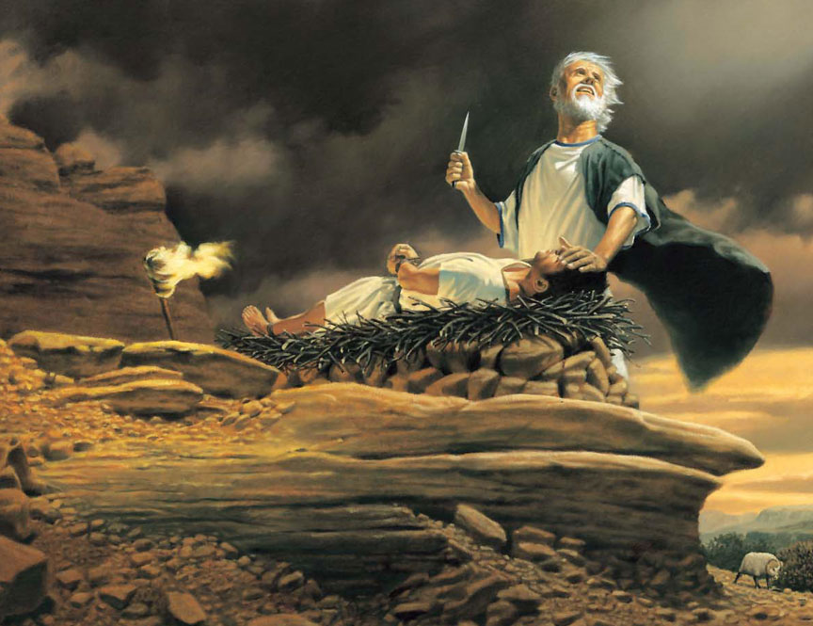
The Resurrection of Isaac
Genesis 22

Slide 4
The Resurrection of Isaac – Genesis 22 –
The Command to Abraham (vv. 1-2)
Hebrews 11:17 – Only Begotten
Jesus – 1 John 4:9-10; John 3:14-16
The Obedience of Abraham (vv. 3-10)
In Abraham’s mind? – (vv. 7-8); Hebrews 11:17-19
Notes:
The Resurrection of Isaac (Genesis 22)
The Command to Abraham (vv. 1-2)
A different, peculiar command – your son, not an animal as has been the case all these years from you call out of Ur of the Chaldees. (More to this – not a coincidence that God commanded him to offer his son…)
“your only son Isaac” – What about Ishmael?
Ishmael cast out with Hagar.
Cf. 21:12 – In Isaac your seed shall be called.
Only son? – The one left, and the one according to promise, through whom the promises would be fulfilled.
“he who had received the promises offered up his only begotten son” (Hebrews 11:17).
Offer him as a sacrifice – ultimate test of obedience, but also a foreshadow of something greater to come.
Jesus:
1 John 4:9-10 – God sent His only begotten Son into the world.
John 3:14-16 – Lifted up – sacrifice – sent only begotten Son that the world would have everlasting life.
The Obedience of Abraham (vv. 3-10)
Abraham obeyed God, and went to where he was commanded without hesitation.
What was going through Abraham’s mind?
(vv. 7-8) – God will provide a lamb?
Perhaps, though God commanded him to offer his son, he was convinced God would not allow such to happen.
This was sufficient for Isaac, AN OBEDIENT SON WHO FOLLOWED HIS FATHER WILLINGLY.
Cf. Hebrews 11:17-19 – Enlightens us further as to what Abraham was thinking.
“offered up Isaac” – It was already decided in his mind. ISAAC WAS AS GOOD AS DEAD.
(v. 19) – Conclusion was that God would raise him up.
Abraham knew what God had said concerning Isaac – the promises would come through HIM, NO OTHER.
He already received Isaac as dead, and thought God would raise him.
Did God raise him? →
The Provision of God (vv. 11-14)

Slide 5
The Resurrection of Isaac – Genesis 22 –
The Command to Abraham (vv. 1-2)
The Obedience of Abraham (vv. 3-10)
The Provision of God (vv. 11-14)
Isaac received as dead figuratively – (vv. 2-3)
Provided ram on 3rd day – (v. 4)
Jesus – Mark 9:31
Ram instead – (vv. 13-14); Jesus (Romans 5:6-11; 6:23)
Jehovah-jireh – (vv. 14, 2; 2 Chronicles 3:1); Jesus (Luke 23:33; John 19:19-20)
Notes:
The Provision of God (vv. 11-14)
(vv. 11-12) – Abraham was in the very motion of slaying his son when God stayed his hand through the angel.
Isaac never LITERALLY died.
However, “even from the dead, from which he also received him in a figurative sense” (Hebrews 11:19).
When did he receive Isaac in this way?
(vv. 2-3) – When God gave the command! – NO HESITATION, NO DOUBT – ISAAC WAS DEAD TO ABRAHAM THEN BECAUSE GOD COMMANDED, AND HE WOULD OBEY.
Note: (v. 4) – They saw the place on the THIRD DAY, and went to the place the same day they saw it.
For 3 days Isaac had been dead in Abraham’s mind.
On the third day, when Abraham set out to do God’s will, he was stopped.
NOW HE KNEW ISAAC DID NOT HAVE TO BE SLAYED.
As Isaac was dead figuratively, he was raised figuratively the 3rd day.
Jesus – “The Son of Man is being betrayed into the hands of men, and they will kill Him. And after He is killed, He will rise the third day” (Mark 9:31).
(vv. 13-14) – God provided a ram instead of Isaac, and Abraham named the place.
NOTE: “instead of his son” – while Isaac typified Christ, there the provision of God that typified Christ.
Romans 5:6-11 – He became the object of God’s wrath in our stead.
Romans 6:23 – Gift of God is eternal life through Jesus.
(v. 14) – Jehovah-jireh – “The-Lord-Will-Provide.”
In the mount of the Lord?
(v. 2) – land of Moriah.
Cf. 2 Chronicles 3:1 – Moriah is the area of Jerusalem.
Specific mountain not given us, but the general MOUNTAIN RANGE where the Lord provided for Abraham, THE LORD PROVIDES HIS SON FOR ALL.
“In the Mount of the Lord it shall be provided” – future tense – “shall”
What? – (v. 8) – a lamb – the lamb of God.
Cf. Luke 23:33; John 19:19-20 – Mount Calvary, near the city – Jerusalem. (Land of Moriah)
The Promise of God (vv. 15-18)

Slide 6
The Resurrection of Isaac – Genesis 22 –
The Command to Abraham (vv. 1-2)
The Obedience of Abraham (vv. 3-10)
The Provision of God (vv. 11-14)
The Promise of God (vv. 15-18)
Because Abraham obeyed, God renewed the promises to him – Land, Nation, SEED.
Notes:
The Promise of God (vv. 15-18)
Because Abraham obeyed, God renewed the promises to Him.
(vv. 15-18) – Land, nation, and most importantly – SEED PROMISE.
Lessons to Learn and Appreciate

Slide 7
Lessons to Learn and Appreciate
The Foreknowledge, Provision, and Love of God
1 Peter 1:1-2 – elect according to foreknowledge.
Ephesians 1:3-6; 3:8-13 – before world’s foundation; eternal purpose.
1 John 4:9-10 – the love of God.
The Necessity of Obedience
Genesis 22:12, 18 – Abraham obeyed.
Hebrews 5:9 – We must obey.
Notes:
Lessons to Learn and Appreciate
The Foreknowledge, Provision, and Love of God
1 Peter 1:1-2 – elect according to foreknowledge of God.
Not individual.
According to – sprinkling of blood of Jesus – God’s plan from the beginning.
Ephesians 1:3-6 – before the world’s foundation.
From the beginning, God knew man would sin, and need a plan for redemption.
Those to be redeemed were chosen before IN CHRIST JESUS – i.e. anyone who would be found in Christ would be redeemed.
Ephesians 3:8-13 – Paul was commissioned to preach the mystery.
“from the beginning of the ages”
“eternal purpose which He accomplished in Christ”
There was never a time when God did not know what He was going to do, and NEVER A CHANCE THAT IT WOULD FAIL.
1 John 4:9-10 – WHAT GREAT LOVE SHOWN AND BESTOWED!
The Necessity of Obedience
The promises were fulfilled in being given to Abraham because he met God’s conditions in obedience – cf. Genesis 22:12, 18 – “because you have obeyed my voice.”
The pattern remains today – “And having been perfected, He became the author of eternal salvation to all who obey Him” (Hebrews 5:9).

Slide 8
The Resurrection of Isaac
Genesis 22
Notes:
Conclusion
The Bible is a grand theme – the theme of redemption.
Christ is seen in all scripture, and is the focus of the Bible.
God has provided us the means for salvation, and planned it from the beginning.
If we obey Him, WE WILL RECEIVE THE PROMISES.

