Slide 2
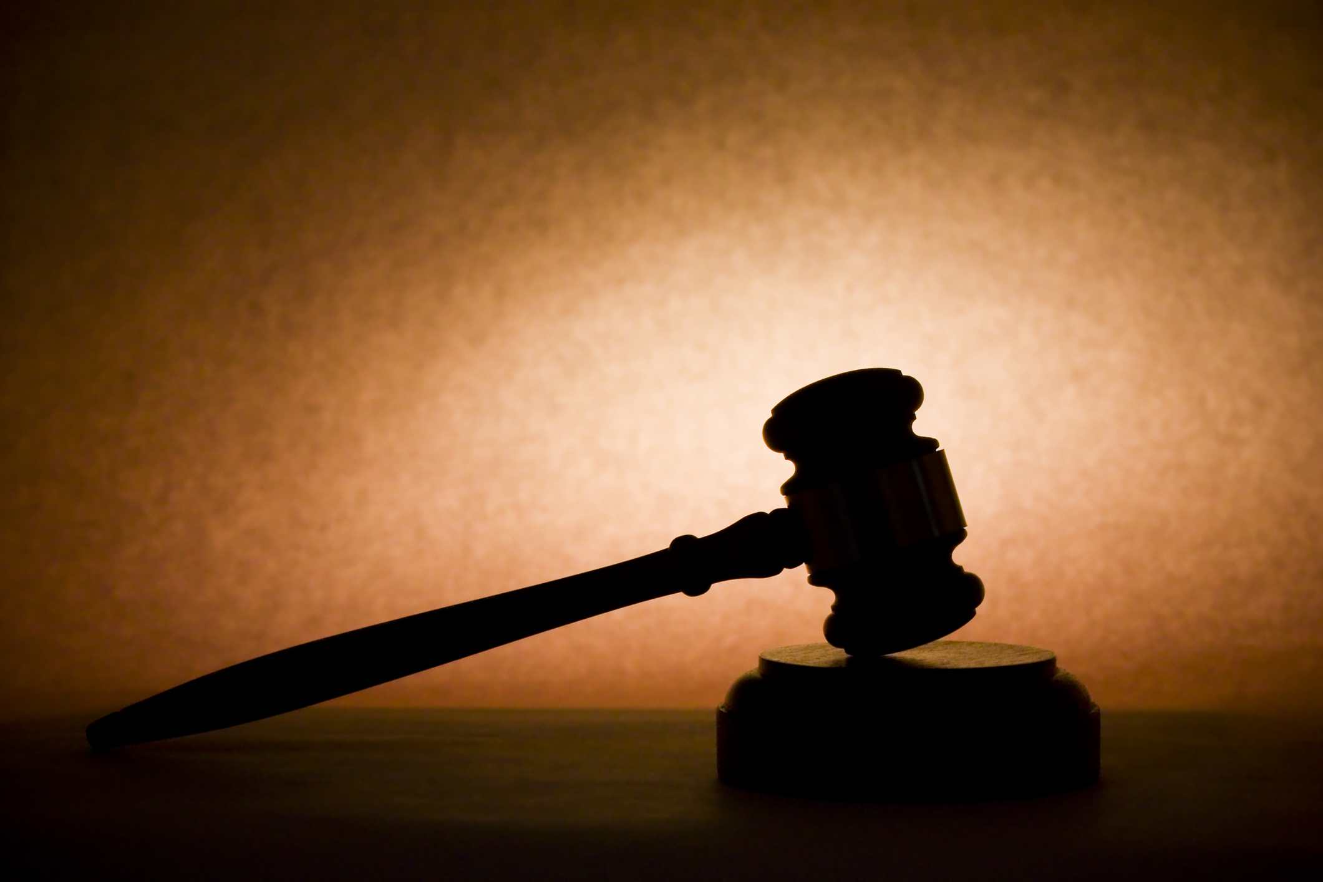
Before the Judge
Worship and Devotion
Psalm 50
Notes:
Before the Judge – Worship and Devotion
Psalm 50
Introduction
Psalm 50 is the first of 12 Psalms ascribed to Asaph.
Asaph – A seer, one of three leaders in song worship who “[ministered] with music before the dwelling place of the tabernacle of meeting” (1 Chronicles 6:32) in the days of David and Solomon.
Psalm 50 – admonitions from God to Israel concerning worship. (Fitting that the HS used Asaph to pen these words.)
Is our worship as individuals acceptable to God? Do our lives reflect what we voice in worship to God? Are we truly devoted to God? Psalm 50 makes us ponder such questions.
“Examine yourselves as to whether you are in the faith. Test yourselves” (2 Corinthians 13:5) – Are we living up to God’s expectations? We will be judged.
Judgment is Coming

Slide 3
Judgment is Coming
Psalm 50
The Nature of the Judge (vv. 1-3)
1 John 1:5 – Light, no darkness.
2 Peter 3:9; Hebrews 12:29 – Is coming, and is a consuming fire.
The Nature of His Judgment (vv. 4-6)
Deuteronomy 30:11-20 – Judgment is just. There are witnesses.
(v. 5) – Covenant made!
Notes:
Judgment is Coming
The Nature of the Judge (vv. 1-3)
(v. 1) – The ONE TRUE God will judge, and all will be present at the judgment.
“God the LORD” – Lord – Jehovah – God of Israelites, i.e. true God, in contrast to false gods, idols.
Rising and going down of sun – the whole globe. (Universal judgment foreshadowed)
(v. 2) – God is bright and beautiful.
Light – “[He] alone has immortality, dwelling in unapproachable light, whom no man has seen or can see” (1 Timothy 6:16). (Beautiful to behold)
Holiness – cf. 1 John 1:5 – NO DARKNESS, key in judgment →
(v. 3) – God will not ignore our deeds, but will come in judgment.
2 Peter 3:9 – Not slack concerning promise.
“Let us have grace, by which we may serve God acceptably with reverence and godly fear. For our God is a consuming fire” (Hebrews 12:28-29).
Worship and service is not to be taken lightly, for we will be judged by a consuming and holy God.
The Nature of His Judgment (vv. 4-6)
(vv. 4, 6) – His judgment is fair – witnesses attest to His righteousness in judgment.
“Righteousness and justice are the foundation of His throne…The heavens declare His righteousness, and all the peoples see His glory” (Psalm 97:2b, 6).
Calling heaven and earth as witness is to establish that the word has been spoken, the standard set, and the Lord’s judgment will be righteous according to it – Deuteronomy 30:15-20 – To 2nd generation who will enter Canaan. (NOTE: v. 19).
What makes His judgment righteous? – (vv. 11-14) – He has given His word; all we need is at our disposal!
(v. 5) – We have agreed to this! Such also declares the righteousness of God’s judgment.
Israelites – dedicated to God, and dedicated themselves to God. (Covenant is mutual)
Christians – same, devoted self in promise to God.
We will be judged! Are we faithful? →
The Judge Testifies

Slide 4
The Judge Testifies
Psalm 50
Regarding True Worship (vv. 7-15)
Prayer – Colossians 4:2
Singing – Ephesians 5:17-19
Lord’s Supper – 1 Corinthians 11:27-29
Giving – 2 Corinthians 9:7; 8:3-5
Preaching – Acts 20:7; 2:42
Regarding True Devotion (vv. 16-21)
Romans 2:17-24 – Do we obey what we know?
Jeremiah 7:1-4, 8-11 – Worship covers sin?
Notes:
The Judge Testifies
Regarding True Worship (vv. 7-15)
The text (Israel):
(vv. 7-8) – The problem is not the actual offerings.
(vv. 9-13) – The problem is the mindset behind the offerings.
Does God NEED what you offer Him?
Is He an idol? – cf. Acts 17:24-25 – Idea behind idolatry is that the god is sustained by sacrifice.
Is God pleased with mere external worship as though the actions themselves sustain Him, and you gain favor before Him?
(vv. 14-15) – What does God desire?
Thanksgiving and devotion in worship (heart invested) – sincerity! (Some brought sacrifice to the alter, but their heart was elsewhere!)
Manifestation of full dependence – following deliverance, gratitude and praise. (Don’t come to God because He needs you, but you need Him!)
The application (Christians) – “true worshipers will worship the Father in spirit and truth” (John 4:23):
Prayer – cf. Colossians 4:2 – Is your prayer earnest? (Individual, but also when one leads a prayer in worship – do you pray, or space out.)
Earnest – to be steadfastly attentive unto, to give unremitting care to a thing. (Strong)
Singing – cf. Ephesians 5:17-19 – Is your singing attentive, and thoughtful?
Contrast – drunkenness and being filled with the Spirit (revelation of HS – “let the word of Christ dwell in you richly” Colossians 3:16).
Drunk man goes where wine takes him – dissipation – asotia, unsavedness.
Man attentive in singing goes where Spirit takes him – Path of God.
Is your heart making melody? Just going through motions?
Lord’s Supper – cf. 1 Corinthians 11:27-29 – Is your mind focused on the sacrifice of the Lord?
LS a sacrament? – sacrament – (1) a visible sign of an inward grace, especially one of the solemn Christian rites considered to have been instituted by Jesus Christ to symbolize or confer grace; (4) something regarded as possessing a sacred character or mysterious significance. (dictionary.com)
Nothing inherent in bread and juice that is holy, or spiritual.
Not discern Lord’s body? – JUDGMENT!
Giving – cf. 2 Corinthians 9:7 – Is your giving sincere, and cheerful?
Some think their giving makes God indebted to them. Do you?
Cf. 2 Corinthians 8:3-5 – be like the Macedonians.
Preaching – cf. Acts 20:7 – When we come together to hear God’s word, are you giving God your attention?
Cf. Acts 2:42 – 1st century Christians continued steadfastly.
The sermon is not for entertainment, nor simply a ritual or tradition. IT HAS GREAT SIGNIFICANCE.
Regarding True Devotion (vv. 16-21)
The text (Israel):
(vv. 16-17) – The word is in their mouth, but they show their contempt for it because they don’t apply it to themselves.
(vv. 18-20) – While you profess godliness with your tongue, and participate OUTWARDLY in worship, you participate with sinners in their sin.
(v. 21) – You were satisfied with this, and assumed God thought the same way.
“for a long time their judgment has not been idle, and their destruction does not slumber” (2 Peter 2:3 – concerning false teachers).
Just God did not do anything immediately does not mean it’s acceptable.
Judgment is coming.
God is NOT LIKE YOU (He is holy, and will punish unrighteousness) – “’For My thoughts are not your thoughts, nor are your ways My ways,’ says the Lord” (Isaiah 55:8).
The application (Christians):
Do we think our knowledge of scripture, and participation in worship covers our sin? – cf. Romans 2:17-24 – Are we putting that word that is in our mouth to practice?
Jeremiah 7:1-4, 8-11 – Do we, as Judah, assume that our showing up to worship, singing songs, partaking of the LS, and hearing preaching makes our sin okay?
God expects us to be a Christian everywhere, and at all times!
His Final Warning and Plea (vv. 22-23)

Slide 5
Before the Judge
Worship and Devotion
Psalm 50
His Final Warning and Plea! (vv. 22-23)
Notes:
His Final Warning and Plea (vv. 22-23)
When you stand before the judgment will you be found wanting? Are you in the faith? Is your heart right with God?
(vv. 22-23) – He has shown us what He requires, and we had better do it!
Offer sincere, heartfelt worship – in spirit and truth.
Do not simply know God’s will, but DO IT!
Conclusion
God is coming soon, and will judge us for our deeds.
Are we sincere in our worship, or just going through the motions? Are we fully devoted to God, being faithful to His every command? Are we only Christians externally on Sunday, or completely and at all times?
EXAMINE YOURSELF!

