Slide 2
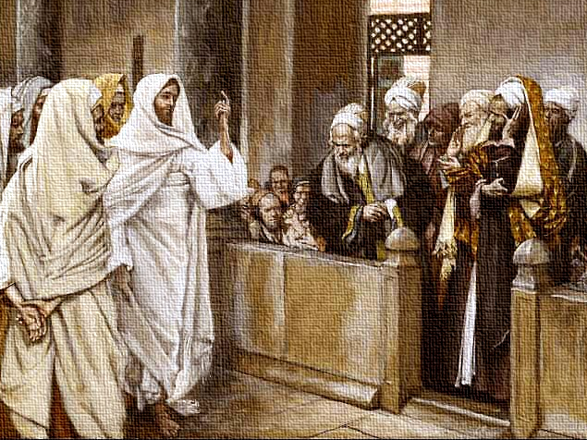
By What Authority?
Luke 20:1-8
Notes:
By What Authority?
Luke 20:1-8
Introduction
Authority is a term which touches most facets of life.
When approaching religious practice before God, whether it be the function of the church, or individual conduct, authority is of utmost importance.
Exousía – power of choice, liberty of doing as one pleases; leave or permission (Thayer).
“from the impersonal verb exesti, ‘it is lawful’” (Vine).
Do we have the right, liberty, leave, or permission to do and say what we are doing and saying? Are our actions and words lawful?
Some in the world do not think authority is important when it comes to serving God:
Just faith?
Just love?
Just sincerity?
Just Jesus? (But is not Jesus “Lord” – the supreme authority?)
The Jewish leaders who opposed Jesus understood that authority was needed in our service to God (cf. Luke 20:1-8):
“by what authority?” – “These things?” – (v. 1) – teaching and preaching (content). Also:
Raised Lazarus from the dead (cf. John 11).
Triumphal entry into Jerusalem, accepted worship (cf. Luke 19:28-40). (v. 39 – Pharisees told Jesus to rebuke His disciples – did not think He had authority to be worshiped.)
Cleansing of the temple (cf. Luke 19: 45-46).
Teaching daily in the temple (cf. Luke 19:47).
Their question shows that there is an understanding that authority is needed before God – “sought to destroy Him” (19:47) – If He did not have authority, He is exposed as a blasphemer.
Jesus’ answer – vv. 3-4 – Did John have authority? He needed it! If he did, why did you not believe him, and obey his teaching?
Authority is a must for the things we say and do.
Authority Needed in Life

Slide 3
Authority
Needed in Life
Athletics/Games – 2 Timothy 2:5
Military – 2 Timothy 2:4; Matthew 8:8-9
Education – Matthew 10:24
Work – Matthew 10:24
Government – Romans 13:1-3; Matthew 22:17, 21
Family – Ephesians 6:1
Notes:
Authority Needed in Life
Athletics/Games
2 Timothy 2:5 – abide by rules.
Rules are set, and only those who abide by them are qualified for the prize.
Military
2 Timothy 2:4 – a soldier has work to do which is defined and directed by his enlister.
Don’t worry about the everyday things of life.
If you wish to please your commanding officer, you must be concerned with his wishes.
Matthew 8:8-9 (Centurion to Jesus) – Commander of 100 has authority to direct others.
Those under him are under his authority.
They MUST have authority to do the things they do, and MUST obey orders.
Education
Matthew 10:24 (Jesus in limited commission) – pupil is under his teacher.
True with apostles under Jesus, true with us under Jesus.
True in secular education – there are tiers of authority – Superintendent, school board, principal, teachers, students.
Work
Matthew 10:24 – servant/master relationship shows authority.
Today we have the employer/employee relationship – the boss has authority over the worker, and the worker must have authority from the boss to do the things he does.
Government
Romans 13:1-3 – If one wishes to remain free, and avoid detainment, they must submit to the government.
Matthew 22:17, 21 – Taxes must be paid. Those who do not pay their taxes are punished.
Family
Ephesians 6:1 – Parents are the authority, and kids are expected to obey them.
Why do some understand authority in the home, but do not think we must obey all things spoken by our spiritual Father?
Authority Needed in Biblical History

Slide 4
Authority
Needed in Biblical History
Moses and the Tabernacle – Hebrews 8:5; Exodus 25:8-9
Balaam and the Messengers – Numbers 22:6-13
David and the Temple – 2 Samuel 7:1-3, 7
Jehoshaphat and Ramoth Gilead – 1 Kings 22:1-8
Peter and Cornelius – Acts 10:28-29
Paul, Silas, and Timothy’s Missionary Journey – Acts 16:6-10
Notes:
Authority Needed in Biblical History
Moses and the Tabernacle
Hebrews 8:5 – Moses divinely instructed to make the tabernacle according to the pattern.
Exodus 25:8-9 – How shall they make it? “Just so,” i.e. just as God had said!
Balaam and the Messengers
Balak sent messengers to Balaam the prophet.
Numbers 22:6 – asked him to come with them to curse the Israelites.
V. 8 – sought the Lord’s words concerning the matter.
V. 12 – God said no.
V. 13 – Balaam told them he had no permission, i.e. authority!
David and the Temple
2 Samuel 7:1-3 – David wished to build God a house, and consulted Nathan the prophet. Nathan spoke presumptuously →
V. 7 – God never gave authority for such!
David sought authority because he knew he needed it. God did not give him authority.
Jehoshaphat and Ramoth Gilead
1 Kings 22:1-8 – King of Israel wants Jehoshaphat, king of Judah, to take Ramoth Gilead with him, but Jehoshaphat wants to know if the Lord authorized such.
Vv. 7-8 – Jehoshaphat did not want to hear from someone else, but the Lord!
Peter and Cornelius
Acts 10:28-29 – Peter explained he had no authority to go to the Gentiles, but God gave him authority, so he went!
V. 29 – he was sent for – not only did he have authority to speak to Cornelius, but he MUST because an authority told him to.
Paul, Silas, and Timothy’s Missionary Journey
Acts 16:6-10 – Paul and his companions sought permission to preach in Asia, and Bithynia but such was forbidden by God. Then God instructed them by a vision to go to Macedonia and they obeyed.
No authority to go to Asia or Bithynia, but authority to go to Macedonia.
The scripture is filled with examples of Bible characters who knew they needed authority from God. The same is true for us →
Authority Needed Before God

Slide 5
Authority
Needed Before God
We Need Authority
We are under law:
1 Corinthians 9:21; Galatians 6:2 – law of Christ
We need permission from Christ’s law:
Colossians 3:17 – whatever you do.
Hebrews 8:5; 2 Timothy 1:13; 2 Thessalonians 2:15 – pattern.
1 Timothy 3:15 – “how you ought”
2 John 4 – walk in truth.
Notes:
Authority Needed Before God
We Need Authority!
We are under law:
1 John 3:4 – sin is lawlessness – anomia (nomia – law; a – negative) – What law is sin a violation of?
1 Corinthians 9:21 – Paul was under law toward Christ. (“the law of Christ” – Galatians 6:2)
Romans 2:16 – All men will be judged by Christ’s gospel – under Christ’s law.
We need permission by law, or authority from Christ’s law:
Colossians 3:17 – Lord – supreme in authority, all in accordance with His will.
Hebrews 8:5 – As did Moses, we are to follow a pattern.
2 Timothy 1:13 – Hold fast to the pattern. What pattern? →
2 Thessalonians 2:15 – Divine traditions of apostles in word and epistle. How serious is this call? →
2 Thessalonians 3:6, 14 – Discipline for those who do not – spiritual state of depravity before God without keeping the pattern.
1 Timothy 3:15 – Paul made sure they knew the requirements of behavior in the church – “how you ought.” (ought – it is necessary)
2 John 4 – The commandment from God is to walk in truth.
Why do we need authority?

Slide 6
Authority
Needed Before God
We Need Authority because:
Without it:
Not a disciple – John 8:31-32
No fellowship with God – 2 John 9
Not saved – Romans 10:13
With it we are released from sin’s burden:
1 John 5:3 – commandments not burdensome.
Matthew 11:28-30 – rest for soul.
Notes:
Why do we need authority?
Without it:
John 8:31-32 – Cannot be a true disciple.
2 John 9 – Cannot have fellowship with God. (He is light, and – “Your word is a lamp to my feet and a light to my path” – Psalm 119:105 – abide in word/doctrine/law – have God)
Romans 10:13 – Cannot be saved – “calls on the name” – appeal to Him for salvation by submitting to His terms and conditions, namely, His law.
With it we are released from the burden of sin:
1 John 5:3 – commandments not burdensome.
Matthew 11:28-30 – His yoke is one which frees from sin – rest for souls.

Slide 7
By What Authority?
Luke 20:1-8
Notes:
Conclusion
The Bible is replete with the admonition to have authority for all that we do.
No Bible character of faith operated without this understanding.
Do we need authority? YES! We need authority for EVERYTHING we say and do as individuals, and as the church.

