Slide 2
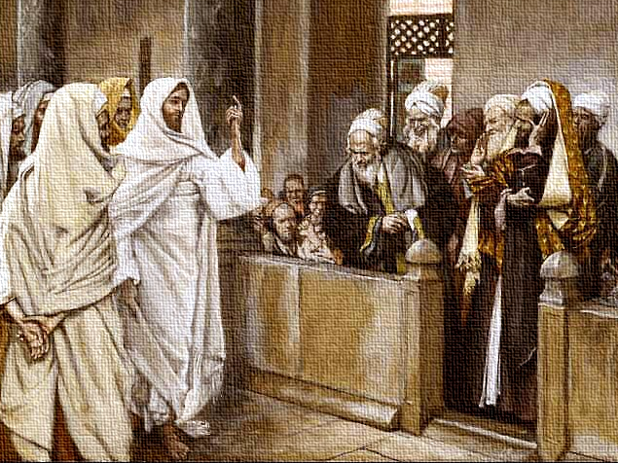
From Heaven or From Men?
Luke 20:1-8
Notes:
From Heaven or From Men?
Luke 20:1-8
Introduction
The Jewish leaders sought to trap Jesus by questioning Him about His authority (cf. Luke 20:1-8).
They did not simply question Him about authority in general, i.e. that He simply had authority. They questioned Him concerning His source of authority.
(v. 2) – By what, or from whom did He have authority. (NOTE: Their motives were dishonest, and impure. Thus, Jesus did not answer them directly, but turned the subject back on them.)
(vv. 3-4) – Jesus asked concerning the authority for John’s baptism and teaching.
(vv. 5-7) – Their reasoning among themselves, and answer to Jesus shows their understanding of the importance of the source of authority.
From heaven – legitimate, binding, must be obeyed.
From men – illegitimate, unlawful, must be refuted.
(vv. 7-8) – They did not want to condemn themselves by their answer, and did not want to anger the crowd, so they took the coward’s way out. (Jesus’ authority was from heaven, and He had proof, but they rejected Him like John.)
It is not enough to claim authority for doing or saying something.
Our authority for what we do must be legitimate. Is it from heaven or from men?
From Heaven or From Men?

Slide 3
Authority
From Heaven or From Men?
Traditions? – Matthew 15:1-9
Conscience? – Proverbs 14:12; Acts 23:1; 26:9
Wisdom of Men? – Jeremiah 10:23; 1 Corinthians 1:20-21
The Majority? – Matthew 7:13-14; Acts 19:32
Law of Moses? – Colossians 2:14-15; Hebrews 8:7-9, 13
New Revelations? – Galatians 1:6-9; Jude 3
God’s Will – Matthew 7:21-23; John 1:12-13
Notes:
From Heaven or From Men?
Traditions?
Are long held and practiced traditions authorized for the sake of their being traditions? Is what we do okay simply because it has always been done that way?
Matthew 15:1-9 – Pharisees claimed traditions to be binding, and a source of authority.
(v. 3) – Allow tradition to supersede the Divine commandments.
(vv. 4-6) – Example – tradition to earmark as a gift to God the support you would have given to parents, no need to honor parents as scripture says. (False source of authority.)
(vv. 7-9) – Jesus’ description of those who do such things – Hypocrites, and false worshipers.
Conscience?
Proverbs 14:12 – It seems right, but it is not.
Acts 23:1; 26:9 – Paul is a case in point.
He fit the description Jesus gave to the apostles – “yes, the time is coming that whoever kills you will think that he offers God service” (John 16:2).
He thought, but he was wrong – Jesus said, “It is hard for you to kick against the goads” (Acts 9:5 – i.e. it is difficult, and harmful for you to rebel against Divine authority.).
Wisdom of Men?
Jeremiah 10:23 – The way of man is not in himself.
Some think they have figured life out. That they have the ultimate wisdom to guide themselves in life. (Philosophical ideas claim at least part of life’s answers…)
1 Corinthians 1:20-21 – Paul is saying that man’s wisdom cannot find truth pertaining to God, and salvation – it is useless in that realm.
The Majority?
Matthew 7:13-14 – Jesus said the majority is wrong. (Not calling to be different for difference sake, but to be on the side of truth.)
Riot at Ephesus – Acts 19:32 – Most did not even know their purpose for gathering.
NOTE: The mob mentality is what in part killed Jesus – “But the chief priests and elders persuaded the multitudes that they should ask for Barabbas and destroy Jesus” (Matthew 27:20).
Law of Moses?
The Law of Moses is from heaven, but does that mean it is a legitimate source for authority?
Colossians 2:14-15 – Such was nailed to the cross with Jesus.
Hebrews 8:7-9, 13 – A new law was God’s plan, and that law has come – the old is obsolete.
One cannot appeal to the Old Testament for authority. In fact – “You have become estranged from Christ, you who attempt to be justified by law (of Moses); you have fallen from grace” (Galatians 5:4).
New Revelations?
What about those who claim to have a new revelation?
Galatians 1:6-9 – It does not matter where or who a new “revelation” comes from, it is to be rejected.
Jude 3 – The faith has been once for all delivered.
God’s Will
Matthew 7:21-23 – Jesus said some practice lawlessness because they do not have authority from God, i.e. they do not do His will.
John 1:12-13 – Those born of God’s will are children of His, and no one else.
From Heaven

Slide 4
Authority
From Heaven
God’s Son – Jesus
Hebrews 1:1-2 – God speaks through His Son.
Matthew 28:18 – Jesus has all authority.
John 7:16-18 – His authority is from God.
John 12:48-50 – His word will judge us.
Hebrews 2:1-4 – We must heed His word, which He has given through others.
Notes:
From Heaven
God’s Son – Jesus
Hebrews 1:1-2 – God now speaks through His Son, Jesus.
Matthew 28:18 – Jesus has all authority.
John 7:16-18 – Jesus’ authority is not usurped, but is from heaven.
(v. 17) – ample proof that His authority is from above, and those wishing to follow God will know such. (Because Jesus’ will and God’s will are the same.)
(v. 18) – Those who claim authority from any source than heaven seek their own glory, not God’s.
John 12:48-50 – Jesus said all would be judged by His words because they are from heaven, i.e. from the Father.
Hebrews 2:1-4 – Jesus spoke some Himself, but continued to speak through ambassadors. God bore witness of their word as being Christ’s word through miracles →
The Holy Spirit, and Apostles

Slide 5
Authority
From Heaven
God’s Son – Jesus
The Holy Spirit, and Apostles
Holy Spirit – John 16:12-15 – will guide apostles into all truth.
Apostles – Matthew 28:18-20 – commissioned to take Jesus’ commands to the world.
Matthew 16:19 – given keys to kingdom.
2 Thessalonians 2:15 – word and epistle.
Notes:
The Holy Spirit, and Apostles
Holy Spirit – John 16:12-15 – Jesus promised the HS to the apostles that He would guide them into the truth. (God’s authority → Jesus’s authority → HS’s authority)
The HS would work in tandem with their testimony, guiding them in inspiration, and validating it with power.
Acts 1:8 – you shall receive power, then you will be My witnesses.
Apostles – Matthew 28:18-20 – Jesus commissioned the apostles to preach the gospel, i.e. the word of Christ, to the world.
(v. 20) – not simply, “I have authority, so listen to Me and do it,” but, “My words are authorized, so teach THEM, and not anything else.” →
Matthew 16:19 – They were given the keys of the kingdom.
The binding and loosing that they were preaching was such already decided in heaven.
2 Thessalonians 2:15 – Such teachings were verbal (word), and written (epistle). (We have the written teaching.) (Evidence of authority from verbal teaching in Acts.)
The Bible

Slide 6
Authority
From Heaven
God’s Son – Jesus
The Holy Spirit, and Apostles
The Bible
1 Corinthians 14:37; Ephesians 3:3-4 – writing of apostles and prophets.
1 Corinthians 13:8-10 – “Perfect” revelation.
Jude 3 – once for all delivered.
2 Timothy 3:16-17 (sufficient); Revelation 22:18-19 (no +, -); 2 Corinthians 11:3-4 (pervert not); Colossians 3:17 (do ALL)
Notes:
The Bible
1 Corinthians 14:37 – Paul’s writings are the commandments of Jesus.
Ephesians 3:3-4 – The revelation of the mystery of Christ was given to men through the holy apostles, and prophets.
NOTE: Paul is also clear about how we are to understand God’s will.
“by which, WHEN YOU READ, YOU MAY UNDERSTAND” – “Be diligent to present yourself approved to God” (2 Timothy 2:15).
1 Corinthians 13:8-10 – Paul wrote about a “perfect” (completed) revelation.
Jude 3 – Such has been once for all delivered.
2 Timothy 3:16-17 – Such is inspired, and sufficient.
Revelation 22:18-19 – It cannot be added to, or subtracted from.
2 Corinthians 11:3-4 – It cannot be perverted. (“simplicity” – singleness)
Colossians 3:17 – It MUST be followed/submitted to.
1 Corinthians 9:21 – under law toward Christ.
1 John 3:4 – Without law (authority) we sin – MUST have authority for everything we do, and that must come from Christ.

Slide 7
From Heaven or From Men?
Luke 20:1-8
Notes:
Conclusion
Not only must we have authority for all the things we say and do, but such must be from the proper source, otherwise it is meaningless.
God has given us the word of Christ to direct our ways, and we must study to know it, then submit to it.
Do we have NT scriptural authority for all that we say and do? Do we have authority from heaven or from men?

