Slide 2
If the Foundations are Destroyed…
Psalm 11
Notes:
If the Foundations are Destroyed
Psalm 11
Introduction
Jesus declared that all authority had been given Him by His Father (cf. Matthew 28:18).
Christians are those who acknowledge this, and render themselves subservient to Christ.
While there are positions of authority set in place by God (Gov’t, Employers, Parents, Teachers, etc.) that the Christian must submit to, his submission is always to God (cf. Ephesians 6:5-8 – example of bondservants to masters – as to the Lord).
Ultimately, the One Christians submit to is Christ (cf. Colossians 3:17).
These positions of authority given by God are to serve in the realm of His will. However, because the course of this world is “according to the prince of the power of the air” (Ephesians 2:2), in many ways it seems that these “foundations are destroyed.”
How are the righteous, the people of God, to live under such circumstances of injustice and ungodliness?
Psalm 11 – A Psalm of David

Slide 3
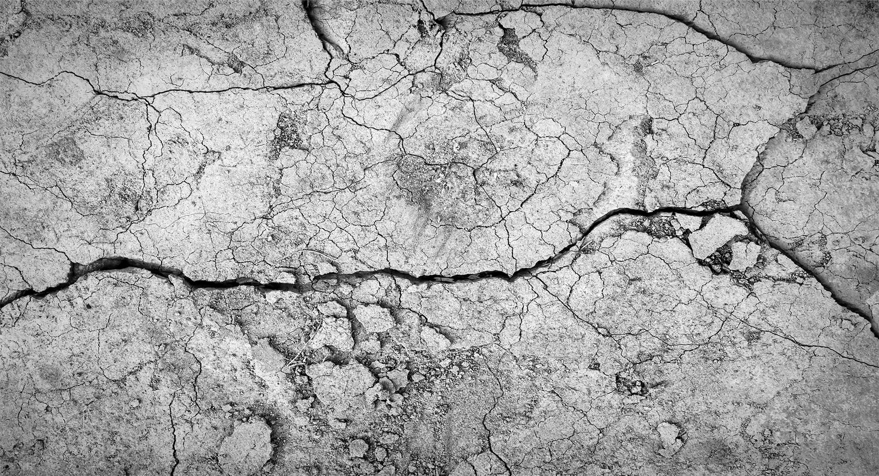
Psalm 11 – A Psalm of David
Occasion of Writing
Persecutions of Saul?
Rebellion of Absalom?
Notes:
Psalm 11 – A Psalm of David
Occasion of Writing
There is no specific occasion of David’s life that is mentioned in the Psalm. However, there are some specific instances in his life that seem to match.
Persecutions of Saul:
Saul rejected from being king – unlawful sacrifice, and sparing the Amalekites – “The Lord has sought for Himself a man after His own heart” (1 Samuel 13:14).
David is anointed King by the Lord – 1 Samuel 16
David steps up and defeats Goliath by the help of the Lord – 1 Samuel 17
Saul resented David after hearing the singing ascribing Saul “thousands,” and David “ten thousands” – 1 Samuel 18:1-9
Saul tries to pin David to the wall with a spear on two occasions – 1 Samuel 18:11; 19:10
Saul continues to conspire against David to kill him on multiple occasions. Twice David could have killed Saul, but spared his life.
Rebellion of Absalom:
Absalom, David’s son, secretly “stole the hearts of the men of Israel” (2 Samuel 15:6).
Absalom’s supporters grew, and he usurped the throne, causing his father David – the true king – to flee from Jerusalem – 2 Samuel 15
The Faith of David – Psalm 11

Slide 4
Psalm 11 – A Psalm of David
Advice Given to David (vv. 1-3)
Flee for safety! (v. 1)
Reasons to flee:
The wicked secretly plot to destroy. (v. 2)
The foundations are destroyed (v. 3)
David’s Thoughts (vv. 4-7)
The Lord reigns, and is in control. (v. 4a)
The Lord sees what is happening. (vv. 4b-5a)
The Lord will serve justice. (vv. 5b-7)
Notes:
The Faith of David – Psalm 11
Advice given to David (vv. 1-3).
Flee for safety! (v. 1) – The idea is that conditions are such that running away is the only safety you have.
Reasons for the call to flee (vv. 2-3):
The wicked secretly ready themselves to destroy David (v. 2).
The conditions are such that it seems the very foundations are destroyed (v. 3).
There is nothing for the righteous to stand on.
Any hope he might have had which rested on foundations of righteousness are swept away when the foundations are destroyed.
“The word ‘foundations,’ here, refers to those things on which society rests, or by which social order is sustained - the great principles of truth and righteousness that uphold society, as the foundations on which an edifice rests uphold the building. The reference is to a destruction of those things in a community, when truth is no longer respected; when justice is no longer practiced; when fraud and violence have taken the place of honesty and honor; when error prevails; when a character for integrity and virtue affords no longer any security.” (Albert Barnes’ Notes on the Bible – Psalm 11:3)
WHEN EVERYTHING THE RIGHTEOUS MAN STANDS FOR, AND TRUSTS IN, SOCIETY HAS REJECTED AND DESTROYED, WHAT CAN HE DO?
David’s thoughts regarding the situation (vv. 4-7).
The Lord is still in control (v. 4a):
In Holy temple – He is set apart from all this unrighteousness.
Throne is in heaven – His throne (He is king) is one of justice and righteousness, and transcends all this filth.
The Lord sees what is happening (vv. 4b-5a):
He sees these things, and allows them as a test for all men – both righteous and unrighteous (v. 4b) – WILL YOU BE FOUND FAITHFUL?
“THE LORD TESTS THE RIGHTEOUS AND THE WICKED” (v. 5a – NASB)
The Lord will serve justice (vv. 5b-7):
He is not indifferent about this calamity, but hates the wicked (v. 5b).
He will destroy the wicked (v. 6) – they will get what is coming to them – “SHALL BE THE PORTION OF THEIR CUP”
Since the Lord is righteous, HE LOVES THE RIGHTEOUS (has not forgotten them (v. 7a).
The righteous are beheld by God – they will see God – “THE UPRIGHT WILL BEHOLD HIS FACE” (v. 7b – NASB)
If the Foundations are Destroyed

Slide 5
When the foundations are destroyed…
In Society
Authorities appointed by God – Romans 13:1-4
What about when those in authority forget about God?
Isaiah 5:20 – False standards.
Exodus 1:8, 11; 5:2; 2 Timothy 3:12 – Persecution.
Notes:
If the Foundations are Destroyed
When the foundations are destroyed…
In Society:
The authorities are God’s ministers for good – cf. Romans 13:1-4 – governing authorities are appointed by God for the good of His people.
“THE MOST HIGH GOD RULES IN THE KINGDOM OF MEN, AND APPOINTS OVER IT WHOMEVER HE CHOOSES” (Daniel 5:21).
Cf. 1 Timothy 2:1-2 – we should pray for them that we may live for God in peace.
What about when leaders, and gov’t in general, along with society, forget about God?
Isaiah 5:20 – a time when everything is backwards.
Issues arise which reject the fundamental principles established in the Bible.
Marriage attacked (gay marriage); Male/female structure is ignored and destroyed (LGBTQ, etc.); Drugs made legal; Gospel speech labeled hate speech; Human life is no longer considered sacred (abortion).
Then the people of God, who don’t conform (cf. Romans 12:2), are persecuted:
Cf. Exodus 1:8, 11 – Pharaoh arose who didn’t know Joseph, and the Israelites were afflicted. (cf. Exodus 5:2 – attitude of Pharaoh toward God – “who is the Lord?”)
2 Timothy 3:12 – This treatment is to be expected – persecution.
In the Church:

Slide 6
When the foundations are destroyed…
In the Church
The church is to support the truth – 1 Timothy 3:15
However, some will turn away from the truth – 2 Timothy 4:3-4; (cf. Isaiah 30:9-11)
Those who uphold the truth are labeled as hateful, and divisive.
Notes:
In the Church:
1 Timothy 3:15 – the church is to uphold the truth. (cf. Romans 1:16 – only the pure gospel saves.)
2 Timothy 4:3-4 – some will turn away from the truth, and desire something pleasant to the ears.
Nothing new under the sun – cf. Isaiah 30:9-11 – desire for smooth things.
Then sin is tolerated, and unrighteousness pervades.
Those who stand for the truth are labeled as hateful, and divisive.
What are we to do when the foundations of society, and even the church seem to be destroyed?
…remember the Lord above!

Slide 7
…remember the Lord above!
The Lord Still Reigns (Psalm 11:4a)
1 Timothy 6:15-16 – King of kings, Lord of lords.
Attempts to thwart His will are vain – cf. Psalm 2:1-6
God does not abandon His people – 2 Timothy 4:16-18
Notes:
…remember the Lord above!
The Lord still reigns:
Psalm 11:4 – while all else might change, this remains the same.
“He…is the blessed and only Potentate, the King of kings and Lord of lords…to whom be honor and everlasting power” (1 Timothy 6:15-16).
God is in control:
Cf. Daniel 5:21 – He still rules in the kingdom of men.
Attempts to thwart His will are in vain – cf. Psalm 2:1-6 – Messianic Psalm – the people tried to destroy the Lord’s anointed, but could not.
God does not abandon His people – cf. 2 Timothy 4:16-18 – While all forsook Paul, the Lord stood with him. THE LORD REIGNS.
The Lord sees all:

Slide 8
…remember the Lord above!
The Lord Sees All (Psalm 11:4b)
None can hide from God – Hebrews 4:13
The deeds of men are recorded, and remembered for judgment – Revelation 20:12
Notes:
The Lord sees all:
Psalm 11:4 – Nothing is hidden from God’s sight.
“And there is no creature hidden from His sight, but all things are naked and open to the eyes of Him to whom we must give account” (Hebrews 4:13).
The wickedness and injustice will not go unnoticed. God sees what is happening, and is taking such into account.
Cf. Revelation 20:12 – the deeds of men are seen by God, and recorded for judgment.
The Lord is testing all:

Slide 9
…remember the Lord above!
The Lord is Testing All (Psalm 11:4, 5)
Everyone’s life is a test – Ecclesiastes 12:13-14; cf. John 12:48
The righteous must understand they aren’t exempt from difficulties. The Lord tests our faith as well – 1 Peter 1:6-9; James 1:2-4
Notes:
The Lord is testing all:
“His eyes behold, His eyelids test the sons of men. The Lord tests the righteous and the wicked” (Psalm 11:4, 5 – NASB).
All are being tested by the way they live – cf. Ecclesiastes 12:13-14 (According to the standard of God’s word – cf. John 12:48)
However, the righteous need to understand that the undesirable conditions are also God’s way of testing them:
1 Peter 1:6-9 – We are to rejoice in our hope of the inheritance, knowing that we will be tested. If we pass the test, and our faith is found genuine we will receive salvation.
James 1:2-4 – We should rejoice in the trials, knowing that such is an opportunity to prove our faithfulness to God.
The Lord will judge:

Slide 10
…remember the Lord above!
The Lord Will Judge (Psalm 11:5-7)
The persecutors will be punished, and the persecuted will be given rest – 2 Thessalonians 1:6-10
All will be judged – Hebrews 9:27
The righteous will be rewarded – 2 Timothy 4:6-8
Notes:
The Lord will judge:
Psalm 11:5-7 – the Lord is testing so He can judge, and render just rewards to the righteous and unrighteous.
2 Thessalonians 1:6-10 – Those who trouble us, i.e. the ones who seek to destroy us and have destroyed the foundations, will be punished for eternity. The righteous will be given rest.
Hebrews 9:27 – all men live once, die once, and WILL be judged.
The righteous will be rewarded – 2 Timothy 4:6-8 – The foundations of society were destroyed for Paul. He was greatly persecuted. He remembered his goal, and his God, and was confident of the reward.
“For the Lord is righteous, He loves righteousness; The upright will behold His face.” (Psalm 11:7 – NASB)

Slide 11
If the Foundations are Destroyed…
Psalm 11
Notes:
Conclusion
When the righteous are targeted, and the foundations of righteousness in the society they are a part of are destroyed, they must not grow faint.
The righteous must remember that God is in control, is all seeing, and will reward justly those who are wicked.
The righteous WILL be rewarded in the end.

