Slide 2
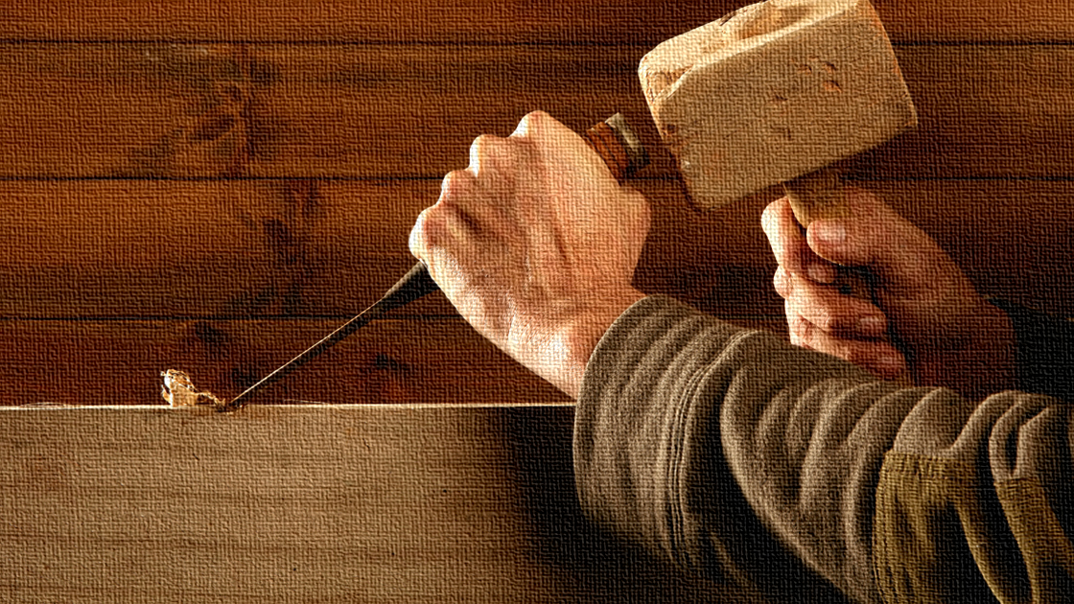
The
Carpenter
Mark 6:1-6

Slide 3

Born into a Carpenter’s Home
Willing Condescension
Isaiah 9:6-7 – The coming Messiah.
Matthew 1:1, 16-17 – Proof that Jesus is that Messiah.
John 17:4-5, 24; 2 Peter 1:16-18 – His true glory.
Isaiah 53:2; Mark 6:3 – His earthly appearance.

Slide 4
Born into a Carpenter’s Home
Willing Condescension
Patience, Diligence, Service
Ecclesiastes 2:22-23 – Vanity in labor under the sun.
Ecclesiastes 9:10 – The need for effort.
Ecclesiastes 3:9-11 – The knowledge of eternity.

Slide 5
Given to a Carpenter’s Work
Physical Creation
Creation by the word of the Lord – Psalm 33:6; Genesis 1:3; John 1:1-3
Maintenance by the word of the Lord – Hebrews 1:1-2; Colossians 1:16-17

Slide 6
Given to a Carpenter’s Work
Physical Creation
Spiritual Creation
A new creation in Christ – 2 Corinthians 5:17; Romans 6:4; Ephesians 2:10; 1 Peter 2:4-5
Jesus thinks like a carpenter, and sees potential in others – 1 Timothy 1:12-14 (Paul); Acts 13:13; 15:36-40; 2 Timothy 4:11 (John Mark); Luke 18:27 (YOU)

Slide 7
Given to a Carpenter’s Work
Physical Creation
Spiritual Creation
Heavenly Preparation
John 14:1-3 – Jesus went to prepare a place.
2 Corinthians 4:16-5:8 – A heavenly house prepared.

Slide 8
Died a Carpenter’s Death
Prophecy
Psalm 22:16-18 – Details concerning the Messiah’s death.
John 3:14-15; 12:32-33 – Jesus signified what death He would die.

Slide 9
Died a Carpenter’s Death
Prophecy
Fulfillment
John 18:28-32 – Taken to the Romans for trial.
John 19:17-18 – Executed the Roman way.
Galatians 3:10-14 – In doing so He became a curse in our stead.

Slide 10
The
Carpenter
Mark 6:1-6

