Slide 2
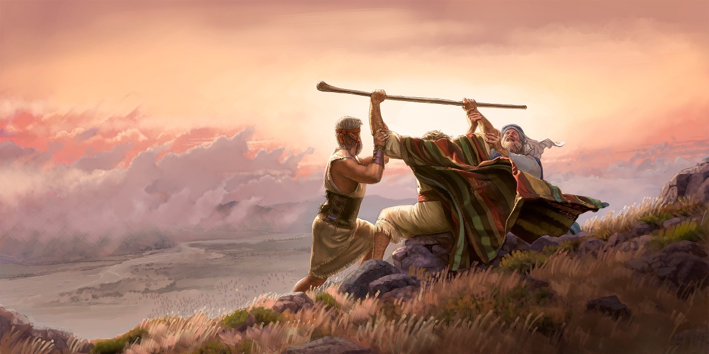
Israel’s Battle with Amalek
Exodus 17:8-16

Slide 3
Israel’s Battle with Amalek
Time – shortly after the Exodus from Egypt – Exodus 14:28-31; Joshua 2:8-11; Psalm 106:8; Joshua 4:21-24
Place – Rephidim – Exodus 17:8
People – Amalek – Numbers 24:20; Deut. 25:17-19
The Battle
Men chosen to fight – vv. 8-9, 13
Moses with the rod of God – vv. 9-13 (cf. Exodus 4:1-5, 17, 20; 14:16)
A memorial made – vv. 14-16

Slide 4
Applications
The Efficacy of Prayer – James 5:16-18; 1 Thess. 5:17
Perseverance and Persistence – Luke 18:1-8; Rom. 5:3-5
The Support of Those in Roles of Authority – Ephesians 4:11-12; Hebrews 13:17
Spiritual Weapons vs Carnal – 2 Corinthians 10:4-6; Ephesians 6:10-13
The Presence of God – 2 Timothy 4:16-18
Victory in the Lord – 1 Corinthians 15:56-58

Slide 5
Israel’s Battle with Amalek
Exodus 17:8-16

