Slide 2
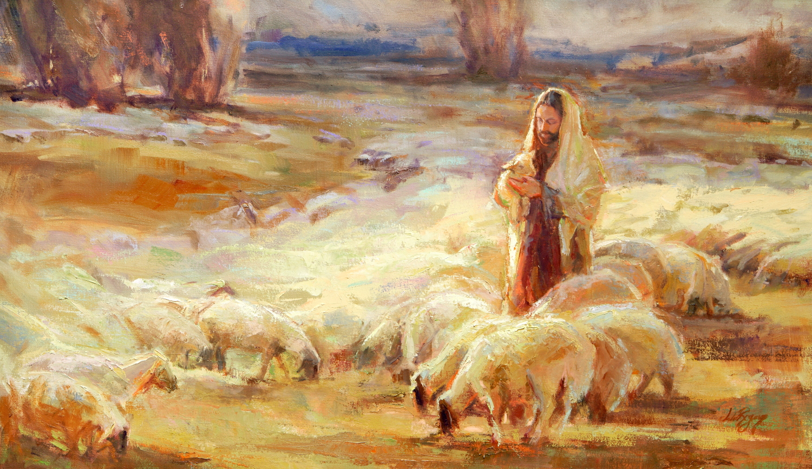
Jesus, the Loving Shepherd
John 10

Slide 3

Jesus, the Loving Shepherd – John 10
The Shepherd Illustration (vv. 1-6)
The Explanation of the Illustration (vv. 7-21)
Jesus - the door (vv. 7-10)
Jesus – the Shepherd (vv. 11-18)
Blindness exposed (vv. 19-21)
Renewed Conflict (vv. 22-39)
Blindness persists (vv. 22-30)
Attempts to stone Jesus again (vv. 31-39)
Jesus Ministers Beyond the Jordan (vv. 40-42)

Slide 4
Points of Application
The Conditions of Salvation and Protection
John 10:7, 9, 10 – Entrance through Jesus (cf. John 14:6; Ephesians 2:18-22)
John 10:27-29 – Protection through hearing, knowing, following (cf. Hebrews 2:1-4; 3:12-15)

Slide 5
Points of Application
The Conditions of Salvation and Protection
The Love of Jesus Expressed in Giving the Sheep What They Need According to God’s Word
John 10:11, 14, 15, 17, 18 – Knows sheep, knows Father (cf. 2 Timothy 3:16-17)

Slide 6
Points of Application
The Conditions of Salvation and Protection
The Love of Jesus Expressed in Giving the Sheep What They Need According to God’s Word
The Need for Humility of Faith in Salvation
John 9:39-40; 10:6, 20, 24 – Pride of the Pharisees keeping them from seeing (cf. 1 Corinthians 3:18-20; James 4:6-10)

Slide 7
Jesus, the Loving Shepherd
John 10

