Slide 2
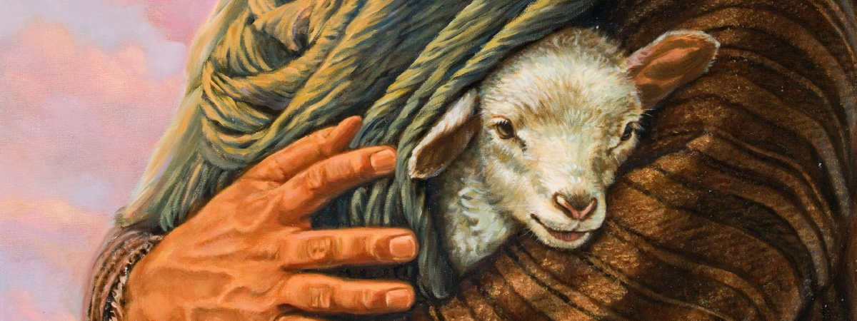
The Divine Protection
John 10:27-29

Slide 3
The Example of Christ
The Life of Christ is an Example
1 Peter 2:21-23 – In suffering – example to follow.
Philippians 2:5 – In humility – a mind to imitate.
1 John 2:3-6 – Steps to follow.
Called to the Standard of Christ
Ephesians 4:13 – He is the measure.
Living without sin – 1 John 2:1, 6, 29; 3:9
Must have faith! – Luke 17:5-6

Slide 4
The Resurrection of Christ
The New Life by the Working of God
Romans 6:1-4 – Raised to a new life. (cf. Colossians 2:12)
Romans 8:9-11 – Life given to mortal bodies.
The Power of His Resurrection In Scripture
Romans 1:16 – Power (dynamis) of God in the gospel.
Don’t quench the power! – 1 Thessalonians 5:19-22
Count loss for the power! – Philippians 3:7-11
Abound more and more! – 1 Thessalonians 2:13; 3:11-4:2

Slide 5
The Plan for Future Pardon
The Standard is No Sin
1 John 2:1-2 – That you may not sin.
Upon the “If” is Provision
1 John 2:1-2 – An Advocate, and propitiation for sins.
Confess and ask forgiveness! – 1 John 1:8-10 – Conditions of pardon.
Need for repentance! – 1 John 5:14-17
Abundant mercy! – Luke 17:3-4

Slide 6
The Family of God
Added to the Body
1 Corinthians 12:12-14, 24-26 – One body whose members care for each other.
1 Peter 1:22 – To, or into love of brethren.
The Protection of the Body
Edification – Ephesians 4:15-16; Exhortation – Hebrews 10:24-25; Rebuke – Galatians 6:1-2; Discipline – 1 Corinthians 5:4-5; Comfort – 2 Corinthians 2:6-7

Slide 7
The Longsuffering of the Lord
2 Peter 3:14-18
Not encouragement to sin.
To give us time to grow and mature as Christians in order to be found blameless when He does come.

Slide 8
The Divine Protection
John 10:27-29

