Slide 2
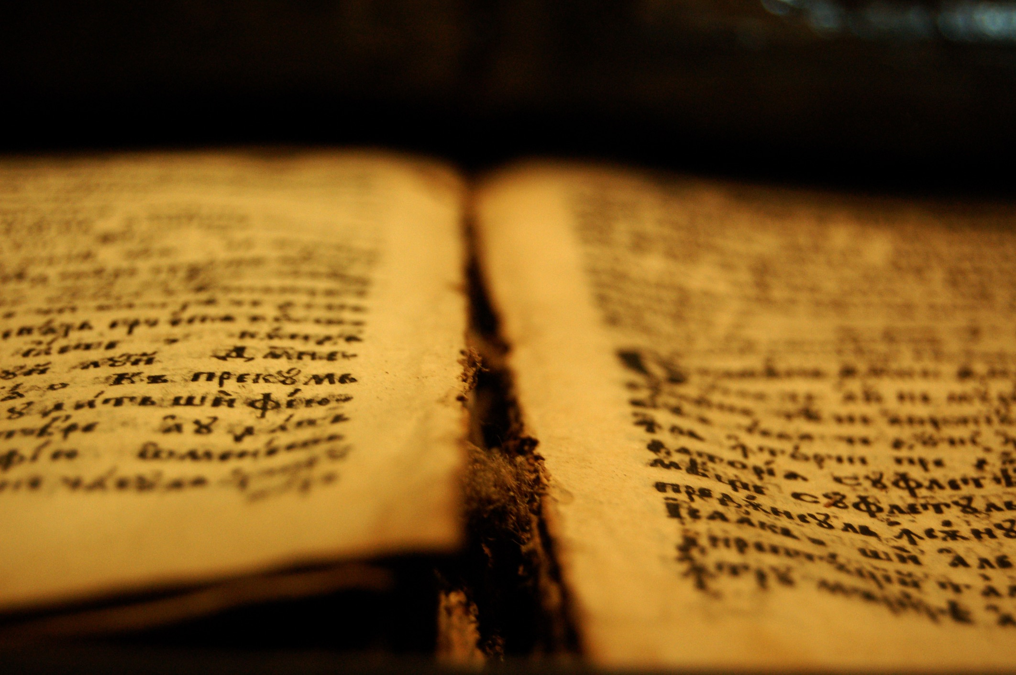
The Israel of God
Galatians 6:16

Slide 3

They Are Not All Israel
Children of the Promise (Romans 9)
Paul laments over his countrymen who are lost spiritually (vv. 1-5).
The true Israel are those of the promise, not the flesh (vv. 6-13).
  Isaac, not Ishmael (vv. 6-9).
  Jacob, not Esau (vv. 10-13).
One New Man from the Two – Ephesians 2:14-18

Slide 4
Fleshly vs Spiritual Israel
Citizenship
Fleshly – 2 Corinthians 11:22; Philippians 3:5 – physical birth.
Spiritual – Luke 16:16 – desire for entrance.
  New birth by choice – John 3:3-5; 1 Peter 1:22-23; Romans 6:3-4; Galatians 3:26-29
  The new creation is that which avails – 2 Corinthians 5:17; Galatians 6:15

Slide 5
Fleshly vs Spiritual Israel
Relationship to the Covenant
Fleshly – Genesis 17:9-11 – physical birth, and sign of the covenant given (circumcision).
  Born into obligation – Exodus 19:4-6; Deuteronomy 7:9; Psalm 103:17-18
  Some had the desire to obey, but other’s didn’t – Psalm 119:9-11, 16; 50:8-15; Jeremiah 6:10, 16-17
  The majority did not keep it, so God spoke of a new covenant – Jeremiah 31:31-32; Hebrews 8:7-9

Slide 6
Fleshly vs Spiritual Israel
Relationship to the Covenant
Spiritual – Colossians 2:11-12 – spiritual circumcision of choice by baptism.
  Desire to obey – Matthew 11:28-30; 1 John 5:3
  Jeremiah prophesied of a new covenant God would make that would include a people with a knowledge of Him, love for Him, thus a desire to obey Him from the heart – Jeremiah 31:33-34

Slide 7
Fleshly vs Spiritual Israel
Justification
Fleshly – Romans 3:9-20 – sought to be justified by law, but fail.
  Claimed Christ, but still sought justification in the law. Therefore, lost the benefits of Christ, and fell from grace – Galatians 5:1-6
Spiritual – Galatians 3:21-29 – seek to be justified according to God’s standard, i.e. apart from the law by faith in Christ.
  Only boast in the cross of Christ because that is their means of salvation – Galatians 6:11-16 – are the “Israel of God” upon whom are “peace and mercy.”

Slide 8
The Israel of God
Galatians 6:16

