Slide 2
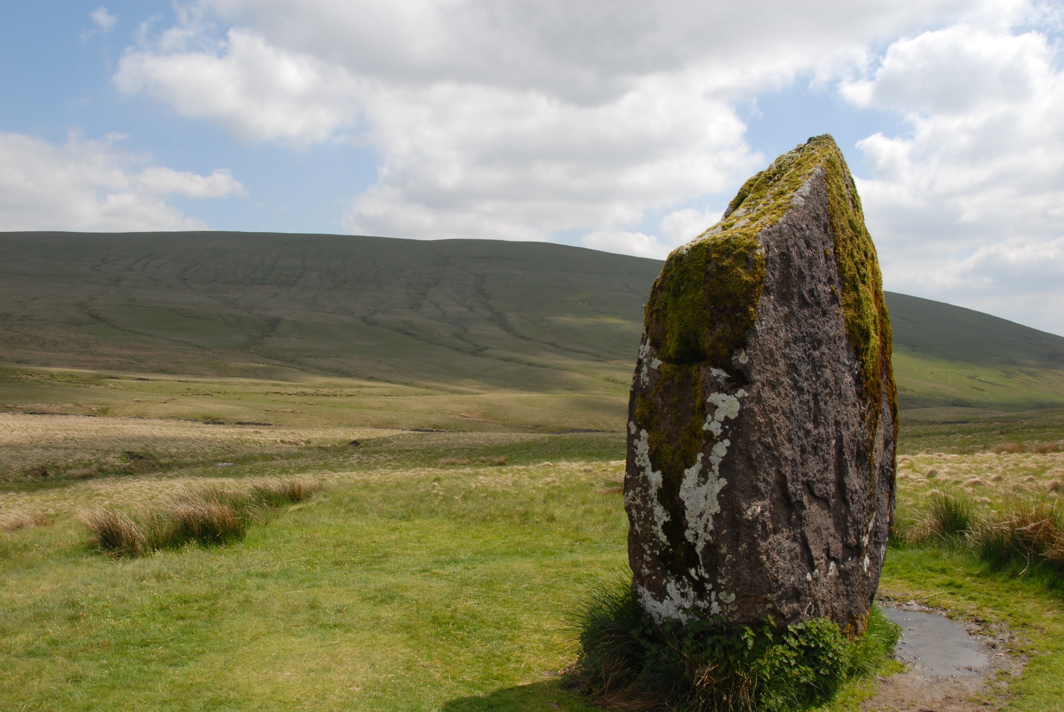
Raising Our Ebenezer
1 Samuel 7:12

Slide 3

Israel’s Victory Over the Philistines
Spiritual State – Unfaithful
Corrupt leadership:
  Hophni and Phinehas – corrupt priests – 1 Samuel 2:12
  Eli – High Priest – honored sons more than God – 1 Samuel 2:28-29; 3:12-13
The people followed in transgression – 1 Samuel 2:24

Slide 4
Israel’s Victory Over the Philistines
Conflict with the Philistines
Went to battle with the Philistines and defeated – 4,000 killed. (4:2)
Brough the ark of the covenant from Shiloh to ensure victory – 30,000 killed, and the ark taken. (4:3-11)
Ichabod born – the glory of the Lord has departed. (4:21-22)
Ark with the Philistines for 7 months – plagues. (5-6)
Ark returned to Israel – in Kirjath Jearim 20 years. (7:1-2)
Israel laments after God. (7:3-4)
Israel battles the Philistines again and gains victory. (7:7-11)

Slide 5
Israel’s Victory Over the Philistines
A Memorial of the Lord’s Help Erected (1 Samuel 7:12)
Ebenezer – ’eḇen; a stone; ‘êzer; aid: — help – Stone of help.
Glory given to God. Reminder of God’s help. Incite thanksgiving and praise to God. Reminder of Israel’s dependence on God. Reminder of unfaithfulness vs faithfulness.
“Here I raise my Ebenezer: Hither by Thy help I’ve come; and I hope by Thy good pleasure safely to arrive at home.” (O Thou Fount Of Every Blessing)

Slide 6
Raising Our Ebenezer
Physical Life - God, Our Creator and Provider
Psalm 100 – praise and thanksgiving to God as our Creator.
When God is not acknowledged as our Creator, and is not thanked – Romans 1:18-25
We depend wholly on God for all of life’s necessities – Hebrews 1:3; Matthew 5:45; James 1:17
Ecclesiastes 12:13 – He created us to serve Him. All that He provides physically is to bring us to this acknowledgement of Him.
Matthew 6:33 – Christians raise their Ebenezer by being faithful.

Slide 7
Raising Our Ebenezer
Spiritual Life - God, Our Savior and Sustainer
All men are completely lost without God’s spiritual provisions – Romans 3:23-28 (salvation through faith – void of boasting); Romans 5:6; Ephesians 2:1-9
We raise our Ebenezer by living as God called us to live – Ephesians 2:10; 4:1
The opposite of thankfulness – Hebrews 10:26-29
Living faithfully because of what God has done – Romans 12:1-2; Galatians 2:20
God sustains us spiritually, and is worthy of our praise – Jude 24-25

Slide 8
Raising Our Ebenezer
1 Samuel 7:12

