Slide 2
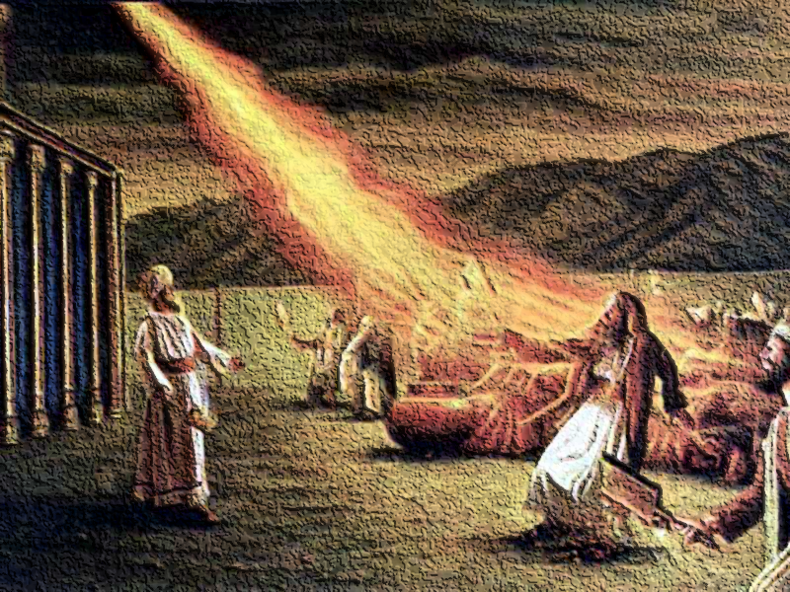
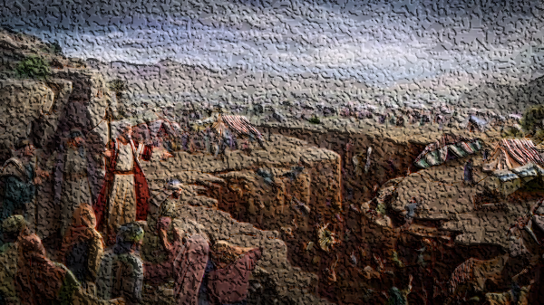
A Tragedy of Fellowship
Numbers 16

Slide 3
The Rebellion of Korah and the Outpouring of God’s Wrath
The Rebellion (vv. 1-3, 8-11)
The Proposed Test (vv. 4-7, 15-19)
The Call for Separation (vv. 20-22, 23-27)
The Punishment (vv. 28-34) (Korah and his household, Datham, and Abiram)
The Punishment of Those Associated (v. 35) (250 men who offered incense)
The Punishment of Those Who Complained (vv. 41-50) (14,700 people)

Slide 4
Principles of Fellowship Examined
The Grounds of Fellowship – 1 John 1:1-7
Implications of Maintaining Fellowship with Those in Sin
God calls for separation from sinners, even if brethren.
Numbers 16:20-24 – Commanded separation.
God is holy, and calls us to holiness – 1 Peter 1:15-16; 2 Corinthians 6:14-7:1
May include separation from family – Matthew 10:34-39
Failure to separate = alignment against God – Num. 16:11

Slide 5
Principles of Fellowship Examined
The Grounds of Fellowship – 1 John 1:1-7
Implications of Maintaining Fellowship with Those in Sin
Failure to separate is tantamount to participation in the sin.
Numbers 16:26 – separate lest you be consumed in their sins. (Guilt by association.)
2 John 9-11 – when one fellowships another who is in sin or error they participate in their evil.

Slide 6
Principles of Fellowship Examined
The Grounds of Fellowship – 1 John 1:1-7
Implications of Maintaining Fellowship with Those in Sin
Failure of separation receives the same punishment as those directly guilty.
Numbers 16:31-33, 35 – all “with” them perished.
2 John 8-11 – the one who fellowships a false teacher or one in sin forfeits his salvation.

Slide 7
Principles of Fellowship Examined
The Grounds of Fellowship – 1 John 1:1-7
Implications of Maintaining Fellowship with Those in Sin
Any complaint regarding such matters is ultimately against God, and those will be punished.
Numbers 16:41, 45, 49 – the congregation complained, and were plagued. (v. 11 – against the Lord)
1 Corinthians 5:4-5 – this command comes from the Lord.
2 Corinthians 2:6, 9 – failure to do so is failure to obey.

Slide 8
A Tragedy of Fellowship
Numbers 16

