Slide 2
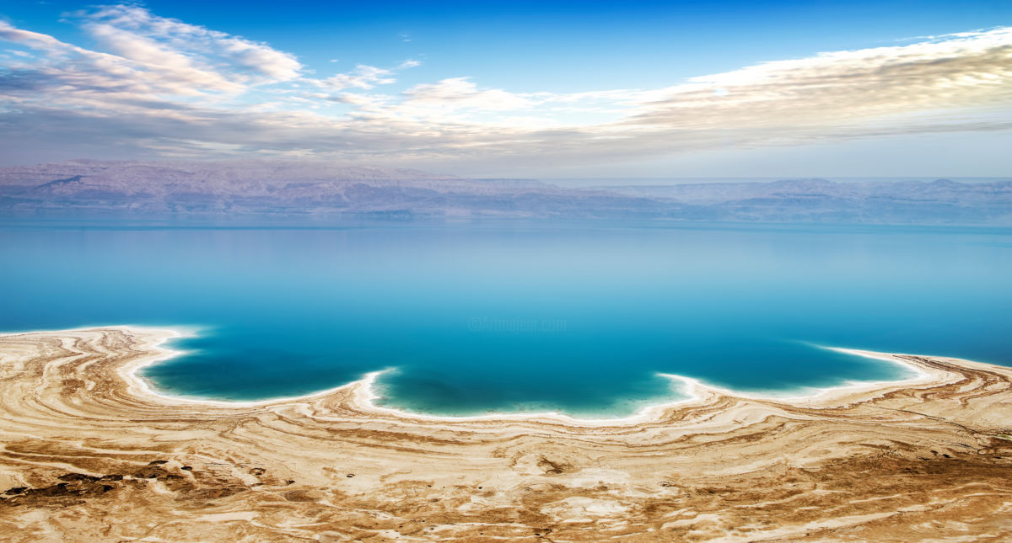
The Dead Sea Disciple

Slide 3
God Gives That We May Give
God’s Design and Desire
He gives that we might be a source of giving to others – John 7:37-38 (cf. John 4:13-15, 28-29)
Context – John 7:39 – concerning the Holy Spirit.
Giving of the Spirit for spiritual sustenance, and is to be given to others as well – Acts 2:17-21; Romans 1:11; 1 Corinthians 12:4-7
Same for us regarding the Spirit revealed word – 2 Timothy 3:16-17 – Given so that we might give – to God and others.

Slide 4
God Gives That We May Give
The Consequence of Only Being a Receiver
We are cut off – John 15:1-2, 4, 6 – Jesus as the vine, and we as the branches.
We will be punished – Matthew 18:21-35 – Parable of the unforgiving servant.

Slide 5
Don’t Be A Dead Sea Disciple
Are We Being a Good Steward?
A disciple is a steward of the things given from God – 1 Peter 4:10; Titus 1:7; 1 Corinthians 4:1-5
With truth?
Edification of the body – 1 Corinthians 12, 13, 14; Ephesians 4:11-12, 15-16
Evangelism – Matthew 28:18-20

Slide 6
Don’t Be A Dead Sea Disciple
Are We Being a Good Steward?
A disciple is a steward of the things given from God – 1 Peter 4:10; Titus 1:7; 1 Corinthians 4:1-5
With truth? With love?
Love is a debt we owe.
To God – 2 Corinthians 5:14-15
Keeping Commandments – John 14:15
To Others – Romans 13:8
Comfort – 2 Corinthians 1:3-4
Helping when we can – 1 John 3:16-18

Slide 7
Don’t Be A Dead Sea Disciple
Are We Being a Good Steward?
A disciple is a steward of the things given from God – 1 Peter 4:10; Titus 1:7; 1 Corinthians 4:1-5
With truth? With love? With money?
God has blessed us with money so that we have sufficiency to give – 2 Corinthians 9:8-11
Contribution – 1 Corinthians 16:2; 2 Corinthians 9:5, 7
Benevolence – Acts 20:35; Romans 15:25-26

Slide 8
Don’t Be A Dead Sea Disciple
Are We Being a Good Steward?
A disciple is a steward of the things given from God – 1 Peter 4:10; Titus 1:7; 1 Corinthians 4:1-5
With truth? With love? With money?
Are We Sharing Jesus? – John 3:16; 7:37-38; 1:41; Galatians 2:20

Slide 9
The Dead Sea Disciple

