Slide 2
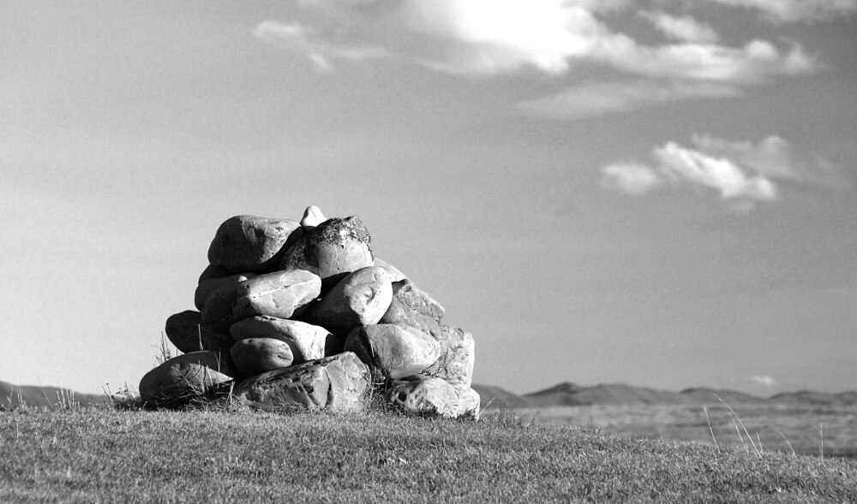
Ancient Landmarks
Proverbs 22:28

Slide 3
of the Church
Ancient Landmarks
The Church is a Kingdom with Borders – Matthew 16:16-19; 2 John 9
Interpretation of Revealed Law – 2 Peter 1:20-21
Revealed to Understand – Ephesians 5:17; 3:3-4
Revealed How to Understand – Command, Example, Necessary Inference
The Proclamation of God’s Will – 1 Peter 4:11
The Whole Counsel – Acts 20:26-27
The Specific Exposure of All Sin and Error – Ephesians 5:11-13; 1 John 4:1

Slide 4
of the Church
Ancient Landmarks
The Church is a Kingdom with Borders – Matthew 16:16-19; 2 John 9
Applying Revealed Law – Defining Specific Borders
Work, Worship, and Organization of the Church
Moral Issues
Fellowship

Slide 5
of Society
Ancient Landmarks
God is the Builder of Society and Sets the Borders – Hebrews 3:4; Psalm 127:1; 11
Origins
Objective Truth – Genesis 1:1-5; John 1:1-5; 3:18-21
Life – Exodus 21:22-25; Luke 1:39-41; Psalm 139:13-16
Gender – Matthew 19:4-6

Slide 6
of Society
Ancient Landmarks
God is the Builder of Society and Sets the Borders – Hebrews 3:4; Psalm 127:1; 11
The Home
Marriage, Divorce, Remarriage – Matthew 19:3-10
Child Rearing – Proverbs 22:6; Ephesians 6:4; Proverbs 13:24
The Nation – Romans 13:1-7; Proverbs 14:34

Slide 7
Ancient Landmarks
Proverbs 22:28

